Slide 1
Fellowship and Honesty
The relationship between Biblical clarity, a man’s honesty, and the limits of our fellowship

Slide 3
Background Events
March 1988
  Homer Hailey preaches error on Marriage, Divorce and Re-marriage in Belen New Mexico
November 1988
  Ed Harrell writes article defending Hailey “Homer Hailey: False Teacher?”

Slide 4
Ed Harrell: “Homer Hailey: False Teacher?” (Christianity Magazine / November 1988 p.6)
“This, then, is my personal defense of Homer Hailey as a man who has earned the respect and esteem of the Christians of our time. Or, more accurately, it is my explanation of why Hailey has won wide esteem among Christians in spite of his views on the subject of divorce and remarriage.”

Slide 5
Ed Harrell: “Homer Hailey: False Teacher?” (Christianity Magazine / November 1988 p.6)
“Homer Hailey believes that those who are baptized into Christ may remain in their present marital state. … I have discussed the matter with brother Hailey on more than one occasion, and, although I am impressed by the erudition and sincerity of his arguments, I do not believe that he is correct.”

Slide 6
Ed Harrell: “Homer Hailey: False Teacher?” (Christianity Magazine / November 1988 p.6)
“Homer Hailey believes that those who are baptized into Christ may remain in their present marital state. … I have discussed the matter with brother Hailey on more than one occasion, and, although I am impressed by the erudition and sincerity of his arguments, I do not believe that he is correct.”

Slide 7
Ed Harrell: “Homer Hailey: False Teacher?” (Christianity Magazine / November 1988 p.8)
“It is perfectly proper that some congregations have not, and would not, invite Homer Hailey to preach because of the position that he holds on this subject. Others, rightly I believe, have decided to use him in spite of the difference.”

Slide 8
Background Events
March 1988
  Homer Hailey preaches error on MDR in Belen New Mexico
November 1988
  Ed Harrell writes article defending Hailey “Homer Hailey: False Teacher?”
February 1989 – June 1990
  Ed Harrell writes 16 articles on “The Bounds of Christian Unity”

Slide 9
Background Events
March 1988
  Homer Hailey preaches error on MDR in Belen New Mexico
November 1988
  Ed Harrell writes article defending Hailey “Homer Hailey: False Teacher?”
February 1989 – June 1990
  Ed Harrell writes 16 articles on “The Bounds of Christian Unity”
November 1997
  Christianity Magazine begins re-distributing Harrell’s articles in pamphlet form

Slide 10
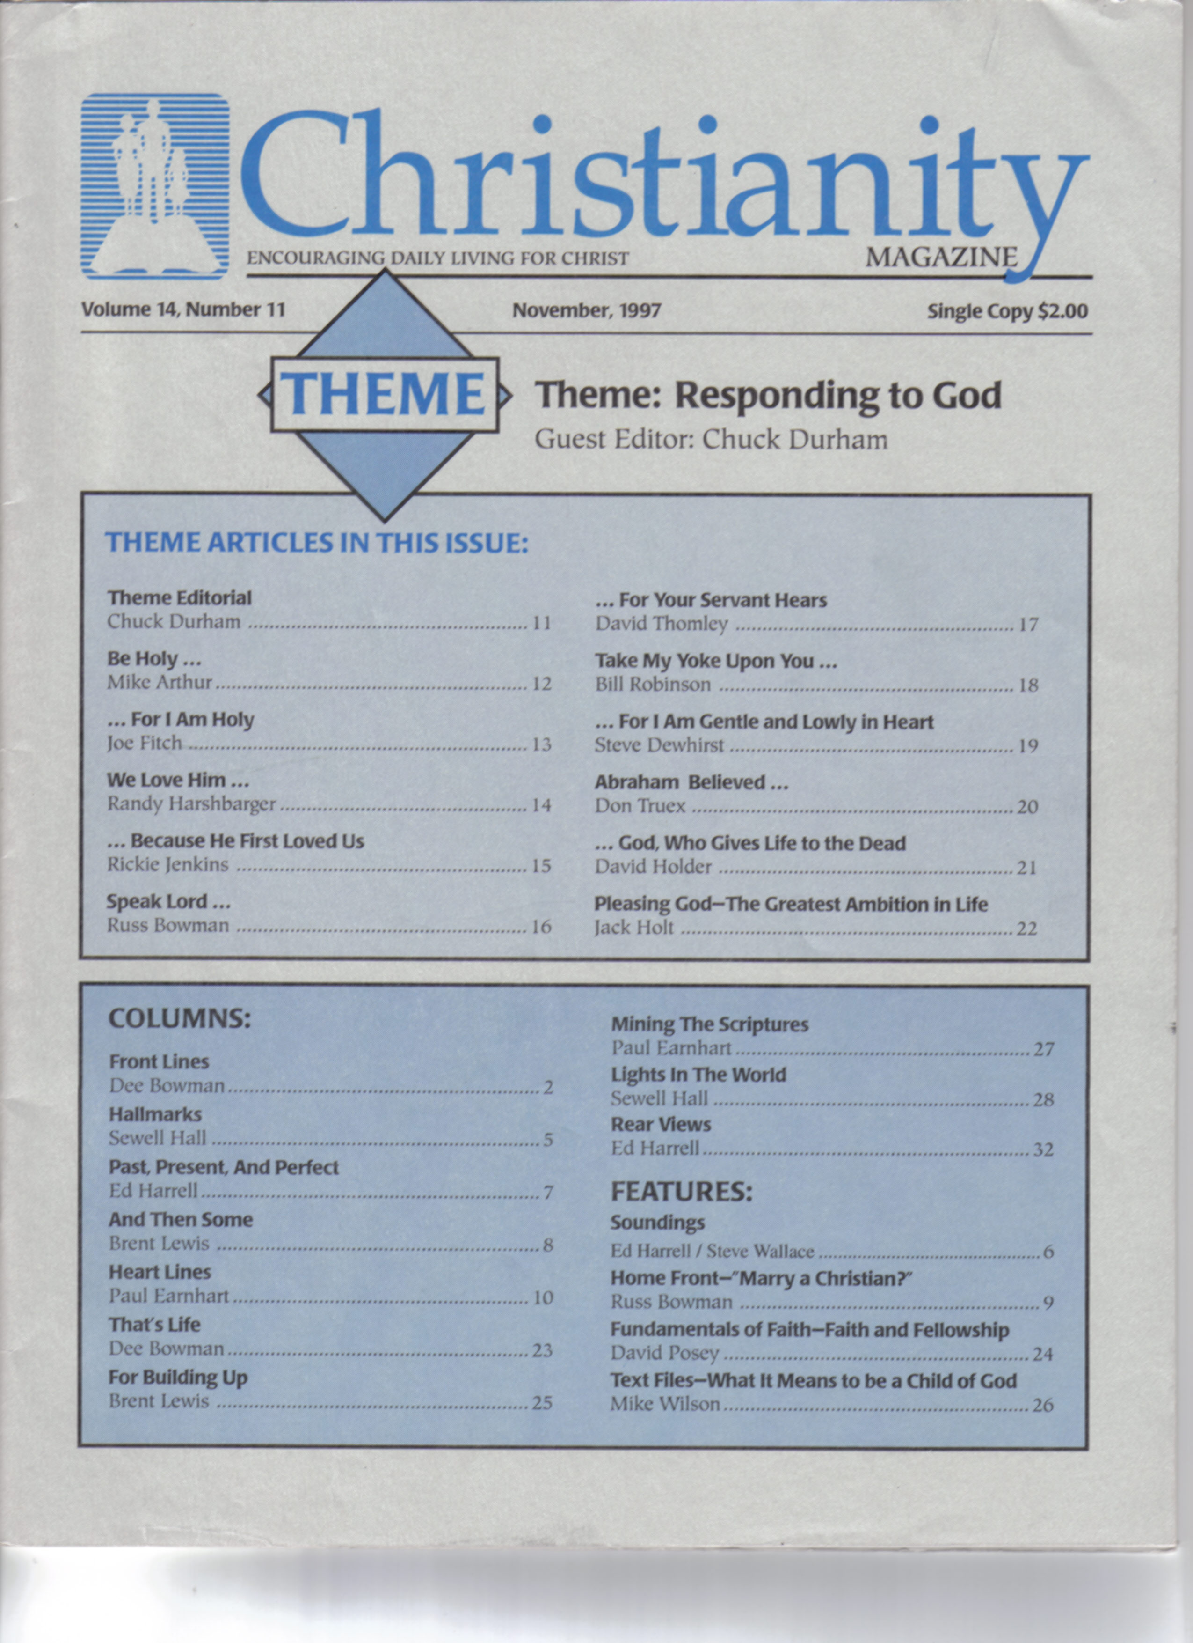

Slide 11
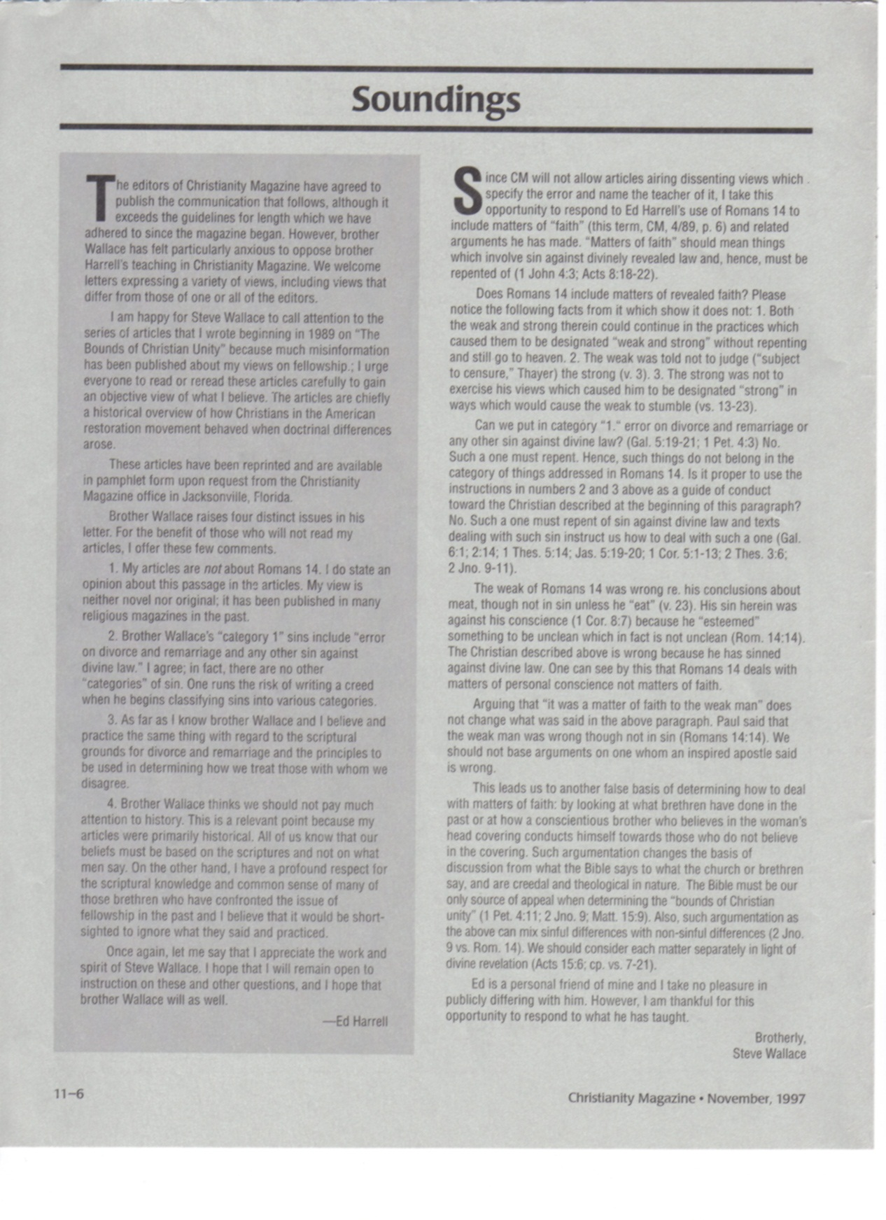

Slide 12


Slide 14


Slide 15


Slide 16
Fellowship and Honesty
The relationship between Biblical clarity, a man’s honesty, and the limits of our fellowship
Notes:
I want to appeal to you tonight that you would humble yourself in the presence of God’s Word to consider what He has to say.
And while you may not , at the end of this night, care much for me or my manner of speaking, I hope you will be able to focus yourself and your attention entirely on what God has had to say.
I want to appeal to you that you would be honest enough that you will not allow the messenger to detract from the message.
I want to appeal to you that you will study with an open mind – an open heart, and that if there would be anything that I would preach that is not in harmony with what this book – the Bible – teaches then I would certainly invite you and appreciate you to bring that to my attention.
I would also ask that if you find the things that I preach are true and that they are not in harmony with your life then I appeal to you and pray that you would be willing to make the proper changes in your life to conform to the Word and Will of God.
November 1988: “Homer Hailey: False Teacher?”
February 1989 – June 1990: 16 articles on “The bounds of Christian Unity”
Put articles in book form: distributed through Christianity Magazine office.

Slide 17
Ed Harrell: “Homer Hailey: False Teacher?” (Christianity Magazine / November 1988 p.9)
“Several principles come into play when one decides the limits of fellowship. Clearly, one must consider the honesty of the other person, and his apparent sincerity in following God’s directions (Ro.14:1-6) .”

Slide 18
Ed Harrell: “The Bounds of Christian Unity 7” (Christianity Magazine / August 1989 p.6)
“I do not have fellowship with a brother because he claims to have an honest mind, but because I judge him to have the mind of Christ.”
“Fellowship is not based on another’s profession, but on my judgment of his spirit.”

Slide 19
Ed Harrell: “The Bounds of Christian Unity 7” (Christianity Magazine / August 1989 p.6)
“My decision does not depend on another’s assertion that he has a clear conscience, but on my assessment of his faithfulness to God’s directions.”
“In short, I company with those whom I judge to be honestly striving to follow God’s teachings.”
(emphasis mine, BWH)
(emphasis mine, BWH)

Slide 20
How Do I Judge A Person’s Honesty In Striving To Follow God’s Directions
?

Slide 21
Ed Harrell on Determining Honesty
“How do I judge the honesty of a brother who misses the point of a scriptural instruction that seems clear to me? Let me suggest several tests that we use - knowingly or unknowingly.”
(Ed Harrell – “The Bounds of Christian Unity 8”. Christianity Magazine / September 1989 p.6)
(emphasis mine, BWH)

Slide 22
Ed Harrell on Determining Honesty
“First, is his argument plainly flawed, is it inherently illogical, or is it possible for a reasonable, godly man to believe?
(Ed Harrell – “The Bounds of Christian Unity 8”. Christianity Magazine / September 1989 p.6)
?

Slide 23
Ed Harrell on Determining Honesty
“Second, is his position an attempt at self justification, is it self-serving?
(Ed Harrell – “The Bounds of Christian Unity 8”. Christianity Magazine / September 1989 p.6)

Slide 24
Ed Harrell on Determining Honesty
“Third, and perhaps most important, how do I view the general character and behavior of the brother?”
(Ed Harrell – “The Bounds of Christian Unity 8”. Christianity Magazine / September 1989 p.6)

Slide 25
Ed Harrell’s Test of Honesty
Not based on the Bible
  No scriptures given
Based on human perception and wisdom
  My impression of a man has often been wrong
  Requires unrighteous judgment
Highly subjective
  Open to personal preference and prejudice

Slide 26
God’s Test of Honesty
Divine
Never Wrong
  Fool-proof
  Doesn’t rely upon imperfect human perception
Universal
  Applies to all men and women everywhere
Accessible to everyone

Slide 27
Ed Harrell on H. Hailey’s Honesty
“I am impressed by the erudition and sincerity of his arguments.”
(Ed Harrell – “Homer Hailey: False Teacher?” Christianity Magazine / November 1988 p.6).

Slide 28
Ed Harrell on H. Hailey’s Honesty
“I think I see flaws in brother Hailey’s reasoning on the subject of divorce and remarriage, but I have never for a moment doubted his integrity, his character, or his devout desire to please God.”
(Ed Harrell – “Homer Hailey: False Teacher?” Christianity Magazine / November 1988 p.9).

Slide 29
Ed Harrell on Determining Honesty
“How do I judge the honesty of a brother who misses the point of a scriptural instruction that seems clear to me? Let me suggest several tests that we use - knowingly or unknowingly.” (emp. mine, BH)
“First, is his argument plainly flawed, is it inherently illogical, or is it possible for a reasonable, godly man to believe? (emphasis mine, BH)
(Ed Harrell – “The Bounds of Christian Unity 8”. Christianity Magazine / September 1989 p.6)

Slide 30
Ed Harrell on H. Hailey’s Honesty
“I think I see flaws in brother Hailey’s reasoning on the subject of divorce and remarriage, but I have never for a moment doubted his integrity, his character, or his devout desire to please God.” (emphasis mine, BH)
(Ed Harrell – “Homer Hailey: False Teacher?” Christianity Magazine / November 1988 p.9).

Slide 31
Ed Harrell on H. Hailey’s Honesty
“I judge him to be one of the most godly and learned men I have ever known. … Finding him always willing to probe those questions where his views conflicted with mine. In my mind, that is not the stuff of which false teachers are made.”
(Ed Harrell – “Homer Hailey: False Teacher?” Christianity Magazine / November 1988 p.9).

Slide 32
Ed Harrell on H. Hailey’s Honesty
“A false teacher is surely one whose dishonest motives and / or ignorance distinguish him from the sincere brother who has reached an erroneous conclusion.”
(Ed Harrell – “Homer Hailey: False Teacher?” Christianity Magazine / November 1988 p.9).

Slide 33
Ed Harrell on Honesty and Scriptural Clarity
“In previous articles I have noted that the bounds of Christian unity require judgments about the clarity of biblical instruction and, by extension, about the honesty of a person who claims to be my brother. Those two judgments are inextricably tied together.”
(Ed Harrell – “The Bounds of Christian Unity 7”. Christianity Magazine / August 1989 p. 6)

Slide 34
Ed Harrell on Honesty and Scriptural Clarity
“In previous articles I have noted that the bounds of Christian unity require judgments about the clarity of biblical instruction and, by extension, about the honesty of a person who claims to be my brother. Those two judgments are inextricably tied together.” (emp. mine BWH)
(Ed Harrell – “The Bounds of Christian Unity 7”. Christianity Magazine / August 1989 p. 6)

Slide 35
Ed Harrell: “Homer Hailey: False Teacher?” (Christianity Magazine / November 1988 p.9)
“Several principles come into play when one decides the limits of fellowship. Clearly, one must consider the honesty of the other person, and his apparent sincerity in following God’s directions (Ro.14:1-6) .”

Slide 36
Ed Harrell on Honesty and Scriptural Clarity
“In previous articles I have noted that the bounds of Christian unity require judgments about the clarity of biblical instruction and, by extension, about the honesty of a person who claims to be my brother. Those two judgments are inextricably tied together.” (emp. mine BWH)
(Ed Harrell – “The Bounds of Christian Unity 7”. Christianity Magazine / August 1989 p. 6)

Slide 37
Clarity of Biblical Instruction
Did God Reveal His Word With Sufficient Clarity That An Honest Person Can Understand It
?

Slide 38
Ed Harrell on Biblical Clarity
“It means that we acknowledge that we are not always certain about sin.”
(Ed Harrell – “The Bounds of Christian Unity 3”. Christianity Magazine / April 1989 p.6)

Slide 39
Ed Harrell on Biblical Clarity
“All of God’s instructions are equally important (though, as we shall see in subsequent articles, all may not be equally clear) - whether dealing with… the Christian and war,… or marriage and divorce.”
(Ed Harrell – “The Bounds of Christian Unity 3”. Christianity Magazine / April 1989 p.6)

Slide 40
Ed Harrell on Biblical Clarity
“All of God’s instructions are equally important (though, as we shall see in subsequent articles, all may not be equally clear) - whether dealing with… the Christian and war,… or marriage and divorce.”
(Ed Harrell – “The Bounds of Christian Unity 3”. Christianity Magazine / April 1989 p.6)

Slide 41
Ed Harrell on Biblical Clarity
“All of God’s instructions are equally important (though, as we shall see in subsequent articles, all may not be equally clear) - whether dealing with… the Christian and war,… or marriage and divorce.” (emp. mine, BH)
(Ed Harrell – “The Bounds of Christian Unity 3”. Christianity Magazine / April 1989 p.6)

Slide 42
Ed Harrell on Biblical Clarity
“Those who love and respect God and who sustain their beliefs with Biblical argument do not always agree. Such a confession acknowledges a variability in Biblical clarity”
(Ed Harrell – “The Bounds of Christian Unity 7” - Christianity Magazine / August 1989 p.6)

Slide 43
Ed Harrell on Biblical Clarity
“Those who love and respect God and who sustain their beliefs with Biblical argument do not always agree. Such a confession acknowledges a variability in Biblical clarity”
(Ed Harrell – “The Bounds of Christian Unity 7” - Christianity Magazine / August 1989 p.6)

Slide 44
Ed Harrell on Biblical Clarity
“Those who love and respect God and who sustain their beliefs with Biblical argument do not always agree. Such a confession acknowledges a variability in Biblical clarity”
(Ed Harrell – “The Bounds of Christian Unity 7” - Christianity Magazine / August 1989 p.6)

Slide 45
Ed Harrell on Biblical Clarity
?
“Those who love and respect God and who sustain their beliefs with Biblical argument do not always agree. Such a confession acknowledges a variability in Biblical clarity”
(Ed Harrell – “The Bounds of Christian Unity 7” - Christianity Magazine / August 1989 p.6)

Slide 46
Ed Harrell on Biblical Clarity
“One can only speculate why God left us in such an unsettled predicament.”
(Ed Harrell – “The Bounds of Christian Unity 8”. Christianity Magazine / September 1989 p.6)

Slide 47
Ed Harrell on Biblical Clarity
“One can only speculate why God left us in such an unsettled predicament.”
(Ed Harrell – “The Bounds of Christian Unity 8”. Christianity Magazine / September 1989 p.6)

Slide 48
Ed Harrell on Biblical Clarity
“One can only speculate why God left us in such an unsettled predicament.”
(Ed Harrell – “The Bounds of Christian Unity 8”. Christianity Magazine / September 1989 p.6)
?
He Did What

Slide 49
Dee Bowman: Letter to Jarrod Jacobs (September 10, 1993)
“While I may not agree with every single thing brother Harrell says, I am in general agreement with what he has written on the subject of fellowship. I believe that we can, and do, have fellowship with people with whom we disagree over matters of faith, but only if I determine that they are honest, and share my convictions that the Bible is the final authority on any religious matter.” (emphasis mine, BH)

Slide 50
Mt.13 on Honesty & Biblical Clarity
(v.10) “Why do you speak to them in parables?”
(v.11) “Because it has been given to you to know the mysteries of the kingdom of heaven, but to them it has not been given.”

Slide 51
Mt.13 on Honesty & Biblical Clarity
(v.12) “For whoever has, to him more will be given, and he will have abundance; but whoever does not have, even what he has will be taken away from him.”
(v.13) “Therefore I speak to them in parables, because seeing they do not see, and hearing they do not hear, nor do they understand.”

Slide 52
Mt.13 on Honesty & Biblical Clarity
The Problem (v.14)
Hearing you will hear and shall not understand
Seeing you will see and not perceive
The Cause (v.15)
For the hearts of this people have grown dull
Their ears are hard of hearing
Their eyes they have closed
The Result
No understanding - No healing (forgiveness)

Slide 53
Mt.13 on Honesty & Biblical Clarity
“But he who received seed on the good ground is he who hears the word and understands it, who indeed bears fruit and produces” (Mt.13:23)
“But that on the good ground are they, which in an honest and good heart, having heard the word, keep it, and bring forth fruit with patience” (Lk.8:15 KJV)
“Good ground” equals “good heart”

Slide 54
Mt.13 on Honesty & Biblical Clarity
The Good Ground:
ACCEPTS the Seed
MAKES PROPER USE of the Seed
BEARS FRUIT from the Seed

Slide 55
Mt.13 on Honesty & Biblical Clarity
The ‘Good (honest) Heart’:
RECEIVES the Word
    He is willing to listen to, and consider the Truth
UNDERSTANDS the Word
    He perceives the Truth
BEARS the FRUIT of the Word
    Not false teaching. True obedience conformed to the Truth

Slide 56
Mt.13 on Honesty & Biblical Clarity
Fruit is determined by the quality of the seed and the soil
Is the Seed (the Word of God) good?
  having been born again, not of corruptible seed but incorruptible, through the word of God which lives and abides forever, (1 Peter 1:23 NKJV)
Then the only variable is the soil
  (the man’s heart)

Slide 57
Mt.13 on Honesty & Biblical Clarity
The Problem (v.14)
Hearing you will hear and shall not understand
Seeing you will see and not perceive
The Cause (v.15)
For the hearts of this people have grown dull
Their ears are hard of hearing
Their eyes they have closed
The Result
No understanding - No healing (forgiveness)

Slide 58
Mt.13 on Honesty & Biblical Clarity
Certified seed manifests the quality of the soil
The incorruptible Word of God manifests the quality (honesty) of a man’s heart

Slide 59
The Word Manifests The Heart
This makes it possible to “judge with righteous judgment” (Jo.7:24)
  “Do not judge according to appearance, but judge with righteous judgment.” (Jo.7:24)

Slide 60
The Word Manifests The Heart
This makes it possible to “judge with righteous judgment”
  “He who rejects Me, and does not receive My words, has that which judges him - the word that I have spoken will judge him in the last day” (Jo.12:48)

Slide 61
The Word Manifests The Heart
This makes it possible to “judge with righteous judgment”
  “In the day when God will judge the secrets of men by Jesus Christ, according to my gospel” (Ro.2:16)

Slide 62
The Word Manifests The Heart
This makes it possible to “judge with righteous judgment”
  “For the word of God is living and powerful, and sharper than any two-edged sword, piercing even to the division of soul and spirit, and of joints and marrow, and is a discerner of the thoughts and intents of the heart” (He.4:12-13)

Slide 63
The Word Manifests The Heart
This makes it possible to “judge with righteous judgment”
  “ … It was necessary that the word of God should be spoken to you first; but since you reject it, and judge yourselves unworthy of everlasting life, behold, we turn to the Gentiles’ ” (Ac.13:46)
Thus men judge themselves, or their heart by their response to the Truth

Slide 64
The Word Manifests The Heart
This makes it possible to “judge with righteous judgment”
  (Mt.7:6) “Do not give what is holy to the dogs; nor cast your pearls before swine…
  How may I know if one is a dog or a hog
?

Slide 65
The Word Manifests The Heart
This makes it possible to “judge with righteous judgment”
  (Mt.7:6) “Do not give what is holy to the dogs; nor cast your pearls before swine…
  (v.16) you will know them by their fruits…
  (v.17-18) every good tree bears good fruit, but a bad tree bears bad fruit. A good tree cannot bear bad fruit, nor can a bad tree bear good fruit”

Slide 66
The Word Manifests The Heart
This makes it possible to “judge with righteous judgment”
  (Mt.7:6) “Do not give what is holy to the dogs; nor cast your pearls before swine…
  (v.16) you will know them by their fruits…
  (v.17-18) every good tree bears good fruit, but a bad tree bears bad fruit. A good tree cannot bear bad fruit, nor can a bad tree bear good fruit”

Slide 67
The Word Manifests The Heart
This makes it possible to “judge with righteous judgment”
  “In this the children of God and the children of the devil are manifest: Whoever does not practice righteousness is not of God… ” (1Jo.3:10)
Thus a man’s obedience to the Word, or lack thereof, manifests his heart.

Slide 68
The Word Manifests The Heart
This is how we “test the spirits”
  “Beloved, do not believe every spirit, but test the spirits, whether they are of God; because many false prophets have gone out into the world… (v.6) … He who knows God hears us; he who is not of God does not hear us. By this we know the spirit of truth and the spirit of error.” (1Jo.4:1)

Slide 69
The Word Manifests The Heart
This is how we “test the spirits”
  “… And you have tested those who say they are apostles and are not, and have found them liars.” (Re.2:2)
  “Test all things; hold fast what is good.” (1Th.5:21)
The Word is the litmus paper of doctrine. When we show it (the Word) to men it becomes the litmus paper of their heart

Slide 70
The Word Manifests The Heart
This is how divisions make manifest “those who are approved” (1Co.11:19)
  “For there must also be factions among you, that those who are approved may be recognized among you” (1Co.11:19)

Slide 71
The Word Manifests The Heart
This is how divisions make manifest “those who are approved”
  “They went our from us, but they were not of us; for if they had been of us, they would have continued with us; but they went out that they might be made manifest, that none of them were of us.” (1Jo.2:19)

Slide 72
Eph.5:8-17 on Honesty and Biblical Clarity
The Fruit of the Spirit is Truth (v.9)
Light makes manifest (v.13)
We can find out what is acceptable (v.10) if we…
  Wake up – open our eyes to Truth (v.14)
  Walk circumspectly (v.15)
  Redeem the time (v.16)
Thus we will “understand what the will of the Lord is” (v.17)

Slide 73
What Do We Mean By ‘Honesty’
One who wants to know the Truth (Ac.17:11)
One who wants to obey the Truth
Thus, one who ‘loves the Truth’

Slide 74
How May I Know That…
One wants to know the truth?
  He will seek the truth and find it (Mt.7:7-8)
  “Ask and it will be given to you; seek, and you will find; knock, and it will be opened to you. For everyone who asks receives, and he who seeks finds, and to him who knocks it will be opened.”

Slide 75
How May I Know That…
One wants to know the truth?
  He will seek the truth and find it (Mt.7:7-8)
  “Ask and it will be given to you; seek, and you will find; knock, and it will be opened to you. For everyone who asks receives, and he who seeks finds, and to him who knocks it will be opened.”

Slide 76
How May I Know That…
One wants to obey the truth?
  He will understand the truth and obey it (Jo.7:17)
  “If anyone wills to do His will, he shall know concerning the doctrine…”

Slide 77
How May I Know That…
One loves the truth?
  He will not believe a lie (2Th.2:10-11)
  “with all unrighteous deception among those who perish, because they did not receive the love of the truth, that they might be saved. And for this reason God will send them strong delusion, that they should believe the lie”

Slide 78
How May I Know That…
One loves the truth?
  He will hate error (Ps.119:104)
    “Through Your precepts I get understanding; Therefore I hate every false way.”
  He will follow Truth wherever it takes him

Slide 79
Remember the Quote…
“In previous articles I have noted that the bounds of Christian unity require judgments about the clarity of biblical instruction and, by extension, about the honesty of a person who claims to be my brother. Those two judgments are inextricably tied together.” (emp. mine, BH)
(Ed Harrell – “The Bounds of Christian Unity 7”. Christianity Magazine / August 1989 p. 6)

Slide 80
Honesty and Biblical Clarity
Honesty and Biblical clarity are “inextricably tied together” because God has revealed His Word in such a way that:
  Those who do not love the Truth will not understand it (2Th.2:10-11)

Slide 81
Honesty and Biblical Clarity
Honesty and Biblical clarity are “inextricably tied together” because God has revealed His Word in such a way that:
  Those who are not willing to obey the Truth will not understand it (Jo.7:17)

Slide 82
Honesty and Biblical Clarity
Honesty and Biblical clarity are “inextricably tied together” because God has revealed His Word in such a way that:
  Those who are not spiritually minded will not understand it (1Co.2:14) (Jo.6:60) (Ro.8:5-7) (Jo.4:23)

Slide 83
1 Corinthians 2:14
But the natural man does not receive the things of the Spirit of God, for they are foolishness to him; nor can he know them, because they are spiritually discerned.

Slide 84
John 6:60
Therefore many of His disciples, when they heard this, said, "This is a hard saying; who can understand it?"

Slide 85
Romans 8:5-7
5 For those who live according to the flesh set their minds on the things of the flesh, but those who live according to the Spirit, the things of the Spirit.
6 For to be carnally minded is death, but to be spiritually minded is life and peace.
7 Because the carnal mind is enmity against God; for it is not subject to the law of God, nor indeed can be.

Slide 86
Honesty and Biblical Clarity
Honesty and Biblical clarity are “inextricably tied together” because God has revealed His Word in such a way that:
  Those who are not spiritually minded will not understand it (1Co.2:14) (Jo.6:60) (Ro.8:5-7) (Jo.4:23)

Slide 87
Why Some Fail To See The Truth
Is it God’s fault?
  God wants all men to be saved and to come to a knowledge of the truth (1Ti.2:3-4)
  “For this is good and acceptable in the sight of God our Savior, who desires all men to be saved and to come to the knowledge of the truth.”

Slide 88
Why Some Fail To See The Truth
Is it God’s fault?
  He says that the Word is able to accomplish everything necessary to save men
  (Ro.1:16) (Jo.5:25)
  (Ac.20:32) (1Pe.2:2)
  (2Ti.3:16-17)

Slide 89
Why Some Fail To See The Truth
Is it God’s fault?
  He says that the Word will do what He wants it to do (Is.55:10-11)
  “For as the rain comes down and the snow from heaven and do not return there… So shall my word be that goes forth from my mouth; It shall not return to me void, but it shall accomplish what I please, and it shall prosper in the thing for which I sent it.”

Slide 90
Why Some Fail To See The Truth
Then where is the problem?
  Race? Skin color? Geographic location?
  Is God a respecter of persons? (Ac.10:34)
  Didn’t God deliver a Word that can penetrate any disadvantage that I have that is out of my control?

Slide 91
Why Some Fail To See The Truth
The only variable left is my heart
  Intellect: What I am willing to know or understand
  Will: What I am willing to do or how far I am willing to go
  Emotion: What I am willing to love or hate
These three compose my honesty
I control all of these

Slide 92
Determining Honesty
If a man is honestly mistaken about a Bible truth, when he is shown the Truth he will either quit being mistaken or he will quit being honest
  (Ac.18:24-28)

Slide 93
Acts 18:24-28
Now a certain Jew named Apollos, born at Alexandria, an eloquent man and mighty in the Scriptures, came to Ephesus. This man had been instructed in the way of the Lord; and being fervent in spirit, he spoke and taught accurately the things of the Lord, though he knew only the baptism of John… When Aquila and Priscilla heard him, they took him aside and explained to him the way of God more accurately… he desired to cross to Achaia… and when he arrived, he greatly helped those who had believed through grace; for he vigorously refuted the Jews publicly, showing from the Scriptures that Jesus is the Christ.

Slide 94
Determining Honesty
If a man is honestly mistaken about a Bible truth, when he is shown the Truth he will either quit being mistaken or he will quit being honest
  (Ac.18:24-28)
  (Mt.19:16-22)

Slide 95
Matthew 19:16-22
Now behold, one came and said to Him, "Good Teacher, what good thing shall I do that I may have eternal life?“… Jesus said to him, "If you want to be perfect, go, sell what you have and give to the poor, and you will have treasure in heaven; and come, follow Me." But when the young man heard that saying, he went away sorrowful, for he had great possessions.

Slide 96
Determining Honesty
If a man is honestly mistaken about a Bible truth, when he is shown the Truth he will either quit being mistaken or he will quit being honest
  (Ac.18:24-28)
  (Mt.19:16-22)
  (Jo.3:19-21)

Slide 97
John 3:19-21
"And this is the condemnation, that the light has come into the world, and men loved darkness rather than light, because their deeds were evil. "For everyone practicing evil hates the light and does not come to the light, lest his deeds should be exposed. "But he who does the truth comes to the light, that his deeds may be clearly seen, that they have been done in God."

Slide 98
Determining Honesty
If a man is honestly mistaken about a Bible truth, when he is shown the Truth he will either quit being mistaken or he will quit being honest
  (Ac.18:24-28)
  (Mt.19:16-22)
  (Jo.3:19-21)

Slide 99
Clarity of Biblical Instruction
Did God Reveal His Word With Sufficient Clarity That An Honest Person Can Understand It
?
Yes!

Slide 100
Honesty and Script. Clarity
God’s Word Is Revealed With Sufficient Clarity That An Honest Person CAN Understand It In Matters That Pertain To THE FAITH
  (i e. Baptism, Lord’s Supper, Music In Worship, Marriage, Divorce and Re-Marriage)

Slide 101
Fellowship and Honesty
Therefore One’s Response To The Truth In Matters of THE FAITH Determines His Honesty And, Consequently, My Fellowship With Him!

Slide 102
Fellowship and Honesty
The relationship between Biblical clarity, a man’s honesty, and the limits of our fellowship

