Slide 1
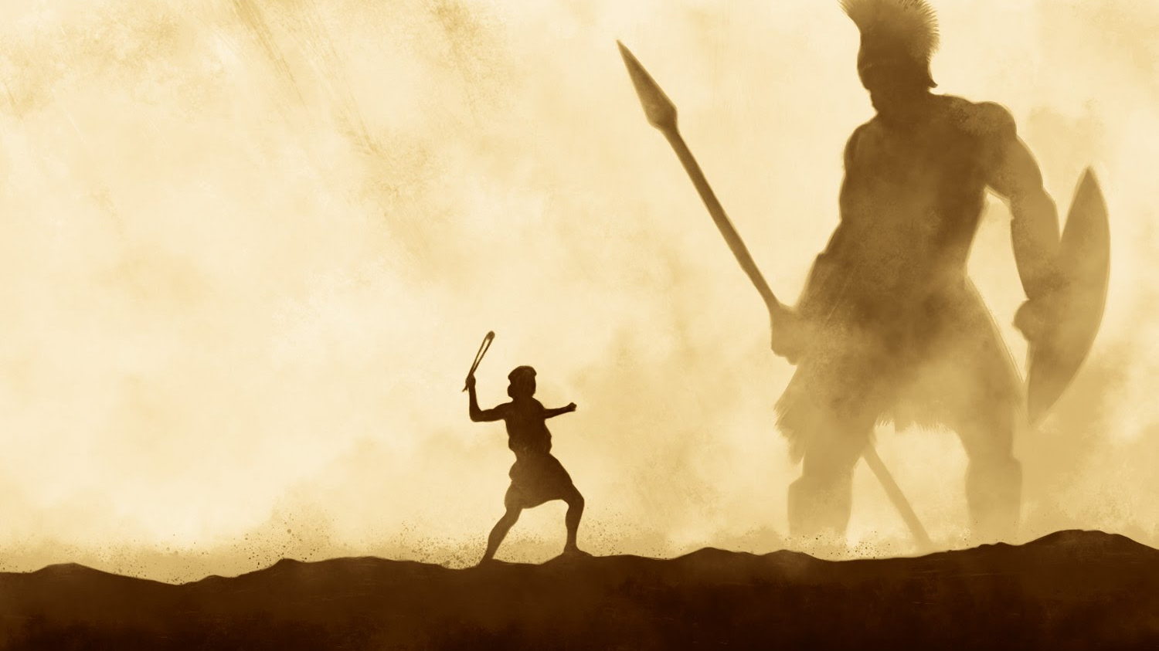
Conquering Giants 1 Samuel 17:40-51
A series of sermons regarding some of the giants that we face today and the power that God provides to overcome them.
Mt. Baker
Church of Christ

Slide 2
Goliath Lives!

Slide 3
Goliath Lives!
The spirit of Goliath today
False teaching and deceit
Fleshly lusts
The Love of the World
Peer Pressure

Slide 4
Goliath Lives!
The spirit of David today
Standing up for truth
Preserving purity
Saying “NO” to worldliness
Defending God’s righteousness

Slide 5
The Text In Context
The Battle Lines
The Giant
The Israelites
The Shepherd / Savior

Slide 6
Questions…
How did a young shepherd become a Giant Slayer?
Why didn’t someone else fight the giant?
Why even fight with giants?

Slide 7
Slaying Giants
He Gave His Heart To The Lord
“Fully devoted”

Slide 8
Slaying Giants
He Gave His Heart To The Lord
“Fully devoted”
He Cared About The Things of The Lord
“Is there not a cause?”

Slide 9
Slaying Giants
He Gave His Heart To The Lord
“Fully devoted”
He Cared About The Things of The Lord
“Is there not a cause?”
He Conquered His Lion and Bear
Begins with every-day obedience

Slide 10
Slaying Giants
He Gave His Heart To The Lord
“Fully devoted”
He Cared About The Things of The Lord
“Is there not a cause?”
He Conquered His Lion and Bear
Begins with every-day obedience
He Recognized that the Battle is The Lord’s
His faith was in God’s power – not his own

Slide 11
Slaying Giants
1 Samuel 17:40-51

