Slide 1
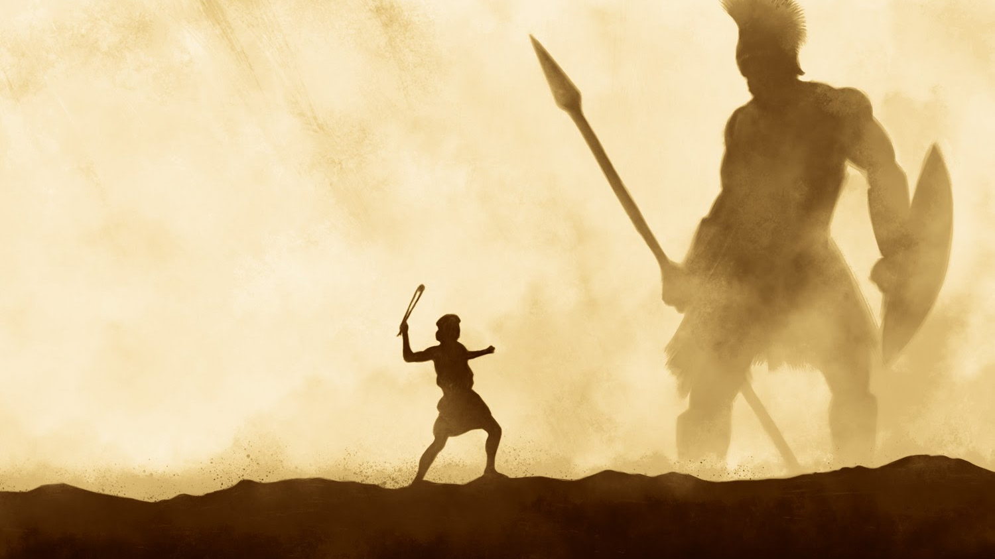
Conquering Giants 1 Samuel 17:40-51
A series of sermons regarding some of the giants that we face today and the power that God provides to overcome them.
Mt. Baker
Church of Christ

Slide 2
Emotionalism
Acts 20:18-38

Slide 3
Importance of Emotion
Emotions attributed to God
Emotions in the life of Christ
Emotions in the life of a Christian

Slide 4
Danger of Emotionalism
Faith based on feeling
Feeling vs. Knowing
Edification based on feeling
Feeling vs. Maturity
Numbers vs. Spiritual Conversion

Slide 5
Emotionalism
Acts 20:18-38

