Slide 1
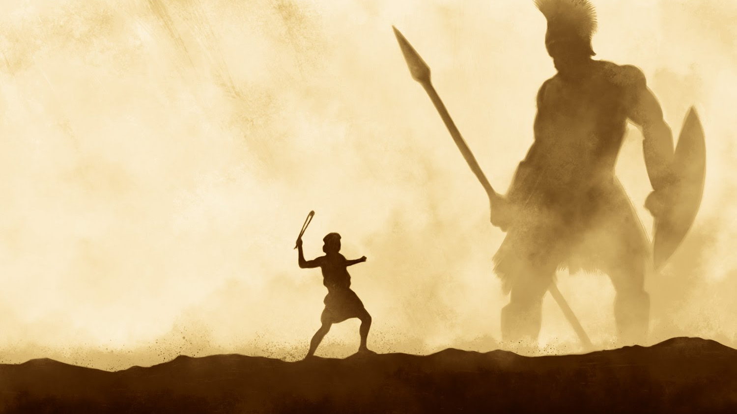
Conquering Giants 1 Samuel 17:40-51
A series of sermons regarding some of the giants that we face today and the power that God provides to overcome them.
Mt. Baker
Church of Christ

Slide 2
In The Beginning…
Genesis 1:1

Slide 3
Go Back To The Beginning!
For Reference
Gives us clues
Answers questions
Shows origin
Reveals purpose – original intent

Slide 4
Beginning – original intent
Matthew 19:4-5
4 And He answered and said to them, "Have you not read that He who made them at the beginning 'made them male and female,'
5 "and said, 'For this reason a man shall leave his father and mother and be joined to his wife, and the two shall become one flesh'?

Slide 5
Purpose In Creation Account
Theological – NOT Scientific!

Slide 6
Theological Purpose
John 20:30-31
30 And truly Jesus did many other signs in the presence of His disciples, which are not written in this book;
31 but these are written that you may believe that Jesus is the Christ, the Son of God, and that believing you may have life in His name.

Slide 7
Purpose In Creation Account
Theological – NOT Scientific!
Pertains to life and godliness
Greatest implication and application of the creation account is the redemption of man back into fellowship with God

Slide 8
In The Beginning…
God
The SOURCE of Creation
Created
The POWER of Creation
The Heavens and the Earth
The ORDER of Creation
It Was Very Good
The PURPOSE of Creation

Slide 9
In The Beginning…
Genesis 1:1

