Slide 1
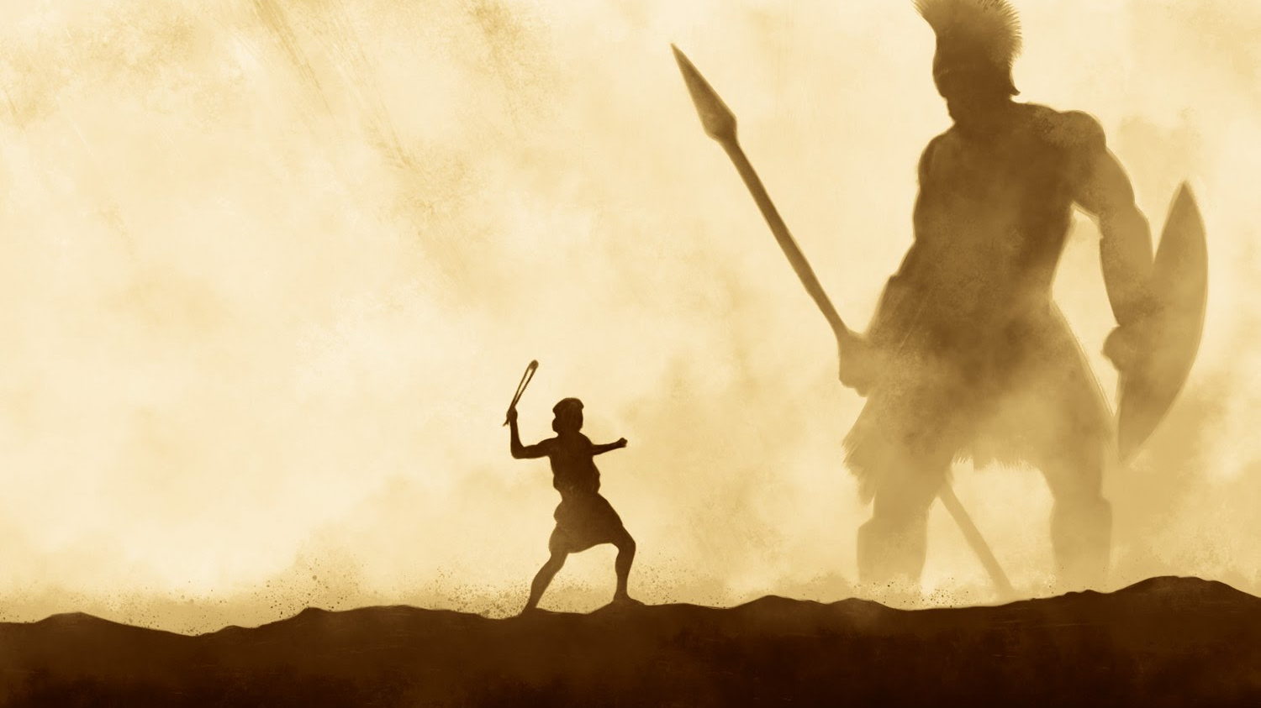
Conquering Giants 1 Samuel 17:40-51
A series of sermons regarding some of the giants that we face today and the power that God provides to overcome them.
Mt. Baker
Church of Christ

Slide 2
THE WHITE HOUSE Office of the Press Secretary ___________________________________________________________ For Immediate Release June 1, 2009 LESBIAN, GAY, BISEXUAL, AND TRANSGENDER PRIDE MONTH, 2009 - - - - - - - BY THE PRESIDENT OF THE UNITED STATES OF AMERICA A PROCLAMATION

Slide 3
Forty years ago, patrons and supporters of the Stonewall Inn in New York City resisted police harassment that had become all too common for members of the lesbian, gay, bisexual, and transgender (LGBT) community. Out of this resistance, the LGBT rights movement in America was born. During LGBT Pride Month, we commemorate the events of June 1969 and commit to achieving equal justice under law for LGBT Americans.

Slide 4
LGBT Americans have made, and continue to make, great and lasting contributions that continue to strengthen the fabric of American society. There are many well-respected LGBT leaders in all professional fields, including the arts and business communities… Due in no small part to the determination and dedication of the LGBT rights movement, more LGBT Americans are living their lives openly today than ever before.

Slide 5
I am proud to be the first President to appoint openly LGBT candidates to Senate-confirmed positions in the first 100 days of an Administration. These individuals embody the best qualities we seek in public servants, and across my Administration -- in both the White House and the Federal agencies -- openly LGBT employees are doing their jobs with distinction and professionalism.

Slide 6
My Administration has partnered with the LGBT community to advance a wide range of initiatives. At the international level, I have joined efforts at the United Nations to decriminalize homosexuality around the world.

Slide 7
Here at home, I continue to support measures to bring the full spectrum of equal rights to LGBT Americans. These measures include enhancing hate crimes laws, supporting civil unions and Federal rights for LGBT couples, outlawing discrimination in the workplace, ensuring adoption rights, and ending the existing "Don't Ask, Don't Tell" policy in a way that strengthens our Armed Forces and our national security.

Slide 8
During LGBT Pride Month, I call upon the LGBT community, the Congress, and the American people to work together to promote equal rights for all, regardless of sexual orientation or gender identity.

Slide 9
NOW, THEREFORE, I, BARACK OBAMA, President of the United States of America, by virtue of the authority vested in me by the Constitution and laws of the United States, do hereby proclaim June 2009 as Lesbian, Gay, Bisexual, and Transgender Pride Month. I call upon the people of the United States to turn back discrimination and prejudice everywhere it exists.

Slide 10
IN WITNESS WHEREOF, I have hereunto set my hand this first day of June, in the year of our Lord two thousand nine, and of the Independence of the United States of America the two hundred and thirty-third. BARACK OBAMA

Slide 11
Homosexuality
…What Is God’s Ruling?

Slide 12
God’s View of Homosexuality
It Is Condemned By “Exclusion”
Whatever is not authorized is excluded (Heb.7:12-14)
Sexuality confined to marriage (Heb.13:4)
Marriage confined to man and woman (1Cor.7:2) (Matt.19:4-6)

Slide 13
The Law / Principle of Exclusion
1996 Defense of Marriage Act
Defines marriage for the purpose of federal law as the legal union between a man and a woman
1996 law does not explicitly forbid anything
Simply defines the bounds of legal marriage
Anything that does not fit this description – a legal union between one man and one woman – is not marriage

Slide 14
The Law / Principle of Exclusion
1996 Defense of Marriage Act
The law does not have to tell us everything that is not marriage
By setting the bounds of marriage, every other kind of relationship is excluded from being marriage
When one in authority tells what is allowed, everything which contradicts this is implicitly disallowed
Authority is “exclusive”
It implicitly forbids (or “bans”) everything inharmonious with what it explicitly allows

Slide 15
God’s View of Homosexuality
It Is Condemned By “Exclusion”
Whatever is not authorized is excluded (Heb.7:12-14)
Sexuality confined to marriage (Heb.13:4)
Marriage confined to man and woman (1Cor.7:2) (Matt.19:4-6)

Slide 16
God’s View of Homosexuality
It is condemned by “exclusion”
It is specifically condemned
In the Old Testament (Lev.18:22; 20:13) (Gen.19:1-13, 24-25) (cf. 2Pet.2:6-9 ; Jude 7)
In the New Testament (1Cor.6:9-10) (Rom.1:18,21,24-28)
It is fornication (Jude 7; cf. Heb.13:4 ; Gal.5:16-21)

Slide 17
Is Homosexuality Something To Take Pride In?
Homosexuality is…(Romans 1:24-28)
Unclean and dishonorable (v.24)
A vile passion (v.26)
Against nature (v.26)
Shameful (v.27)
Error (v.27)
The result of a “debased” mind (v.28)

Slide 18
“He who justifies the wicked… an abomination to the Lord” (Prov.17:15)
Homosexuality represented as simply an alternate lifestyle for establishing a lifelong loving and caring relationship
1% of homosexuals have had fewer than 8 lifetime partners!
75% of homosexual men report more than 30 partners
The average homosexual has had 59 to 500 different sexual contacts, depending on the study

Slide 19
“He who justifies the wicked… an abomination to the Lord” (Prov.17:15)
Homosexuality represented as simply an alternate lifestyle for establishing a lifelong loving and caring relationship
(Isaiah 5:20) Woe to those who call evil good, and good evil; Who put darkness for light, and light for darkness; Who put bitter for sweet, and sweet for bitter!

Slide 20
“He who justifies the wicked… an abomination to the Lord” (Prov.17:15)
Homosexuality not a matter of morality but a matter of civil rights??
(Proverbs 17:15) He who justifies the wicked, and he who condemns the just, Both of them alike are an abomination to the LORD.

Slide 21
How Should We Respond?
Speak Out!
We must not shut our mouth
(Jer.20:7-9) (Ezek.3:17-21)
Reach Out!
We must love all sinners enough to take the gospel to them
(1Cor.6:9-11) (Rom.1:16)

Slide 22
How You Can Overcome Homosexuality
Believe that Jesus Christ is your Savior who can free you from your habit
(Jn.3:16; Phil.4:13; 1Cor.10:13)
Repent of your sins, including homosexuality
(Acts 17:30; 2Pet.3:9; Dan.1:8; Prov.28:13)

Slide 23
How You Can Overcome Homosexuality
Confess Christ and be baptized to receive the forgiveness of your sins by Jesus’ blood
(Mk.16:16; Acts 22:16; 2:38; Rom.6:3-4)
Totally devote your life to God’s service
(Rom.12:1-2)

Slide 24
How You Can Overcome Homosexuality
Study the Bible diligently
(2Tim.2:15; Acts 17:11; Matt.4:1-11; Psa.119:9-16)
Pray to God regularly
(Matt.6:13; 26:36-46)
Worship with the church faithfully
(Heb.10:24-25)

Slide 25
How You Can Overcome Homosexuality
Talk to faithful Christians about your struggle with sin
(Jas.5:16; Gal.6:2)
Learn to control your thoughts
(Prov.4:23; Matt.15:19-20; Phil.4:8)

Slide 26
How You Can Overcome Homosexuality
Avoid people and places that tempt you
(1Cor.15:33; Prov.13:20; Matt.6:13; Psa.26:5)
If you sin again, repent and pray to God to forgive you
(Acts 8:22; 1Jn.1:8-10; 1Cor.9:24-27)

Slide 27
Proverbs 14:34
Righteousness exalts a nation, But sin is a reproach to any people.

Slide 28
Homosexuality
…What Is God’s Ruling?

