Slide 1
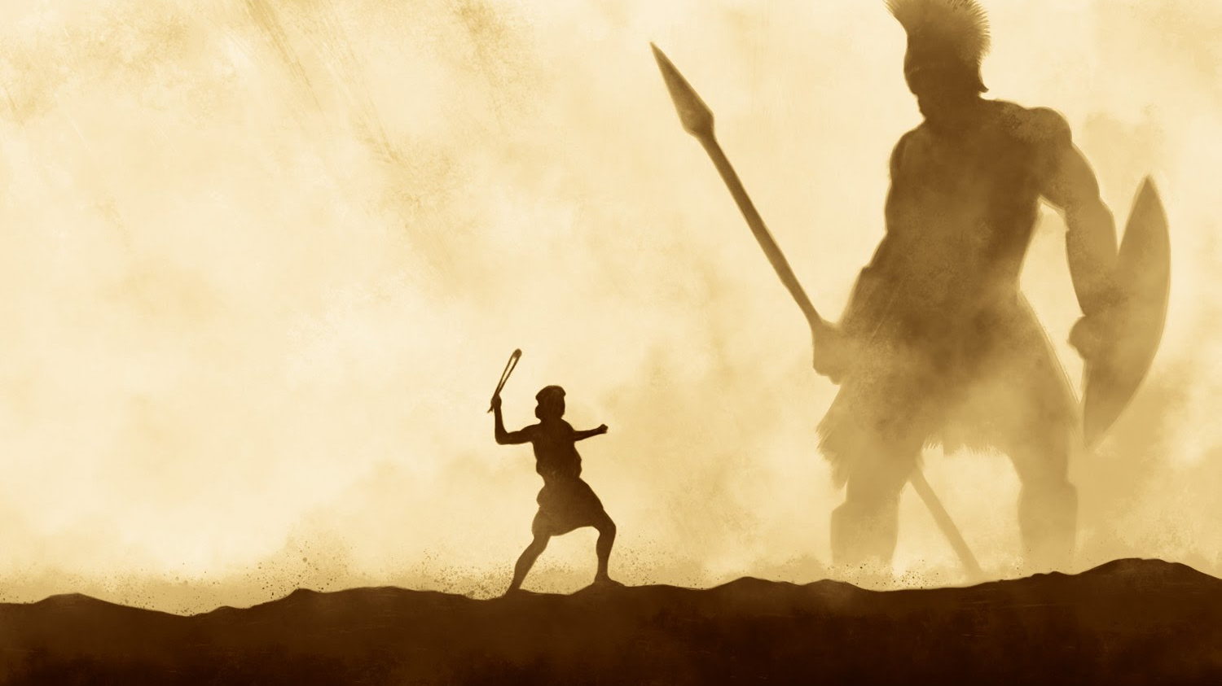
Conquering Giants 1 Samuel 17:40-51
A series of sermons regarding some of the giants that we face today and the power that God provides to overcome them.
Mt. Baker
Church of Christ

Slide 2
The Spirit of Fear
2 Timothy 1:7

Slide 3
2 Timothy 1:7
For God has not given us a spirit of fear, but of power and of love and of a sound mind.

Slide 4
The Spirit of Fear
The Fear of Man
Israel
Abraham
The Jewish Rulers
The Challenge for Us

Slide 5
The Spirit of Fear
The Fear of Failure
Inferiority / Insecurity
Moses
Gideon
The One Talent Man
Lost Opportunities

Slide 6
Overcoming Fear
Fear God
Don’t fear man
Examples of Courage
Joshua and Caleb
Shadrach, Meshach, Abed Nego
Esther

Slide 7
Overcoming Fear
Fear God
Don’t fear man
Add to your faith virtue
Realize that you are never alone
Pursue righteousness

Slide 8
Overcoming Insecurity
Prayer
Study
Apply yourself
Proper thinking
Quit comparing yourself to others
Realize who your Father is
Realize the power to do great things is in God – not you

Slide 9
The Spirit of Fear
2 Timothy 1:7

