Slide 2

Help in Times of Trouble
Philippians 4:4-13

Slide 3
1. Rejoice v. 4
To rejoice is “to be glad, happy, delighted, full of joy.”
We are to rejoice in the Lord (v. 4)
We are to rejoice in hope (Rom. 12:12)
We are to rejoice in the love and care shown by our brethren (v. 10)

Slide 4
2. Be Gentle v. 5
“Let your gentleness be known” (NKJV)
“Let your moderation be known” (KJV)
“Let your forbearing spirit be known” (NASV)
We must be conscious of the way we react to the troubles and problems of life.
We must avoid extremes, realizing suffering does not give us a right to sin.

Slide 5
3. Do Not Be Anxious - Pray vs. 6-7
Times of trouble can disturb and threaten to destroy our peace.
This peace is regained through prayer.
“Casting all your care upon Him, for He cares for you” (1 Peter 5:7).

Slide 6
4. Meditate On Good Things v. 8
It is easy to become cynical and focus upon the negative things in our life.
Thus the Lord commands us to focus upon the good things:
  whatsoever is true, noble, just, pure, lovely, good report, virtuous and praiseworthy

Slide 7
5. Learn To Be Content vs. 11-13
Our happiness and peace must come from something other than external circumstances.
We cannot control other people.
We must learn to accept things the way they are and deal with them in the proper manner.

Slide 8
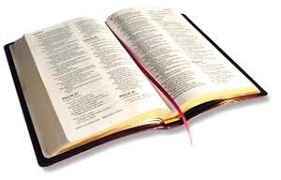
Help in Times of Trouble
Rejoice in the Lord
Respond in a Gentle Manner
Do Not Be Anxious, But Pray
Meditate on the Good Things
Learn To Accept Things

