Slide 2
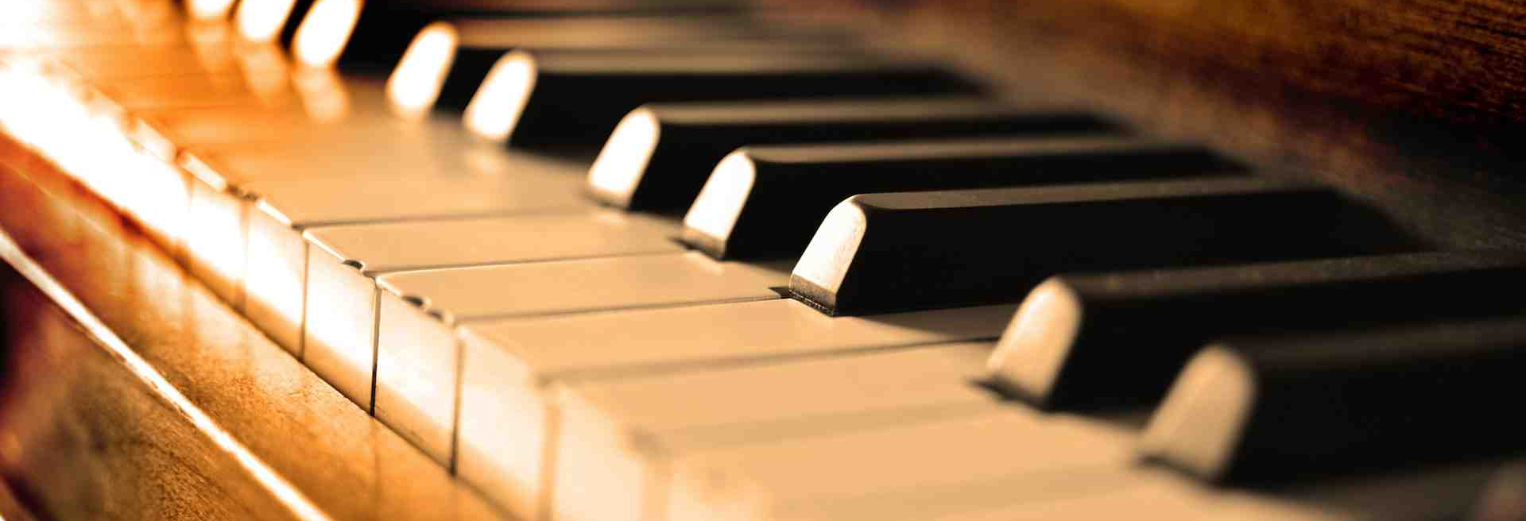
Why We Oppose the Use of Instrumental Music In Worship

Slide 3
1. We Are Told To Sing

Slide 4
1. We Are Told To Sing
Matthew 26:30
Acts 16:25
Romans 15:9
1 Corinthians 14:15
Ephesians 5:19
Colossians 3:16
Hebrews 2:12, 13:15
James 5:13

Slide 5
1. We Are Told To Sing
“Whoever transgresses and does not abide in the doctrine of Christ does not have God…” (2 John 9)

Slide 6
1. We Are Told To Sing
“sing”
“Whoever transgresses and does not abide in the doctrine of Christ does not have God…” (2 John 9)

Slide 7
1. We Are Told To Sing
musical instruments
“sing”
“Whoever transgresses and does not abide in the doctrine of Christ does not have God…” (2 John 9)

Slide 8
2. Instruments Are Not Authorized

Slide 9
2. Instruments Are Not Authorized
“Show me where the Bible says, ‘Thou shalt not use instruments?’”

Slide 10
2. Instruments Are Not Authorized
“Show me where the Bible says, ‘Thou shalt not use instruments?’”
“Where does the Bible say that we can use musical instruments?”

Slide 11
2. Instruments Are Not Authorized
Hebrews 7:12-14 - silence of Scripture is prohibitive, not permissive.
Genesis 6:14-16 - gopher wood automatically excluded all other types of wood.
Numbers 19:2 - animal specified by God automatically excluded all other animals.
“Singing” automatically excludes all other types of music.

Slide 12
3. Answering Arguments In Favor of the Instrument
“I like the use of musical instruments.”
Worship is not about what we like, but about what God wants from us (John 4:23-24).

Slide 13
3. Answering Arguments In Favor of the Instrument
“Instruments Help Improve Our Singing.”
No, instruments drown out the singing, and completely change the kind of music that we are offering to God.
We are to make melody in our “heart” (Eph. 5:19), not on a “harp.”
Some who use the instrument are often complimentary of the singing heard in the Lord’s church.

Slide 14
3. Answering Arguments In Favor of the Instrument
“Used Instruments in the Old Testament.”
Such was commanded (2 Chron. 29:25-28).
If we go back and keep one part of the Law of Moses, we are obligated to keep all (Gal. 5:3).
Law of Moses was fulfilled and taken out of the way when Jesus died (Col. 2:14).

Slide 15
3. Answering Arguments In Favor of the Instrument
“Aren’t There Harps In Heaven?”
Revelation 5:8, 14:2, 15:2
Revelation is a book of signs and symbols.
Will there really be harps in heaven?
To follow this passage, every person would have to play a harp.

Slide 16
3. Answering Arguments In Favor of the Instrument
“Doesn’t the Greek word for ‘making melody’ in Eph. 5:19 indicate the use of instruments?”
psallo: originally meant “to twitch or twang,” then came to refer to playing a stringed instrument with one’s fingers.
The instrument must be supplied in the context: “making melody in your heart.”

Slide 17
3. Answering Arguments In Favor of the Instrument
“Doesn’t the Possession of Talents Infer the Use of Those Talents?”
“If one is a good piano player, shouldn’t he play the piano in church to the glory of God?”
What if a woman were a good public speaker? 1 Cor. 14:34-35, 1 Tim. 2:11-12

Slide 18
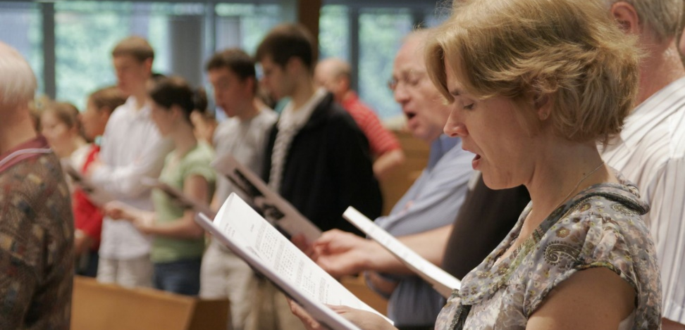
Why We Oppose Instrumental Music in Worship To God
It is not authorized in the New Testament.
We are told to “sing.” Anything else is beyond the limitations of the doctrine of Christ.
Arguments in favor of the instrument are answered with an appeal to Bible authority.

