Slide 2
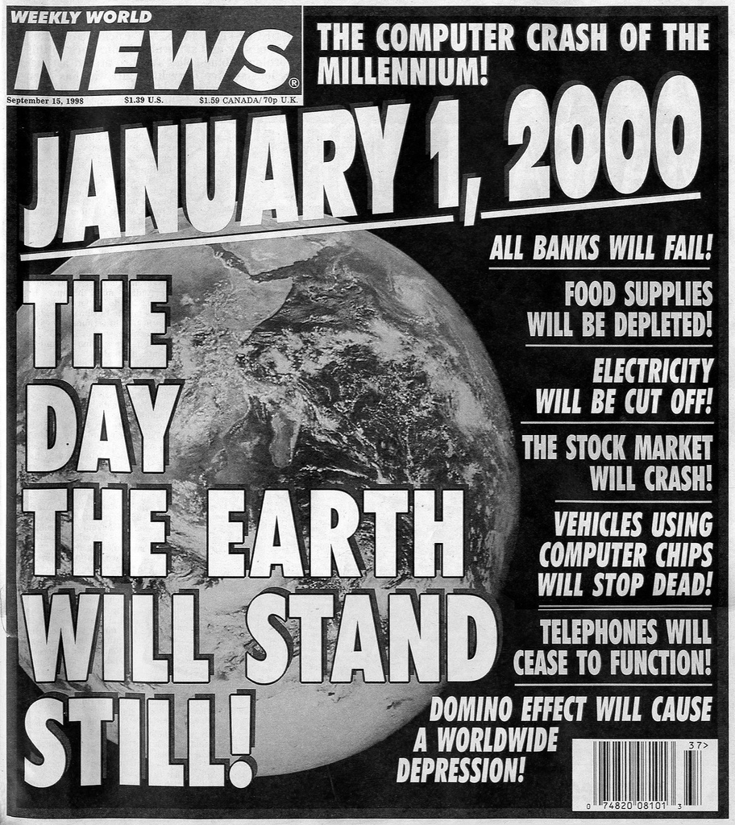
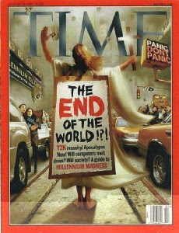

Slide 3
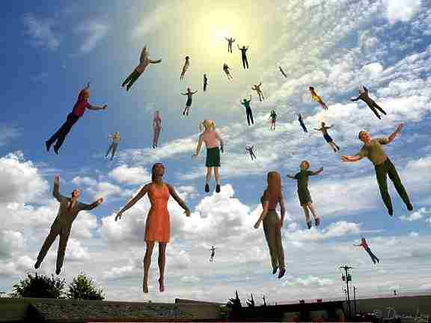

Slide 4
The Last Day… What Then?

Slide 5
1. Jesus Will Return
It will be a personal appearance (Acts 1:11).
He will descend from the clouds of heaven.
It will be seen by all men (Rev. 1:7).
It will be announced with a shout and a trumpet (1 Thess. 4:16).
It will come unexpectedly (1 Thess. 5:1-3).

Slide 6
2. Resurrection of the Dead
There will only be one resurrection:
Acts 24:15; John 5:28-29

Slide 7
2. Resurrection of the Dead
First Corinthians 15:35-50
Incorruptible (v. 42)
Glorious (v. 43)
Powerful (v. 43)
Spiritual (v. 44)
Any further description is unknown (1 John 3:2)

Slide 8
3. Those Living Will Be Changed
First Corinthians 15:50-53

Slide 9
4. Caught Up Together To Meet the Lord in the Air
First Thessalonians 4:17
We will meet the Lord in the air, not on the earth. He will never set foot on the earth again.

Slide 10
5. Earth Will Be Destroyed
Second Peter 3:10-13
The heavens will pass away
The elements will melt
The earth will be burned up

Slide 11
6. Judgment
Matthew 25:31-32
Revelation 20:11-13

Slide 12
7. Eternity Will Begin
Matthew 25:46
The lost will be cast into Hell with the devil and his angels (Matt. 25:41; Rev. 20:15).
The saved will be delivered to the Father in Heaven (1 Cor. 15:24; Matt. 10:32).

Slide 13
The Last Day… What Then?
Jesus Will Return
Resurrection of the Dead
Those Living Will Be Changed
Caught Up To Meet the Lord in the Air
Earth Will Be Destroyed
Judgment
Eternity Will Begin

Slide 14
When Will This Happen?
NO ONE KNOWS!
Matthew 24:36; 1 Thess. 5:2; 2 Pet. 3:10
Matthew 24:42-44 – “watch” “be ready”

