Slide 2
What is my Life Like in Fellowship with God?

Slide 3
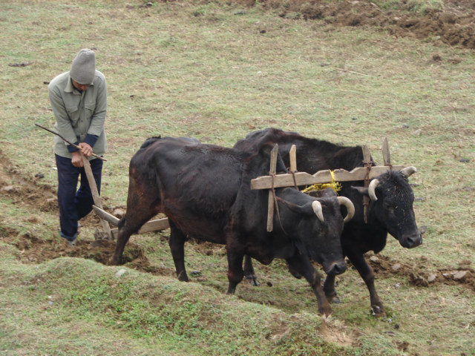
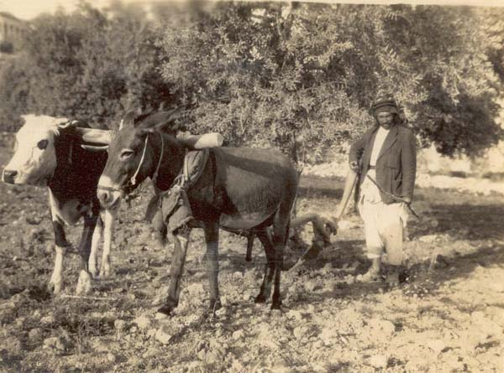
“unequally yoked” – Deut. 22:10

Slide 4
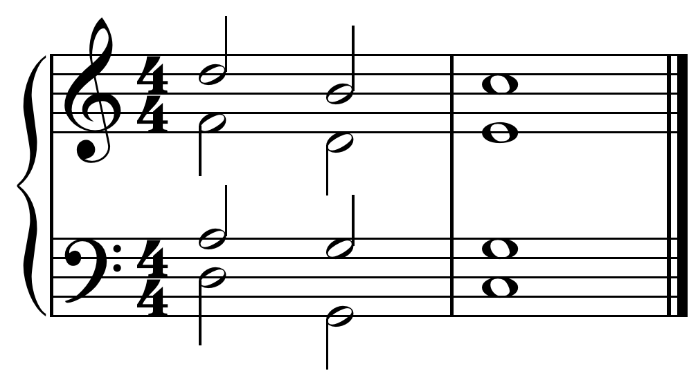
Concord - Harmony
“Sharing in -Partnership with”
“unequally yoked” – Deut. 22:10

Slide 5
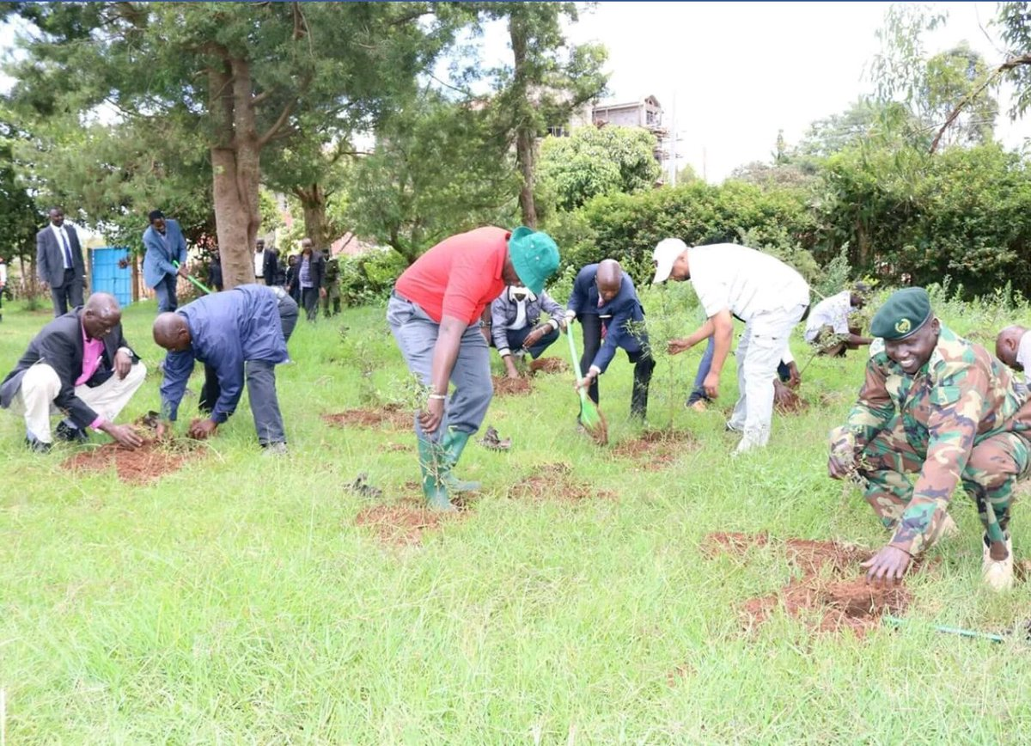
Concord - Harmony
“Sharing in -Partnership with”
“unequally yoked” – Deut. 22:10
“Portion”

Slide 6
Fellowship – Spiritual Relationship
“fellow – citizens” (Eph. 2:19)
“fellow – heirs” (Eph. 3:6)
“fellow – elder” (I Pet. 5:1)
“fellow – soldier” (Philm. 2)
“fellow – workers (Rom. 16:3)

Slide 7
Fellowship – Purpose of Word (I Jn. 1:3-7)
Basis of fellowship “with us” (Apostles – Man) and “with the Father and the Son” (God)

Slide 8
Fellowship – Purpose of Word (I Jn. 1:3-7)
Basis of fellowship “with us” (Apostles – Man) and “with the Father and the Son” (God)
Apostles Declare Revealed Truth: God is light (v. 3,5)

Slide 9
Fellowship – Purpose of Word (I Jn. 1:3-7)
Basis of fellowship “with us” (Apostles – Man) and “with the Father and the Son” (God)
Apostles Declare Revealed Truth: God is light (v. 3,5)
Revealed light produces differences for the mind – no darkness at all (v. 5)

Slide 10
Fellowship – Purpose of Word (I Jn. 1:3-7)
Basis of fellowship “with us” (Apostles – Man) and “with the Father and the Son” (God)
Apostles Declare Revealed Truth: God is light (v. 3,5)
Revealed light produces differences for the mind – no darkness at all (v. 5)
Revealed light establishes boundary for living – walk in the light (v. 7)

Slide 11
Fellowship with God – When My Life is not Sinless ??? (I Jn. 1:5,7)
Spiritual Mindset: I will not continue in sin (I Jn. 3:9, Rom. 6:10-11)

Slide 12
Fellowship with God – When My Life is not Sinless ??? (I Jn. 1:5,7)
Spiritual Mindset: I will not continue in sin (I Jn. 3:9, Rom. 6:10-11)
Yet…??? (Truth: I Jn. 1:6, 8, 10)

Slide 13
Fellowship with God – When My Life is not Sinless ??? (I Jn. 1:5,7)
Spiritual Mindset: I will not continue in sin (I Jn. 3:9, Rom. 6:10-11)
Yet…??? (Truth: I Jn. 1:6, 8, 10)
Spiritual Action: CONFESS; REPENT, PRAY (I Jn. 1:9, Acts 8:13, 18-19, 22-24)

Slide 14
Fellowship with God – When My Life is not Sinless ??? (I Jn. 1:5,7)
Spiritual Mindset: I will not continue in sin (I Jn. 3:9, Rom. 6:10-11)
Yet…??? (Truth: I Jn. 1:6, 8, 10)
Spiritual Action: CONFESS; REPENT, PRAY (I Jn. 1:9, Acts 8:13, 18-19, 22-24)
Was Simon’s Sin a “sin unto death”? (Rom. 6:23, I Jn. 5:16-17, Acts 8:23-24)

Slide 15
I will walk in the light – do the truth
What is my Life Like in Fellowship with God?

Slide 16
I will walk in the light – do the truth
I will make the necessary corrections when I do sin…
What is my Life Like in Fellowship with God?

Slide 17
Fellowship with God – Grounded in Absolute Truth
Jesus Christ – His Word (Jn. 14:6, Jn. 8:31-32)

Slide 18
Fellowship with God – Grounded in Absolute Truth
Jesus Christ – His Word (Jn. 14:6, Jn. 8:31-32)
Truth “in us” – we should “do the truth” (I Jn. 1:6,8)

Slide 19
Fellowship with God – Grounded in Absolute Truth
Jesus Christ – His Word (Jn. 14:6, Jn. 8:31-32)
Truth “in us” – we should “do the truth” (I Jn. 1:6,8)
Objective Truth Clarifies Subjective Claims (I Jn. 2:4-6)
“I Know Jesus”
“I love God”
“I am in Him”

Slide 20
Fellowship with God – Grounded in Absolute Truth
Found in the “Apostles’ Doctrine” (I Jn. 4:2-6, Acts 2:42)
We know the Truth from God’s Spirit, and are Of God if we believe Jesus Christ has come in the flesh (I Jn. 4:2).

Slide 21
Fellowship with God – Grounded in Absolute Truth
Found in the “Apostles’ Doctrine” (I Jn. 4:2-6, Acts 2:42)
We know the Truth from God’s Spirit, and are Of God if we believe Jesus Christ has come in the flesh (I Jn. 4:2).
Don’t confess this Truth? - Not of God (I Jn. 4:3)
Those of God hear “us” the apostles : can distinguish between Truth And Error (I Jn. 4:6)

Slide 22
Fellowship with God – We Do Not Love the World (I Jn. 2:15-17)
Knowledge Equips Us With A “Discerning Love” (Phil. 1:9-10)

Slide 23
Fellowship with God – We Do Not Love the World (I Jn. 2:15-17)
Knowledge Equips Us With A “Discerning Love” (Phil. 1:9-10)
We will value the world or value God (cf. I Peter 2:11)
The world with all its trappings will perish – obey God: you will abide forever (I Jn. 2:17)

Slide 24
Fellowship with God – We Will Love Our Brother (I Jn. 2:9-10)
Determining factor if we are walking in the light or walking in Darkness.
One is in Darkness, despite of what one says, if he hates his brother.

Slide 25
Fellowship with God – We Will Love Our Brother (I Jn. 2:9-10)
Determining factor if we are walking in the light or walking in Darkness.
One is in Darkness, despite of what one says, if he hates his brother.
Being in the light – one is not a stumbling block to self or others.

Slide 26
Fellowship with God – We Will Love Our Brother (I Jn. 2:9-10)
Determining factor if we are walking in the light or walking in Darkness.
One is in Darkness, despite of what one says, if he hates his brother.
Being in the light – one is not a stumbling block to self or others.
Love God and Obey His Commandments: you will know if you are loving your brother (I Jn. 5:2) – no stumbling block.

Slide 27
Fellowship with God – Are You Dressing Modestly? (I Tim. 2:9-10)
Will manifest when heart is molded by God’s declaration of Truth: “Shamefastness” and “Sobriety”
Shamefastness: “shrinking back from crossing the line of impropriety”
Lack of it: (Lk. 11:5-8)

Slide 28
Fellowship with God – Are You Dressing Modestly? (I Tim. 2:9-10)
Will manifest when heart is molded by God’s declaration of Truth: “Shamefastness” and “Sobriety”
Shamefastness: “shrinking back from crossing the line of impropriety”
Lack of it: (Lk. 11:5-8)
Nakedness covered? (Ex. 28:42, Isa. 47:2-3)

Slide 29
Fellowship with God – Are You Dressing Modestly? (I Tim. 2:9-10)
Will manifest when heart is molded by God’s declaration of Truth: “Shamefastness” and “Sobriety”
Shamefastness: “shrinking back from crossing the line of impropriety”
Lack of it: (Lk. 11:5-8)
Nakedness covered? (Ex. 28:42, Isa. 47:2-3)
Sobriety: the sound mind – in control of self, sober mind – sound reasoning (I Tim. 2:15, Acts 26:25)

