Slide 2
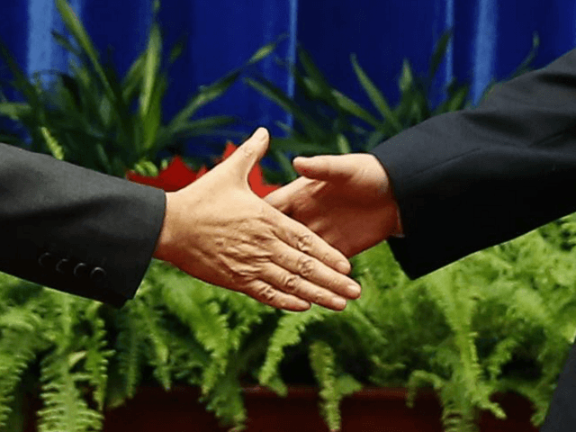
To Receive or Not Receive
Romans 14 – 2 John

Slide 3
To Receive or Not Receive
Involves Fellowship: 2 Jn. 11 –Rom. 14:3
Romans 14 – 2 John

Slide 4
To Receive: “take to oneself”
Communicating a close agreement with another – Gal. 2:9

Slide 5
To Receive…
One - Without judgmental debate – “passing judgment on reasonings” “decision of scruples” – hesitation because of doubt (Rom. 14:1)

Slide 6
To Receive…
One - Without judgmental debate – “passing judgment on reasonings” “decision of scruples” – hesitation because of doubt (Rom. 14:1)
One in their practice – not eating meats, eating meats (Rom. 14:2)
One has “faith” to eat all things – “strong”
One “eat herbs” – “weak” in this particular aspect of one’s faith

Slide 7
To Receive…
One - Without judgmental debate – “passing judgment on reasonings” “decision of scruples – hesitation because of doubt (Rom. 14:1)
One in their practice – not eating meats, eating meats (Rom. 14:2)
One has “faith” to eat all things – “strong”
One “eat herbs” – “weak” in this particular aspect of one’s faith
One unto the Lord (Rom. 14:3)…

Slide 8
To Receive…
One unto the Lord (Rom. 14:3, 7-9, 10-12)
The Lord receives the “meat eating” one
Both have one Master
We all will stand before God’s judgment seat

Slide 9
To Receive…
Matters of conscience – “fully assured in own mind” (Rom. 14:5, 23)

Slide 10
To Receive…
Matters of conscience – “fully assured in own mind” (Rom. 14:5, 23)
Matters that are “indifferent with God” – eat or not eat “unto the Lord” (Rom 14:6, I Cor. 8:8)

Slide 11
To Receive…
Matters of conscience – “fully assured in own mind” (Rom. 14:5, 23)
Matters that are “indifferent with God” – eat or not eat “unto the Lord” (Rom 14:6, I Cor. 8:8)
Matters where fellowship with God is highlighted in loving our brother…

Slide 12
Receive… loving our brother
Walking in light: loving our brother – putting no stumbling block before him (Rom. 14:13,15, 21 I Jn. 2:10)

Slide 13
Receive… loving our brother
Walking in light: loving our brother – putting no stumbling block before him (Rom. 14:13,15, 21 I Jn. 2:10)
Walking with God (Rom. 14:16-18)

Slide 14
Receive… loving our brother
Walking in light: loving our brother – putting no stumbling block before him (Rom. 14:13,15, 21 I Jn. 2:10)
Walking with God (Rom. 14:16-18)
Walking after peace seeking to edify not overthrow (Rom. 14:19-20)

Slide 15
Receive… loving our brother
Walking in light: loving our brother – putting no stumbling block before him (Rom. 14:13,15, 21 I Jn. 2:10)
Walking with God (Rom. 14:16-18)
Walking after peace seeking to edify not overthrow (Rom. 14:19-20)
Walking in love – not hiding the Truth (Rom. 14:22, 14)

Slide 16
Receive Not…
God’s declaration: you do not have God when you go beyond the “doctrine” - “teaching of Christ” (2 Jn. 9, Rev. 2:14,15)

Slide 17
Receive Not…
God’s declaration: you do not have God when you go beyond the “doctrine” - “teaching of Christ” (2 Jn. 9, Rev. 2:14,15)
God’s declaration: You have both the Father and the Son when you “abide” in the teaching (2 Jn. 9)

Slide 18
Receive Not…
God’s declaration: you do not have God when you go beyond the “doctrine” “teaching of Christ” (2 Jn. 9, Rev. 2:14,15)
God’s declaration: You have both the Father and the Son when you “abide” in the teaching (2 Jn. 9)
If one comes to you not “bringing” – bearing, upholding this teaching… (2 Jn. 10)

Slide 19
Receive Not…
God’s declaration: you do not have God when you go beyond the “doctrine” “teaching of Christ” (2 Jn. 9, Rev. 2:14,15)
God’s declaration: You have both the Father and the Son when you “abide” in the teaching (2 Jn. 9)
If one comes to you not “bringing” – bearing, upholding this teaching… (2 Jn. 10)
Receive him not into your house – give him “no greeting” – “God-speed”

Slide 20
Receive Not…
God’s declaration: you do not have God when you go beyond the “doctrine” “teaching of Christ” (2 Jn. 9, Rev. 2:14,15)
God’s declaration: You have both the Father and the Son when you “abide” in the teaching (2 Jn. 9)
If one comes to you not “bringing” – bearing, upholding this teaching… (2 Jn. 10)
Receive him not into your house – give him “no greeting” – “God-speed”
If you do give such greeting – you “partake” (share in) his evil works” (2 Jn. 11)

Slide 21
Fellowship: God’s Pattern…
Why Not Apply the Appropriate Pattern ? (2 Tim. 1:13)

Slide 22
Fellowship: God’s Pattern…
Why Not Apply the Appropriate Pattern ? (2 Tim. 1:13)
2 John 9-11: Don’t Receive the Teacher in His teaching of error
Romans 14: Receive the person in their practice

Slide 23
Error of those applying diversity in Rom. 14 – David McClister
“No where does God say we have to agree on every issue” – Women preachers??? (I Tim. 2:12) Baptism for remission of sins (Acts 2:38)

Slide 24
Error of those applying diversity in Rom. 14 – David McClister
“No where does God say we have to agree on every issue” – Women preachers??? (I Tim. 2:12) Baptism for remission of sins (Acts 2:38)
Rom. 14 is showing us “how to relate to those who sincerely apply the faith of Jesus Christ differently from me” – Where is the diversity of the faith regarding if meats or clean or not? (Rom. 14:14, I Tim. 4:3-5, Mk. 7:19)

Slide 25
Error of those applying diversity in Rom. 14 – David McClister
“No where does God say we have to agree on every issue” – Women preachers??? (I Tim. 2:12) Baptism for remission of sins (Acts 2:38)
Rom. 14 is showing us “how to relate to those who sincerely apply the faith of Jesus Christ differently from me” – Where is the diversity of the faith regarding if meats or clean or not?
“We are free to practice the faith of Jesus Christ according to our own convictions” – Convictions came from O.T. (Lev. 11) not faith of Jesus Christ

Slide 26
To Receive or Not Receive
Romans 14 – matters of indifference with God
2 John 9-11 – Matters that God demands in His Teaching

Slide 27
To Receive or Not Receive
Romans 14 – matters of indifference with God
2 John 9-11 – Matters that God demands in His Teaching
James 4:11-12
Who Are You To Judge Your Neighbor?

Slide 28
To Receive or Not Receive
Romans 14 – matters of indifference with God
2 John 9-11 – Matters that God demands in His Teaching
James 4:11-12
Who Are You To Judge Your Neighbor?
Home School

Slide 29
To Receive or Not Receive
Romans 14 – matters of indifference with God
2 John 9-11 – Matters that God demands in His Teaching
James 4:11-12
Who Are You To Judge Your Neighbor?
Home School
Diet

Slide 30
To Receive or Not Receive
Romans 14 – matters of indifference with God
2 John 9-11 – Matters that God demands in His Teaching
James 4:11-12
Who Are You To Judge Your Neighbor?
Home School
Diet
Television - Internet

