Slide 2
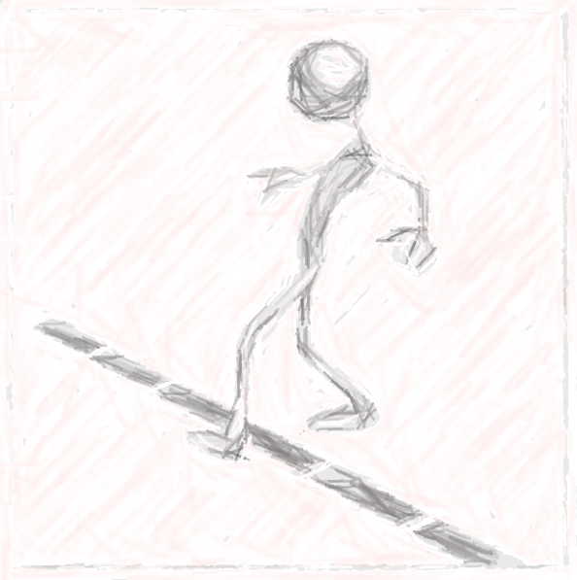
Boundaries of Fellowship

Slide 3
Christian: No fellowship
with Darkness
Ephesians 5:11

Slide 4
Do not participate… (Eph. 5:5-8)
Why? No inheritance in kingdom of Christ and God (Eph. 5:5)
“surety”… (v.5)
)

Slide 5
Do not participate… (Eph. 5:5-8)
Why? No inheritance in kingdom of Christ and God (Eph. 5:5)
“surety”… (v.5)
Why? Wrath of God upon sons of disobedience (Eph. 5:6) “therefore”… (v.6-7)

Slide 6
Do not participate… (Eph. 5:5-8)
Why? No inheritance in kingdom of Christ and God (Eph. 5:5)
“surety”… (v.5)
Why? Wrath of God upon sons of disobedience (Eph. 5:6) “therefore”… (v.6-7)
Why? Ye were once darkness, but now are light in the Lord (v.8) (v.85:8)

Slide 7
FRUIT OF LIGHT Eph. 5:9
Goodness – benefit to others (Matt. 5:14-16)
Righteousness – Gospel (Rom. 1:16-17)
Truth -Word (Jn. 17:17)

Slide 8
Walk as children of light – Proving What is Pleasing Unto The Lord (vs. 8,10)
FRUIT OF LIGHT Eph. 5:9
Goodness – benefit to others (Matt. 5:14-16)
Righteousness – Gospel (Rom. 1:16-17)
Truth -Word (Jn. 17:17)

Slide 9
Have no fellowship… (v.11)
With Unfruitful works of darkness – Reprove them…
Not participating in same things – not even in agreement with such things (v.7)
Person is connected with Actions (v. 12; 2 Jn 10-11)

Slide 10
No fellowship with darkness!
Awake… (Isa. 60:1)
Rise from the dead… Serious?

Slide 11
No fellowship with darkness!
Awake… (Isa. 60:1)
Rise from the dead… Serious?
Christ shall shine on you…approval, example

Slide 12
No fellowship with darkness!
Awake… (Isa. 60:1)
Rise from the dead… Serious?
Christ shall shine on you…approval, example
Children of light: no participants in works of darkness, but no way sharing in them manifested by reproving those who practice such unspeakable things.

Slide 13
Mark those Causing Division…
Maintaining fellowship with God demands one mark those causing divisions through their doctrinal error – and turn away from them (Rom. 16:17)

Slide 14
Mark those Causing Division…
Maintaining fellowship with God demands one mark those causing divisions through their doctrinal error – and turn away from them (Rom. 16:17)
“Mark” – pointing them out will help those fellow Christians know the source of the division – help keep them from “stumbling” …

Slide 15
Romans 16:17
Pointing out those who are walking in harmony with God is a living pattern – godly action to follow in our walk with God (Phil. 3:17)
Noting the source of division who is contradicting the sound doctrine of Christ is also helpful – one can know where the pitfall is.
Turn away from evil – by turning away from them (cf. I Pet. 3:11)
Mark

Slide 16
Bob Owen – Romans 16:17
“…Paul didn’t say withdraw from everybody that differs with you. He says mark and avoid those that are causing division. Not everybody who teaches something I disagree with does it in a manner that drives a wedge in a local church and causes people to be divided and split and factious. You don’t tolerate the disunity in a local church. Does that mean you’ve got to agree on every single item according to the Scripture? No. But there is a difference in differing and dividing.”

Slide 17
Church Discipline…
Maintaining fellowship with God demands the members of a local church withdraw their approving social contact from a member who persists in sin (I Cor. 5: 4-13, 2 Thess. 3:6-14).

Slide 18
Fellowship has been Broken – Now Recognized (I Cor. 5, 2Thess. 3)
The members gather with the Lord’s authority backing them to deliver the sinning brother over to Satan for the destruction of the flesh – so he will turn and be in a saved state in the day of the Lord (v.4-5)
All members withdraw themselves from sinning brother: (cf. 2 Cor. 2:6)
Must keep no company – association, mingle with,
Must not even eat with them.

Slide 19
Withdrawing –Four-Fold Purpose
Action proposed to cause one to destroy or kill his sinful desires and return to fellowship with God (v. 5)
Action proposed to cause one to be “turning in self” (entrepo) in shame because he is out of step with the tradition revealed in the traditions established by word and letters of the apostles (2Thess. 2:15 -3:14)
Action proposed out of the desire to save the sinner’s spirit/soul, and for the purity of the church - from the loving heart of a brother, not an enemy. (I Cor. 5:5,6-7; 2 Thess. 3:15)

Slide 20
Boundaries of Fellowship
Light
Unity
Darkness
Righteousness
Division
Persisting in sin

