Slide 1


Slide 2
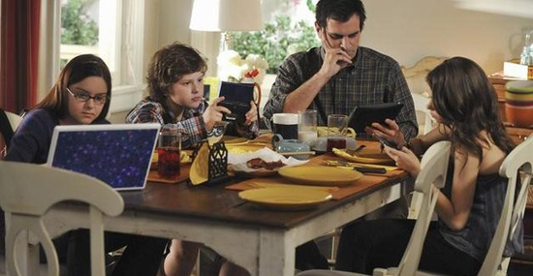
The Effects of Entertainment

Slide 3
The Effects of Entertainment
On our Time
On our Mind
On our Influence

Slide 4
The Effects of Entertainment
On Our Time
  “I don’t have time.” (cf. Acts 24:25)
    Average time spent watching TV per day in the U.S. is 5 hours.
    Years the average person will have spent watching TV – 9 years.

Slide 5
The 23rd Channel
The TV is my shepherd, My spiritual growth shall want; It makes me to sit down and do nothing for His Name's sake.
It requires all my spare time; It keeps me from doing my Christian duty. It produces so many good shows that I must see; It restores my knowledge of the world.
It keeps me from the study of God's Word. It leads me in the path of failing to attend worship and doing nothing for the kingdom of God.

Slide 6
The 23rd Channel
Yea, though I live to be a hundred years old I shall view my TV as long as it works. It seems to be my closest companion; Its sounds and pictures they comfort me.
It provides entertainment for me and keeps me from doing important things with my family. It fills my head with ideas which differ from God's will.
Surely, because of all the wasted hours there will be a lack of reward at the Gates of Heaven; I shall not dwell in the house of the LORD forever.

Slide 7
The Effects of Entertainment
On Our Time
  “I don’t have time.”
    Average time spent watching TV per day in the U.S. is 5 hours.
    Years the average person will have spent watching TV – 9 years.
      Ephesians 5:15-16; Colossians 4:5
      Matthew 24:42-44; 9:37-38
      Psalm 1:2; I Thess. 5:17; James 1:27

Slide 8
The Effects of Entertainment
On Our Mind
  “For as he thinks in his heart, so is he” (Proverbs 23:7).
  “And do not be conformed to this world, but be transformed by the renewing of your mind, that you may prove what is that good and acceptable and perfect will of God” (Romans 12:2).

Slide 9
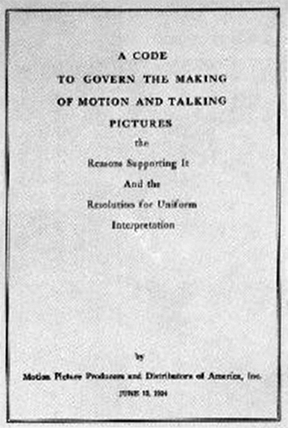


Slide 10
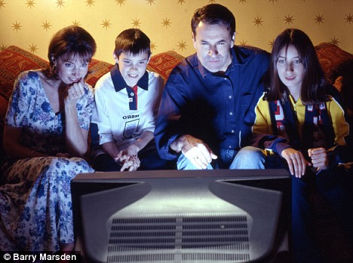
The Effects of Entertainment
“I will set nothing wicked before my eyes” (Psalm 101:3).
“Turn away my eyes from looking at worthless things, and revive me in Your way” (Psalm 119:37).

Slide 11
The Effects of Entertainment
“If then you were raised with Christ, seek those things which are above, where Christ is, sitting at the right hand of God. Set your mind on things above, not on things on the earth. For you died, and your life is hidden with Christ in God” (Colossians 3:1-3).

Slide 12
The Effects of Entertainment
“Finally, brethren, whatever things are true, whatever things are noble, whatever things are just, whatever things are pure, whatever things are lovely, whatever things are of good report, if there is any virtue and if there is anything praiseworthy--meditate on these things” (Philippians 4:8).

Slide 13
The Effects of Entertainment
On Our Influence
  Ephesians 5:23
  Proverbs 22:6
  Ezekiel 16:44
  Joshua 24:15
  Matt. 5:13-16; Philippians 2:15

Slide 14
The Effects of Entertainment
“For the ways of man are before the eyes of the LORD, and He ponders all his paths” (Prov. 5:21).
“The eyes of the LORD are in every place, keeping watch on the evil and the good” (Proverbs 15:3).
“And there is no creature hidden from His sight, but all things are naked and open to the eyes of Him to whom we must give account” (Hebrews 4:13).

Slide 15
The Effects of Entertainment
On our Time
On our Mind
On our Influence

