Slide 2
John 6:60-63
60 Therefore many of His disciples, when they heard this, said, “This is a hard saying; who can understand it?” 61 When Jesus knew in Himself that His disciples complained about this, He said to them, “Does this offend you? 62 What then if you should see the Son of Man ascend where He was before? 63 It is the Spirit who gives life; the flesh profits nothing. The words that I speak to you are spirit, and they are life.”

Slide 3
John 6:64-66
64 “But there are some of you who do not believe.” For Jesus knew from the beginning who they were who did not believe, and who would betray Him. 65 And He said, “Therefore I have said to you that no one can come to Me unless it has been granted to him by My Father.” 66 From that time many of His disciples went back and walked with Him no more.

Slide 4
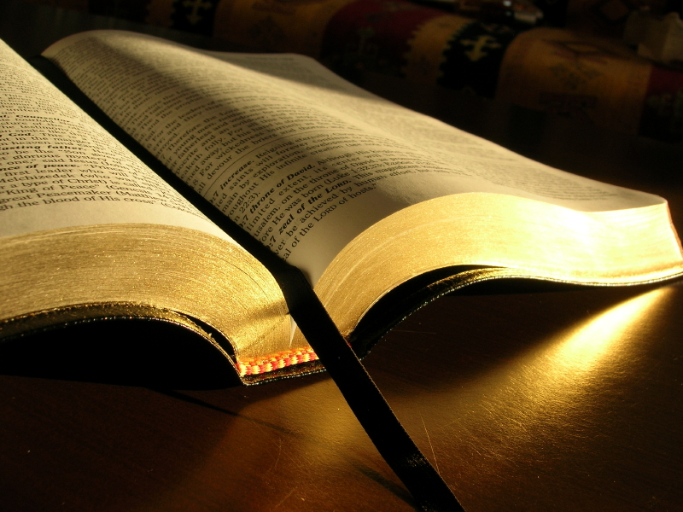
Does This Offend You? John 6:61

Slide 5
How God’s Word is to be Preached
Speak the truth in love (Ephesians 4:15).
With humility (2 Timothy 2:25).
From good will (Philippians 1:15).
In sincerity (2 Corinthians 2:17; Phil. 1:16).
Out of love (Philippians 1:17).
With boldness (Ephesians 6:20).
Notes:
It certainly should never be our intention to purposely offend others.

Slide 6
Truth Will Offend The World
“And this is the condemnation, that the light has come into the world, and men loved darkness rather than light, because their deeds were evil. For everyone practicing evil hates the light and does not come to the light, lest his deeds should be exposed. But he who does the truth comes to the light, that his deeds may be clearly seen, that they have been done in God” (John 3:19-21).

Slide 7
Truth Will Offend The World
“For even His brothers did not believe in Him. Then Jesus said to them, ‘My time has not yet come, but your time is always ready. The world cannot hate you, but it hates Me because I testify of it that its works are evil’” (John 7:5-7).
“I have given them Your word; and the world has hated them because they are not of the world, just as I am not of the world” (17:14).

Slide 8
The Truth Offends The World
When their Immorality is Condemned
The Sin of Homosexuality
Genesis 19:1-11; Leviticus 20:13; Romans 1:26-27; I Corinthians 6:9-10
The Sin of Fornication
Galatians 5:19; Ephesians 5:5-6; I Tim. 1:9-10
The Sin of Adultery
Matt. 5:32; 19:9; Mark 6:17-20; Hebrews 13:4
Notes:
Mt 11:6 "And blessed is he who is not offended because of Me."

Slide 9
The Truth Offends The World
When their Religious Beliefs and Practices are Condemned
Matthew 15:7-14
The sin of denominationalism (John 17:20-21; I Cor. 1:10; Matt. 16:18; Eph. 4:4-6)
Mechanical instruments of music in worship is without Bible authority (Eph. 5:19; Col. 3:16)
Baptism is necessary for salvation (Mark 16:16; Acts 2:38; 22:16; I Peter 3:21)

Slide 10
The Truth Offends The World
When their Religious Beliefs and Practices are Condemned
Matthew 15:7-14
Special “holy days” of men, not God (Gal. 4:9-11; Colossians 2:8, 16-17)
Women are not permitted to teach or to have authority over a man (I Tim. 2:12; I Cor. 14:34)
The social gospel perverts the gospel of Christ (Gal. 1:6-9; Romans 14:17; 1:16; I Tim. 3:15)

Slide 11
Does This Offend You? John 6:61

