Slide 1
Preaching What We Practice!
“Thus Saith the Scriptures!”
Why do you people in the Church of Christ do…
Notes:
Title Slide: Preaching What We Practice.

Slide 2

Notes:
Easy answer—”It’s in the book!”

Slide 3

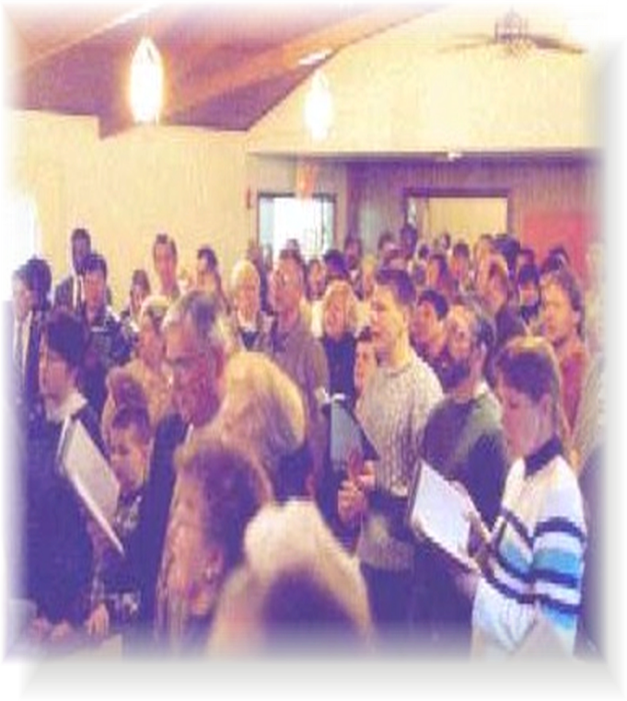
Why does the Church of Christ Sing—Without Musical Instruments?

Slide 4
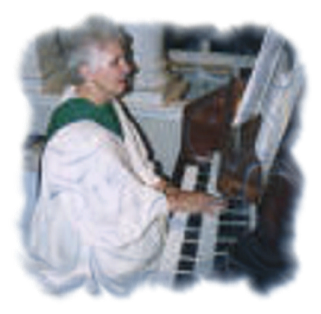
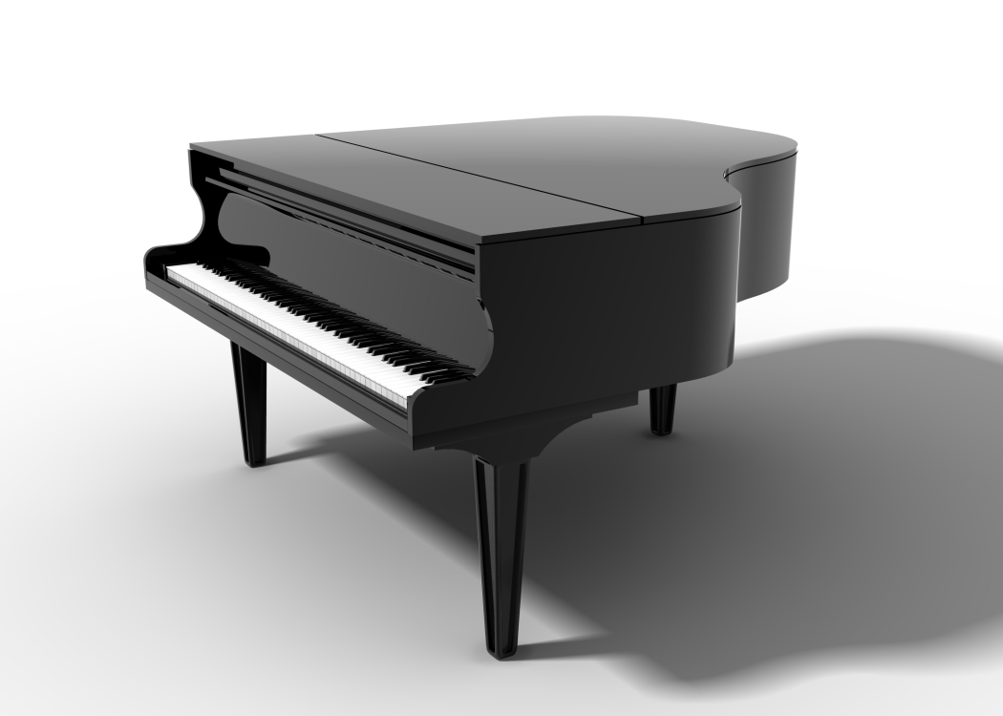
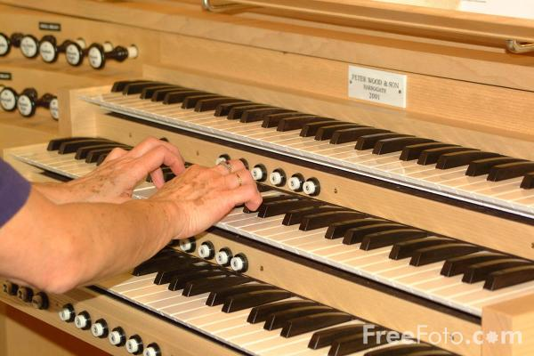

Slide 5
“Musical instruments in celebrating the praises of God would be no more suitable than the burning of incense, the lighting of lamps, and the restoration of the other shadows of the law. The Papists therefore, have foolishly borrowed, this, as well as many other things, from the Jews. Men who are fond of outward pomp may delight in that noise; but the simplicity which God recommends to us by the apostles is far more pleasing to him. Paul allows us to bless God in the public assembly of the saints, only in a known tongue (1 Corinthians 14:16) What shall we then say of chanting, which fills the ears with nothing but an empty sound?”
― John Calvin

Slide 6
“WE do not use instrumental music in the worship of God because we consider that it would be a violation of the simplicity of our worship. We
think it far better to hear the voices of Christian men and women than all the sounds which can be made by instruments. Yet I am sure there is no
Christian here who would object to a minister who can play well upon an instrument and, indeed, a minister is good for nothing if he does not
know how, spiritually, to give forth instrumental music!”
― Charles Spurgeon

Slide 7
“I have no objection to instruments of music in our chapels, provided they are neither heard nor seen!”
― John Wesley
“Although Josephus tells of the wonderful effects produced in the Temple by the use of instruments, the first Christians were of too spiritual a fibre to substitute lifeless instruments for or to use them to accompany the human voice. Clement of Alexandria severely condemns the use of instruments even at Christian banquets.”
-Roman Catholic Encyclopedia, Vol. 10, p. 652

Slide 8

1 Corinthians 14:15
“What is the conclusion then? I will pray with the spirit, and I will also pray with the understanding. I will sing with the spirit, and I will also sing with the understanding.”
Notes:
Text—1 Cor.14:15…

Slide 9
Ephesians 5:19
“Speaking to one another in psalms and hymns and spiritual songs, singing and making melody in your heart to the Lord.”
Notes:
Text—Eph.5:19…

Slide 10
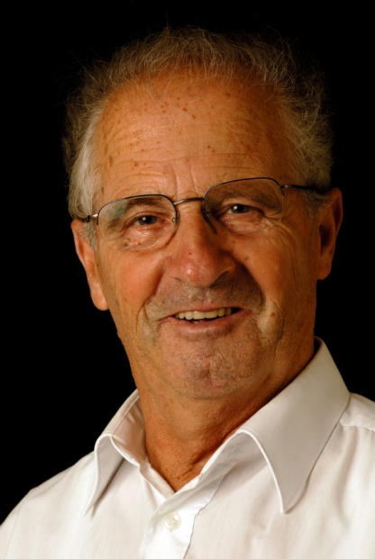


Why does the Church of Christ have Elders—in every church?
Notes:
Why does the Church of Christ have ELDERS in EVERY CHURCH?

Slide 11


The Church “Jesus Built”
Establishing The N.T. Pattern…
Acts 14:23
“So when they had appointed elders in every church, and prayed with fasting, they commended them to the Lord in whom they had believed.”
Plural in number
Notes:
Plural in the singular—Acts 14:23…(cf. Gal.3:17)
Matthew 4:1-10 (NKJV)
Then Jesus was led up by the Spirit into the wilderness to be tempted by the devil. [2] And when He had fasted forty days and forty nights, afterward He was hungry. [3] Now when the tempter came to Him, he said, "If You are the Son of God, command that these stones become bread." [4] But He answered and said, "It is written, 'Man shall not live by bread alone, but by every word that proceeds from the mouth of God.' " [5] Then the devil took Him up into the holy city, set Him on the pinnacle of the temple, [6] and said to Him, "If You are the Son of God, throw Yourself down. For it is written: 'He shall give His angels charge over you,‘ and, 'In their hands they shall bear you up, Lest you dash your foot against a stone.' " [7] Jesus said to him, "It is written again, 'You shall not tempt the Lord your God.' " [8] Again, the devil took Him up on an exceedingly high mountain, and showed Him all the kingdoms of the world and their glory. [9] And he said to Him, "All these things I will give You if You will fall down and worship me." [10] Then Jesus said to him, "Away with you, Satan! For it is written, 'You shall worship the Lord your God, and Him only you shall serve.' "
James 1:13-16 (NKJV)
Let no one say when he is tempted, "I am tempted by God"; for God cannot be tempted by evil, nor does He Himself tempt anyone. [14] But each one is tempted when he is drawn away by his own desires and enticed. [15] Then, when desire has conceived, it gives birth to sin; and sin, when it is full-grown, brings forth death. [16] Do not be deceived, my beloved brethren.
1 John 2:15-17 (NKJV)
Do not love the world or the things in the world. If anyone loves the world, the love of the Father is not in him. [16] For all that is in the world--the lust of the flesh, the lust of the eyes, and the pride of life--is not of the Father but is of the world. [17] And the world is passing away, and the lust of it; but he who does the will of God abides forever.

Slide 12
The Church “Jesus Built”
Establishing The N.T. Pattern…
Titus 1:5
“For this reason I left you in Crete, that you should set in order the things that are lacking, and appoint elders in every city as I commanded you.”
Those who
met the
Qualifications:
1 Timothy 3:1-7
Titus 1:5-9
Plural in number
Notes:
Plural in the singular—Titus 1:5…(1 Tim.3:1-7; Titus 1:5-9)
Matthew 4:1-10 (NKJV)
Then Jesus was led up by the Spirit into the wilderness to be tempted by the devil. [2] And when He had fasted forty days and forty nights, afterward He was hungry. [3] Now when the tempter came to Him, he said, "If You are the Son of God, command that these stones become bread." [4] But He answered and said, "It is written, 'Man shall not live by bread alone, but by every word that proceeds from the mouth of God.' " [5] Then the devil took Him up into the holy city, set Him on the pinnacle of the temple, [6] and said to Him, "If You are the Son of God, throw Yourself down. For it is written: 'He shall give His angels charge over you,‘ and, 'In their hands they shall bear you up, Lest you dash your foot against a stone.' " [7] Jesus said to him, "It is written again, 'You shall not tempt the Lord your God.' " [8] Again, the devil took Him up on an exceedingly high mountain, and showed Him all the kingdoms of the world and their glory. [9] And he said to Him, "All these things I will give You if You will fall down and worship me." [10] Then Jesus said to him, "Away with you, Satan! For it is written, 'You shall worship the Lord your God, and Him only you shall serve.' "
James 1:13-16 (NKJV)
Let no one say when he is tempted, "I am tempted by God"; for God cannot be tempted by evil, nor does He Himself tempt anyone. [14] But each one is tempted when he is drawn away by his own desires and enticed. [15] Then, when desire has conceived, it gives birth to sin; and sin, when it is full-grown, brings forth death. [16] Do not be deceived, my beloved brethren.
1 John 2:15-17 (NKJV)
Do not love the world or the things in the world. If anyone loves the world, the love of the Father is not in him. [16] For all that is in the world--the lust of the flesh, the lust of the eyes, and the pride of life--is not of the Father but is of the world. [17] And the world is passing away, and the lust of it; but he who does the will of God abides forever.

Slide 13
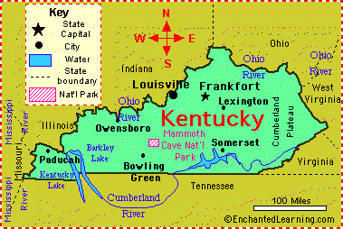
The Church “Jesus Built”
Establishing The N.T. Pattern…
Elders
Elders
Plural in every place!
Elders
Elders
Elders
Notes:
Plural in the Singular—Every City—KY—Paduach—Louisville—Lexington—Somerset—Bowling Green…
Matthew 4:1-10 (NKJV)
Then Jesus was led up by the Spirit into the wilderness to be tempted by the devil. [2] And when He had fasted forty days and forty nights, afterward He was hungry. [3] Now when the tempter came to Him, he said, "If You are the Son of God, command that these stones become bread." [4] But He answered and said, "It is written, 'Man shall not live by bread alone, but by every word that proceeds from the mouth of God.' " [5] Then the devil took Him up into the holy city, set Him on the pinnacle of the temple, [6] and said to Him, "If You are the Son of God, throw Yourself down. For it is written: 'He shall give His angels charge over you,‘ and, 'In their hands they shall bear you up, Lest you dash your foot against a stone.' " [7] Jesus said to him, "It is written again, 'You shall not tempt the Lord your God.' " [8] Again, the devil took Him up on an exceedingly high mountain, and showed Him all the kingdoms of the world and their glory. [9] And he said to Him, "All these things I will give You if You will fall down and worship me." [10] Then Jesus said to him, "Away with you, Satan! For it is written, 'You shall worship the Lord your God, and Him only you shall serve.' "
James 1:13-16 (NKJV)
Let no one say when he is tempted, "I am tempted by God"; for God cannot be tempted by evil, nor does He Himself tempt anyone. [14] But each one is tempted when he is drawn away by his own desires and enticed. [15] Then, when desire has conceived, it gives birth to sin; and sin, when it is full-grown, brings forth death. [16] Do not be deceived, my beloved brethren.
1 John 2:15-17 (NKJV)
Do not love the world or the things in the world. If anyone loves the world, the love of the Father is not in him. [16] For all that is in the world--the lust of the flesh, the lust of the eyes, and the pride of life--is not of the Father but is of the world. [17] And the world is passing away, and the lust of it; but he who does the will of God abides forever.

Slide 14
1 Peter 5:2
“Shepherd the flock of God which is among you, serving as overseers, not by compulsion but willingly, not for dishonest gain but eagerly.”
Notes:
Text—1 Pet.5:2…

Slide 15
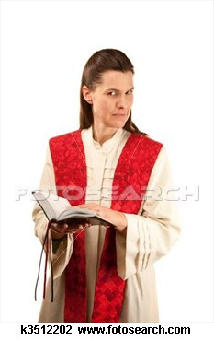
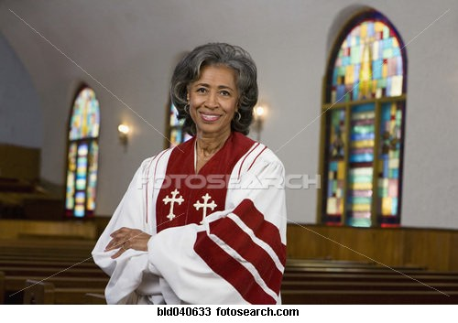
Why does the Church of Christ have no woman preachers?
Notes:
Why does the Church of Christ have ELDERS in EVERY CHURCH?

Slide 16
1 Timothy 2:11,12
“Let a woman learn in silence with all submission. And I do not permit a woman to teach or to have authority over a man, but to be in silence.”
Notes:
Text—1 Tim.2:11,12…

Slide 17
1 Corinthians 14:34
“Let your women keep silent in the churches, for they are not permitted to speak; but they are to be submissive, as the law also says.”
Notes:
Text—1 Corinthians 14:34…

Slide 18
1 Corinthians 11:3
“But I want you to know that the head of every man is Christ, the head of woman is man, and the head of Christ is God.”
Notes:
Text—1 Corinthians 11:3…

Slide 19
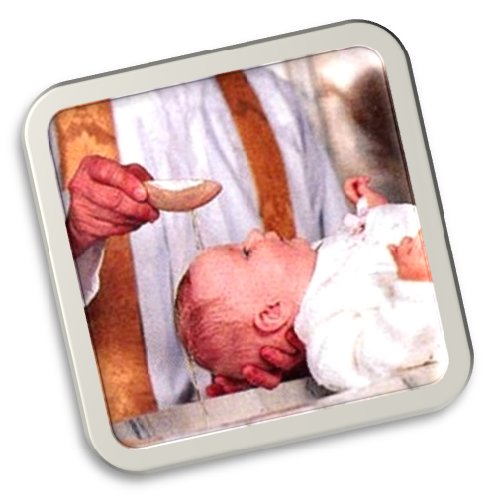
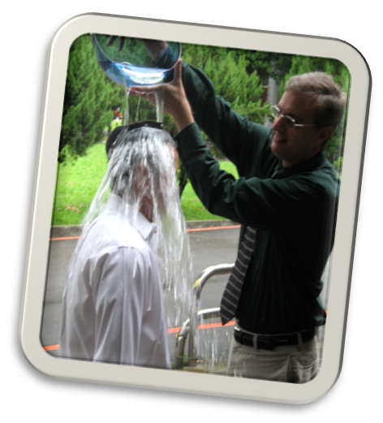
Why does the Church of Christ only practice baptism by immersion?
Notes:
Why does the Church of Christ have ELDERS in EVERY CHURCH?

Slide 20
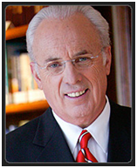
The Purpose of Baptism
“An Outward Sign of Inward Grace?”
“Baptism is the outward sign of one’s faith in Christ. It is an act of obedience by which a person demonstrates the reality of his salvation. Salvation is not visibly seen but is a supernatural, spiritual transaction. The fruit, or result of salvation, however, should be evident.” –
A Daily Touch of God’s Grace
by John MacArthur, pg 17
Notes:
Purpose of Baptism—”An Outward Sign of Inward Grace”—Quote from John MacArthur, A Daily Touch of God’s Grace (pg.17)

Slide 21
Romans 6:4
“Therefore we were buried with Him through baptism into death, that just as Christ was raised from the dead by the glory of the Father, even so we also should walk in newness of life.”
Notes:
Text—Romans 6:4…

Slide 22
Colossians 2:11,12
“In Him you were also circumcised with the circumcision made without hands, by putting off the body of the sins of the flesh, by the circumcision of Christ, buried with Him in baptism, in which you also were raised with Him through faith in the working of God, who raised Him from the dead.”
Notes:
Text—Colossians 2:11,12…

Slide 23
Acts 8:38,39
“So he commanded the chariot to stand still. And both Philip and the eunuch went down into the water, and he baptized him. Now when they came up out of the water...”
Notes:
Text—Acts 8:38,39…

Slide 24

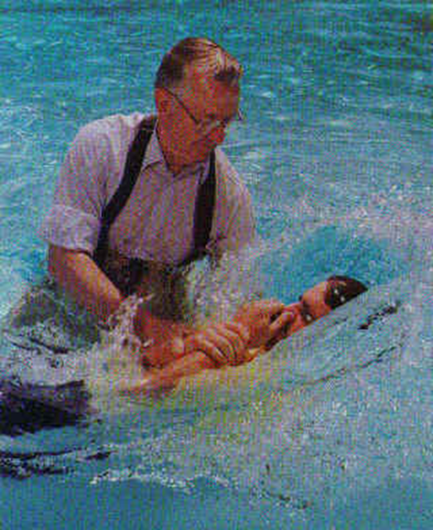

Slide 25
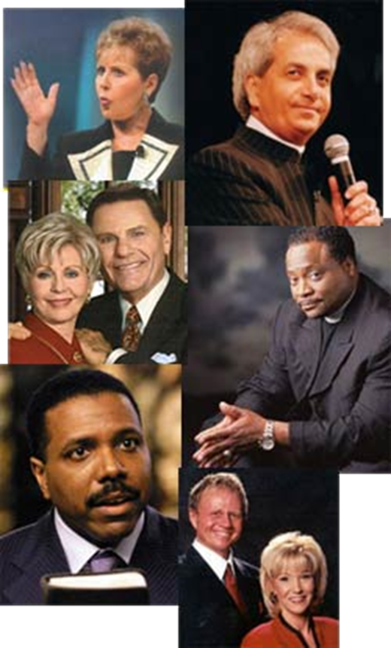
Why do the Church of Christ ministers wear no religious titles?
Reverend?
Pastor?
Father?
Most Reverend?
Notes:
Why does the Church of Christ have ELDERS in EVERY CHURCH?

Slide 26
Matthew 23:8,9
“But you, do not be called 'Rabbi'; for One is your Teacher, the Christ, and you are all brethren. Do not call anyone on earth your father; for One is your Father, He who is in heaven.”
Notes:
Text—Matt.23:8,9…

Slide 27
Psalm 111:9
“He has sent redemption to His people; He has commanded His covenant forever: Holy and awesome is His name.”
Notes:
Text—Psalm 111:9…

Slide 28
1 Timothy 3:1
“This is a faithful saying: If a man desires the position of a bishop, he desires a good work.”
Notes:
Text—1 Tim.3:1…

Slide 29
Hebrews 13:23
“Know that our brother Timothy has been set free, with whom I shall see you if he comes shortly.”
Notes:
Text—Heb.13:23…notice his title—BROTHER…

Slide 30
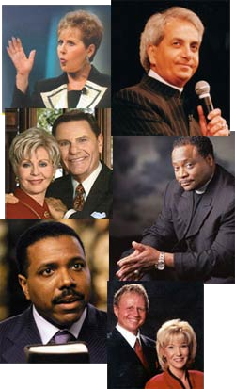
Bible Terms and Phrases
Used in Unbiblical Ways
Church
Pastor, Elder, Bishop…
Baptism
Grace
Works
Faith
Sin
Indwelling of Holy Spirit
Holy Spirit Baptism
Fellowship
Notes:
We do all these “religion leaders” of the day mean when they discuss these Bible topics…Church—Pastor, Elders, Bishops-Baptism—Grace—Works—Faith—Sin—Indwelling of Holy Spirit—Holy Spirit Baptism—Fellowship…

Slide 31
Notes:
Check out God’s answers in His book—Invitation!

