Slide 1
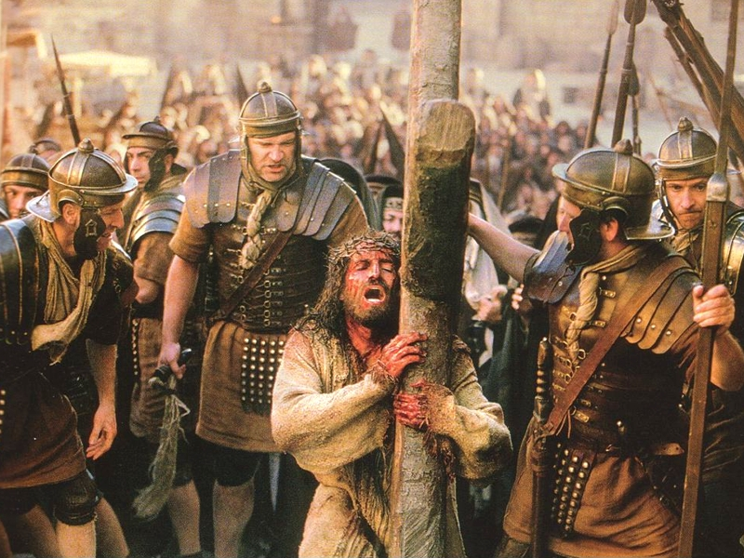
“Taking up My Cross”
“Then Jesus said to His disciples, ‘If anyone desires to come after Me, let him deny himself, and take up his cross, and follow Me.’” {Matthew 16:24}
Notes:
Title Slide: “Taking Up My Cross”—Matthew 16:24

Slide 2
Denying Myself and Taking up My Cross
What does it mean to “take up my cross?”
Context of the passages…
Many desire to follow Jesus, but don’t understand what is involved.
Jesus said to COUNT the cost.
Luke 14:28-32
Notes:
What did Jesus mean when He said that one must deny himself, take up his cross, and follow Him?
In the context of these passages, Jesus had predicted His own death. When Peter rebuked Him, Jesus responded with these statements. They refer back to what He was discussing before Peter interrupted.
Jesus said He must DIE. Regarding this, Peter had expressed a desire to follow his own will, instead of God’s. Jesus showed how His death proves we must not follow our own desires, as Peter had suggested, but God’s desires.

Slide 3
Denying Myself and Taking up My Cross
What does it mean to “take up my cross?”
Denying self…
Taking up my cross…
Following Jesus…
Losing my life…
Daily…
Notes:
What did Jesus mean when He said that one must deny himself, take up his cross, and follow Him? We will examine the answer in four points:
(1) Denying myself (2) Taking up my cross (3) Following Jesus. (4) Losing my life.

Slide 4
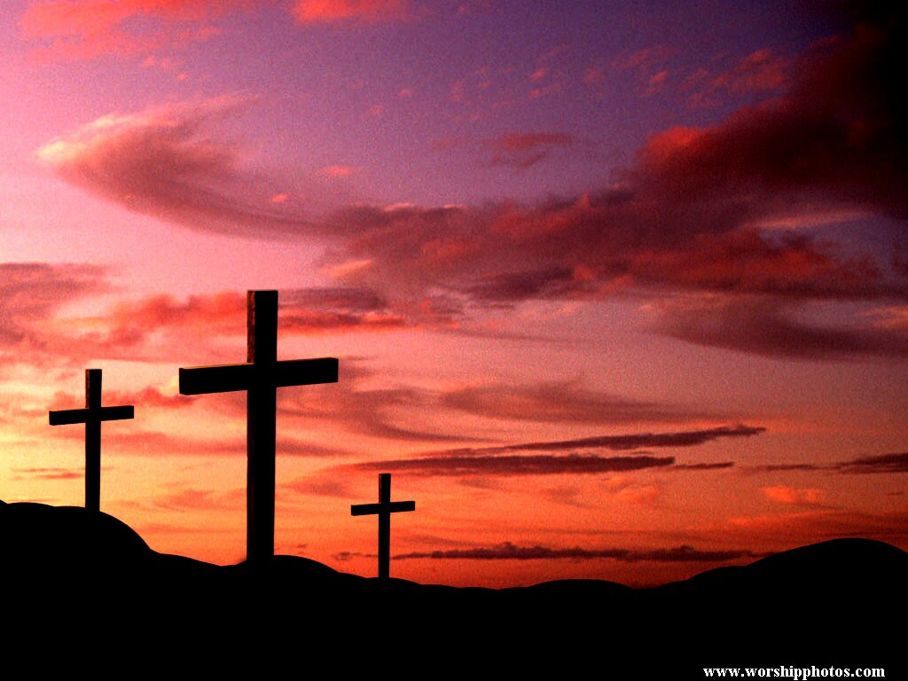
Defining Discipleship
Matthew 16:24
Notes:
Defining Discipleship…Matt.16:24

Slide 5
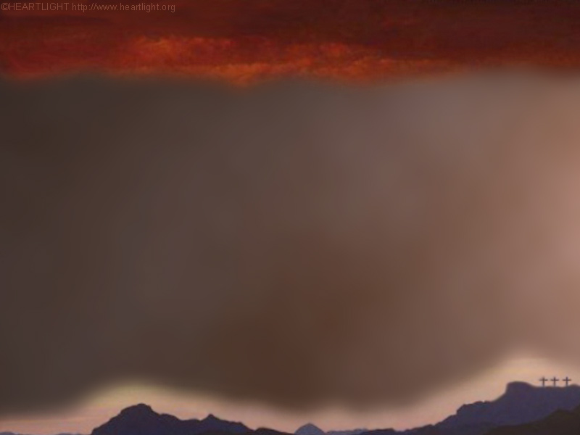
Defining Discipleship
Matthew 16:24
"If" - It is conditional
Notes:
Defining Discipleship: “IF…”—It is conditional. One must choose. Discipleship is not forced on anyone. I must base my choice on the proper motive and reason—I want to serve God!

Slide 6
Defining Discipleship
Matthew 16:24
"If" - It is conditional
"anyone" - It is open to all
Notes:
Defining Discipleship: “ANYONE”—it is open to all. This is a universal invitation. Jesus sent His disciples into “all the world,” (Matt.28:19,20; MK.16:15; LK.24:44-47).

Slide 7
Defining Discipleship
Matthew 16:24
“If" - It is conditional.
“anyone" - It is open to all.
“deny himself" - It demands total commitment.
Notes:
Defining Discipleship: “Deny Himself”—it demands total commitment.
Essential fruit of the Spirit (Gal.5:22,23; 2 Pet.1:5,6)
Denying self requires giving up anything we want or seek that could hinder our doing God’s will. This means we must take our wants and desires down from the throne and accept Jesus and His will as the governing power in our lives.
There is room for only One Master (Matt.6:24). If God rules in our lives, then our wills must become subservient to His. We must be willing to give up anything to please Him (Rom.12:2; Matt.6:33; 2 Cor.5:14,15).
Connected to judgment—good judgment (Acts 24:25).
Connected to discipline (1 Cor.9:25-27)—must be able to say NO to ourselves!

Slide 8
Defining Discipleship
Matthew 16:24
"If" - It is conditional
"anyone" - It is open to all
“deny himself" – It demands total commitment .
“his cross" – Requires personal sacrifice.
Notes:
Defining Discipleship: “HIS CROSS”—it requires personal sacrifice. Many believe this means bearing burdens and suffering hardships for the Lord. Surely such hardships will, at times, be required, but there is much more to see here.
Self-crucifixion is necessary to self-control. We must stop sinning (Rom.6:2-11). The mind is involved (Prov.23:7).
What is a cross for? It is far more than just a burden to be borne. The cross was an instrument of death and sacrifice.
Each person has his own cross, and each is different. Hence, “take up your cross” refers to giving your entire life to God, as Jesus was about to give His life for us! It involves bearing burdens, but it is still deeper. It is total dedication of life. One gives his whole life to serving God in any way He requires. This results in willing self-denial. We must live our lives as He lived His (1 Pet.2:21; Matt.34,35; 1 Cor.11:1).

Slide 9
Defining Discipleship
Matthew 16:24
"If" - It is conditional
"anyone" - It is open to all
“deny himself " - It demands total commitment .
“his cross" - Requires personal sacrifice.
"follow" - It demands action.
Notes:
Defining Discipleship: “Follow”—it demands action. This is not just lip service, but faith that is demonstrated by faithful obedience (Lk.5:20; Jam.2:18; Col.3:23-25). It includes following His examples in all things. “What would Jesus do?”—Not just a catchy phrase, but knowledge of what He would do (Jno.8:31,32; Jno.14:15; Lk.6:46).

Slide 10
Defining Discipleship
Matthew 16:24
"If " - It is conditional
"anyone" - It is open to all
"deny himself " - Demands total commitment
"his cross" - Requires personal sacrifice
"follow" - Demands action
"Me" – There’s only one model, teacher, and guide.
Notes:
Defining Discipleship: “ME”—There’s only one model, teacher, and guide. He must be our pattern for thinking, speech, and actions.

Slide 11
Defining Discipleship
Matthew 16:24
"If " - It is conditional
"anyone" - It is open to all
"deny himself " - Demands total commitment
"his cross" - Requires personal sacrifice
"follow" - Demands action
"Me" – There’s only one model, teacher, and guide.
“Daily”—Must be a continual way of life.
Notes:
Defining Discipleship: “Daily”—must be a continual way of life. Not a ONE-DAY-a-week job; it’s 24/7; 365 days per year. There’s no retirement plan! Luke adds “take up your cross daily.” (Lk.9:23) There is a sense in which Christians must give their lives to God every day. Discipleship requires daily, total self-sacrifice to do the will of Christ. Whatever He asks of me is what I must do. What I want no longer matters, I’ve given myself to Him, just as He gave Himself for me. One makes this type of determination by practicing repentance—changing his course. Stay on the right path (Matt.7;13,14) and you’ll have no regrets later (Lk.9:62).

Slide 12
The Cross…
Notes:
The Cross…Some concluding thoughts…

Slide 13
The Cross…
Demands that we transform our
wills…
Notes:
The Cross…Demands a transformation of our will…Must truly give ourselves FIRST to the Lord (2 Cor.8:5). Mortify things of the body (Col.3:5).

Slide 14
The Cross…
Demands that we transform our wills
Requires both hands (I cannot carry
anything else)
Notes:
The Cross…Requires both hands (I cannot carry anything else). There is no such thing as a “spilt allegiance” or walking the “proverbial tightrope.” Cannot hold to God and the world and carry our cross—1 Jno.2:15-17; Jam.4:4.

Slide 15
The Cross…
Demands that we transform our wills
Requires both hands (I cannot carry anything else.
It gives us a heavenly focus and goal
Notes:
The Cross…It gives us a heavenly focus and goal. Must keep our eyes on the finish line--Phil.3:12-14; Phil.3:20; 2 Tim.4:6-8; Rev.2:10.

Slide 16
The Cross…
"Therefore we also, since we are surrounded by so great a cloud of witnesses, let us lay aside every weight, and the sin which so easily ensnares us, and let us run with endurance the race that is set before us, looking unto Jesus, the author and finisher of our faith, who for the joy that was set before Him endured the cross, despising the shame, and has sat down at the right hand of the throne of God.“ {Hebrews 12:1-2}
Notes:
Summary—Invitation. What about you? Are you bearing your cross?

