Slide 1
The Majesty Of God
"The heavens declare the glory of God!" (Psalm 19:1)

Slide 2
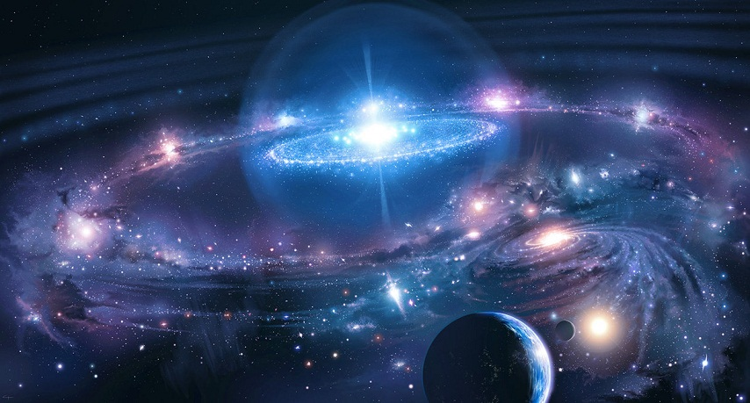
Genesis 1:1-2
“In the beginning God created the heavens and the earth. And the earth was waste and void; and darkness was upon the face of the deep: and the Spirit of God moved upon the face of the waters.” (cf. Ps. 14:1)
Man has often been a fool! Cf. Rom. 1:20ff

Slide 3
Commanded To FEAR God
Angel said, “... with a great voice, Fear God, and give him glory; for the hour of his judgment is come: and worship him that made the heaven and the earth and sea and fountains of waters.” Rev. 14:7
  “phoberós: to fear, be afraid; absolutely to be struck with fear, to be seized with alarm... to reverence, venerate, to treat with deference or reverential obedience” (Thayer) Cf. Rev. 1:13-17

Slide 4
Why Is There No Reverence?
Familiarity. 2 Sam. 6:7
  Note who Uzzah was. cf. 1 Sam. 7:1-2;
  2 Sam. 6:3
Our view of God must not be casual.
  He is the creator of heaven and earth.
  Gen. 1:1
  He caused the sun and the moon to stand still. Josh. 10:12-14
  He delivered his people from the hand of the Egyptians with wonders and signs. Ex. 7-14
  He raised his Son from the dead. Jno. 20

Slide 5
Revelation 14:7
“Fear God and give glory to Him . . .”
Ps 99:1-3 “Jehovah reigneth; let the peoples tremble: He sitteth (above) the cherubim; let the earth be moved. Jehovah is great in Zion; and he is high above all the peoples. Let them praise thy great and terrible name: Holy is he.”

Slide 6
Revelation 14:7
“Fear God and give glory to Him . . .”
Ps 111:9 “He has sent redemption to His people; He has commanded His covenant forever: Holy and awesome is His name.” NKJV
Nehemiah described God, Neh. 1:5 –
“I beseech thee, O Jehovah, the God of heaven, the great and terrible (Awesome NASV) God…”

Slide 7
Revelation 14:7
“Fear God and give glory to Him . . .”
Heb 12:28-29 “Wherefore, receiving a kingdom that cannot be shaken, let us have grace, whereby we may offer service well-pleasing to God with reverence and awe: for our God is a consuming fire.”

Slide 8
Revelation 14:7
“Fear God and give glory to Him . . .”
Ps 89:6-7 “For who in the skies can be compared unto Jehovah? Who among the sons of the mighty is like unto Jehovah, A God very terrible in the council of the holy ones, and to be feared above all them that are round about him?”

Slide 9
Revelation 14:7
“Fear God and give glory to Him . . .”
Isa 6:1-3 “In the year that king Uzziah died I saw the Lord sitting upon a throne, high and lifted up; and his train filled the temple. Above him stood the seraphim: each one had six wings; with twain he covered his face, and with twain he covered his feet, and with twain he did fly. And one cried unto another, and said, Holy, holy, holy, is Jehovah of hosts: the whole earth is full of his glory. “ Cf. Rev. 4:8-11
Sacred

Slide 10
Reverence Is A Response
To God’s Majestic Glory.
  Moses hid his face. Ex. 3:6;
  cf. Rev. 19:5; Ps. 85:9;
  2 Kgs. 19:35; Cf. Mt.26:53
  Changes who you are! Lk. 5:8
    Be holy. 1 Pet. 1:14-16
    Partakers of the divine nature. 2 Pet. 1:4
    The way you look at sin! 1 Pet. 4:3

Slide 11
Reverence Is A Response
To God’s Incredible Power.
  Noah moved with godly fear. Heb. 11:7;
  cf. 2 Pet. 3:5ff
  Abraham offered up Isaac. Heb. 11:17;
  cf. Gen. 22:11
  Ninevites repented. Jonah 3:4-5
  Believed God!!! Cf. Acts 27:22-25

Slide 12
Reverence Is A Response
To God’s Amazing Grace And Mercy. Eph. 2:8-9; cf. Rom. 3:22-26
  Will transform who you are. Rom. 11:30-32; 12:1-2

Slide 13
Without Reverence
There Is No Change
We have lots of problems!
“…. There is no fear of God before their eyes.” Rom. 3:10-18
When we stand in AWE of God, things will change.
  Dress. 1 Tim. 2:9-10
  Speech. Mt. 6:9
  Lives. 1 Cor. 6:9-11

