Slide 1
Attitudes: “What Has God Ever Done For Me?”
Ps 66:16 “Come, and hear, all ye that fear God, and I will declare what he hath done for my soul.”

Slide 2
What Has God Done For Me?
Job. Job 23:8
Asaph. Ps. 73:13
Pharaoh. Ex. 5:2 “Who is the Lord that I should obey His voice.?”
Martha & Mary and others. Jno. 11:21,
32, 37

Slide 3

What Has God Done For Me?
Given Us His Image. Gen. 1:26
James 3:8-9 “…made after the likeness of God.”
Ps. 139:14-16 “I will give thanks unto thee; for I am fearfully and wonderfully made:

Slide 4
What Has God Done For Me?
Given Us His Image. Gen. 1:26 Animals... Gen 1:24 “And God said, Let the earth bring forth living creatures after their kind, cattle, and creeping things, and beasts of the earth after their kind: and it was so.”

Slide 5
What Has God Done For Me?
Given Us His Image. Gen. 1:26
Man... Gen 1:26-27 “And God said, Let us make man in our image, …And God created man in his own image, in the image of God created he him; male and female created he them.”
Gen 1:28 “And God blessed them: and God said unto them, Be fruitful, and multiply, and replenish the earth, and subdue it;

Slide 6
What Has God Done For Me?
Given Us His Image. Gen. 1:26
Intelligence: Rom. 12:1; 6:16-17
Love: Mt. 22:35-38; 1 Jno. 4:8

Slide 7
What Has God Done For Me?
Given Us His Image. Gen. 1:26
Man turned away from God.
2 Tim. 3:2-4; Lk. 19:14; Jer. 6:16;
Isa. 30:10

Slide 8
What Has God Done For Me?
God Has Given His Son. Jno. 3:16
Why? John 1:11-12 “He came unto his own, and they that were his own received him not. But as many as received him, to them gave he the right to become children of God, (even) to them that believe on his name.”

Slide 9
What Has God Done For Me?
God Has Given His Son. Jno. 3:16
No one loved like God. Cf. Rom. 5:6ff
Note: Eph. 3:8

Slide 10
What Has God Done For Me?
God Has Given His Son. Jno. 3:16
What does that mean to you???
Gal 2:20 “I have been crucified with Christ; and it is no longer I that live, but Christ living in me: and that (life) which I now live in the flesh I live in faith, (the faith) which is in the Son of God, who loved me, and gave himself up for me.”

Slide 11
What Has God Done For Me?
God Has Given His Son. Jno. 3:16
What does that mean to you???
Phil 1:19-21 “…(so) now also Christ shall be magnified in my body, whether by life, or by death. For to me to live is Christ, and to die is gain.”
– Magnify megalunoo; to make great, magnify Matt 23:5; to deem or declare great, i. e., to esteem highly, to extol, to laud, to celebrate: Luke 1:16 (Thayer)

Slide 12

What Has God Done For Me?
God Has Given His Mind (thoughts). 1 Cor. 2:9-12
Majesty of God, in His Creation. Rom. 1:20;
Ps. 19:1
Will of God, in His word. Eph. 3:3-4; 5:17
God has spoken. Heb. 1:1-2
Rom. 1:16
Phil. 2:16
2 Thess. 2:14-15
Mk. 16:16
Mt. 19:9
2 Tim. 3:16-17

Slide 13
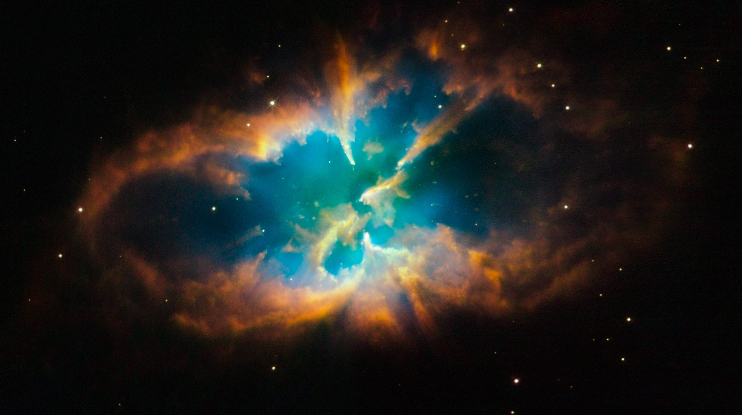
What Has God Done For Me?
God Has Given Us His Promise. John 14:2 A New Home!
Ps 33:13-14 “Jehovah looketh from heaven; He beholdeth all the sons of men; From the place of his habitation he looketh forth upon all the inhabitants of the earth”
Rom. 8:17 Heirs of God.
2 Cor. 4 – 5 House not made with hands.
Heb. 11:9-16 City with foundations, heavenly.

Slide 14
What Has God Done For Me?
Given Us His Image. Gen. 1:26-27
Given Us His Son. John 3:16
Given Us His Thoughts. 1 Cor. 2:9-12
Given Us His Promise. John 14:2

