Slide 2
Vanity of Vanities
The Meaning of Life, Revealed in the Scriptures (Ecclesiastes)
“‘Vanity of vanities,’ says the Preacher; ‘Vanity of vanities, all is vanity.’”
Ecclesiastes 1:2
Notes:
Preached at the Loop 287 church of Christ in Lufkin, TX
March 22, 2015 AM Class

Slide 3
Two Philosophies of Life
Humanism
Definition: (Websters) - a philosophy that asserts the dignity and worth of man and his capacity for self-realization through reason and that often rejects supernaturalism
Man is the sum of all things, and self-sufficient
Theism
Definition: (Websters) - belief in the existence of one God viewed as the creative source of man and the world who transcends yet is immanent in the world

Slide 4
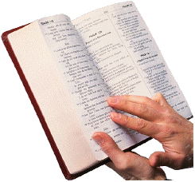
Genesis 1:1-2
“In the beginning God created the heavens and the earth. ² The earth was without form, and void; and darkness was on the face of the deep. And the Spirit of God was hovering over the face of the waters.”
Christians believe in God, and look to Him as our Creator and Savior.

Slide 5
Jeremiah 10:23
“O LORD, I know the way of man is not in himself; It is not in man who walks to direct his own steps.”
Christians recognize their inability for self-realization through reason, as humanists claim.

Slide 6
2 Timothy 3:16-17
“All Scripture is given by inspiration of God, and is profitable for doctrine, for reproof, for correction, for instruction in righteousness, ¹⁷ that the man of God may be complete, thoroughly equipped for every good work.”
Christians recognize their dependence upon scripture to reveal God’s will to them; i.e. - the Bible has the answers to life.

Slide 7
What About Humanism?
The Premise of our Lesson: Life lived without respect to God is Vain
“Under the Sun” (30 times)
“Under Heaven” (3 times)
In effect, life lived without any acknowledgment of God. Such life is characterized in the book of Ecclesiastes as VAIN!

Slide 8
Ecclesiastes 1:1-2
“The words of the Preacher, the son of David, king in Jerusalem. ‘Vanity of vanities,’ says the Preacher; ‘Vanity of vanities, all is vanity.’”

Slide 9
The Humanistic View of Life
Introductory statement of the book of Ecclesiastes:
Life in general is Vain!
Ecclesiastes 1:3-8

Slide 10
Ecclesiastes 1:3-8
“What profit has a man from all his labor In which he toils under the sun? ⁴ One generation passes away, and another generation comes; But the earth abides forever. ⁵ The sun also rises, and the sun goes down, And hastens to the place where it arose. ⁶ The wind goes toward the south, And turns around to the north; The wind whirls about continually, And comes again on its circuit. ⁷ All the rivers run into the sea, Yet the sea is not full; To the place from which the rivers come, There they return again. ⁸ All things are full of labor; Man cannot express it. The eye is not satisfied with seeing, Nor the ear filled with hearing.”

Slide 11
The Vanity of Men’s Accomplishments
“I have seen all the works that are done under the sun; and indeed, all is vanity and grasping for the wind.” (1:14)
The “Unsinkable” Titanic

Slide 12
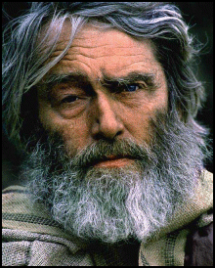
The Vanity of Wisdom
“And I set my heart to know wisdom and to know madness and folly. I perceived that this also is grasping for the wind. For in much wisdom is much grief, And he who increases knowledge increases sorrow.”
(1:17-18)
Compare to the bliss of a small child
Notes:
Happiness of my granchildren

Slide 13
The Vanity of Pursuing Pleasure
“I said in my heart, Come now, I will test you with mirth; therefore enjoy pleasure; but surely, this also was vanity. I said of laughter; Madness!; and of mirth, What does it accomplish?”
(2:1-2)
Hedonism & Narcissism characteristic of our culture

Slide 14
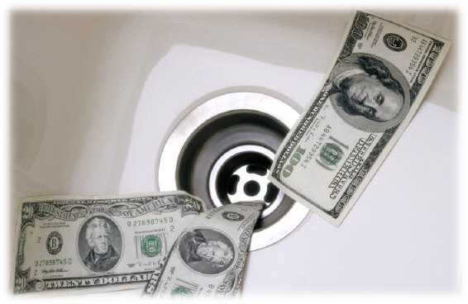
The Vanity of Material Possessions
“He who loves silver will not be satisfied with silver; Nor he who loves abundance, with increase. This also is vanity.”
(5:10)
“He/She who dies with the most things, WINS!”

Slide 15
The Vanity of Work
“Therefore I hated life because the work that was done under the sun was distressing to me, for all is vanity and grasping for the wind. Then I hated all my labor in which I had toiled under the sun, because I must leave it to the man who will come after me. And who knows whether he will be wise or a fool? Yet he will rule over all my labor in which I toiled and in which I have shown myself wise under the sun. This also is vanity.” (2:17-19)

Slide 16
The End of Humanism
Man is no better than the animals
Ecclesiastes 3:18-20

Slide 17
Ecclesiastes 3:18-20
“I said in my heart, ‘Concerning the condition of the sons of men, God tests them, that they may see that they themselves are like animals.’ ¹⁹ For what happens to the sons of men also happens to animals; one thing befalls them: as one dies, so dies the other. Surely, they all have one breath; man has no advantage over animals, for all is vanity. ²⁰ All go to one place: all are from the dust, and all return to dust.”

Slide 18
The End of Humanism
Man is no better than the animals
Ecclesiastes 3:18-20
Humanism, Atheism, Evolution
Deny that man is anything other than an animal

Slide 19
The End of Humanism
Man is no better than the animals
Ecclesiastes 3:18-20
Humanism, Atheism, Evolution
Deny that man is anything other than an animal
Environmental Paganism
Equates the value of plants and animals with that of man

Slide 20
The End of Humanism
Man is no better than the animals
Ecclesiastes 3:18-20
Humanism, Atheism, Evolution
Deny that man is anything other than an animal
Environmental Paganism
Equates the value of plants and animals with that of man
Nihilism
The eventual end of humanism. Men who depend upon self will see only frustration.

Slide 21
Jeremiah 23:16-20
“Thus says the LORD of hosts: ‘Do not listen to the words of the prophets who prophesy to you. They make you worthless; They speak a vision of their own heart, Not from the mouth of the LORD. ¹⁷ They continually say to those who despise Me, “The LORD has said, ‘You shall have peace’” ; And to everyone who walks according to the dictates of his own heart, they say, “No evil shall come upon you.” …

Slide 22
Jeremiah 23:16-20
…“For who has stood in the counsel of the LORD, And has perceived and heard His word? Who has marked His word and heard it? ¹⁹ Behold, a whirlwind of the LORD has gone forth in fury; A violent whirlwind! It will fall violently on the head of the wicked. ²⁰ The anger of the LORD will not turn back Until He has executed and performed the thoughts of His heart. In the latter days you will understand it perfectly.”

Slide 23
Conclusion: All Is Vanity!
“‘Vanity of vanities,’ says the Preacher; ‘All is vanity.’”
Ecclesiastes 12:8
There is NO ultimate, sustained joy or worth in life lived under the sun. (Without respect to God)

Slide 24
So, Why Am I Here?
I am here to serve God!
Lasting joy is found only in service to the Almighty
Ecclesiastes 12:13-14
2 Timothy 4:7-8

Slide 25
Ecclesiastes 12:13-14
“Let us hear the conclusion of the whole matter: Fear God and keep His commandments, For this is man's all. ¹⁴ For God will bring every work into judgment, Including every secret thing, Whether good or evil.”
Lasting joy is found only in this.
It is the Meaning of Life !

Slide 26
2 Timothy 4:7-8
“I have fought the good fight, I have finished the race, I have kept the faith. ⁸ Finally, there is laid up for me the crown of righteousness, which the Lord, the righteous Judge, will give to me on that Day, and not to me only but also to all who have loved His appearing.”
The end of life lived for God!

