Slide 2
Our God, He Is Alive
Hymns for Worship #9

Slide 3
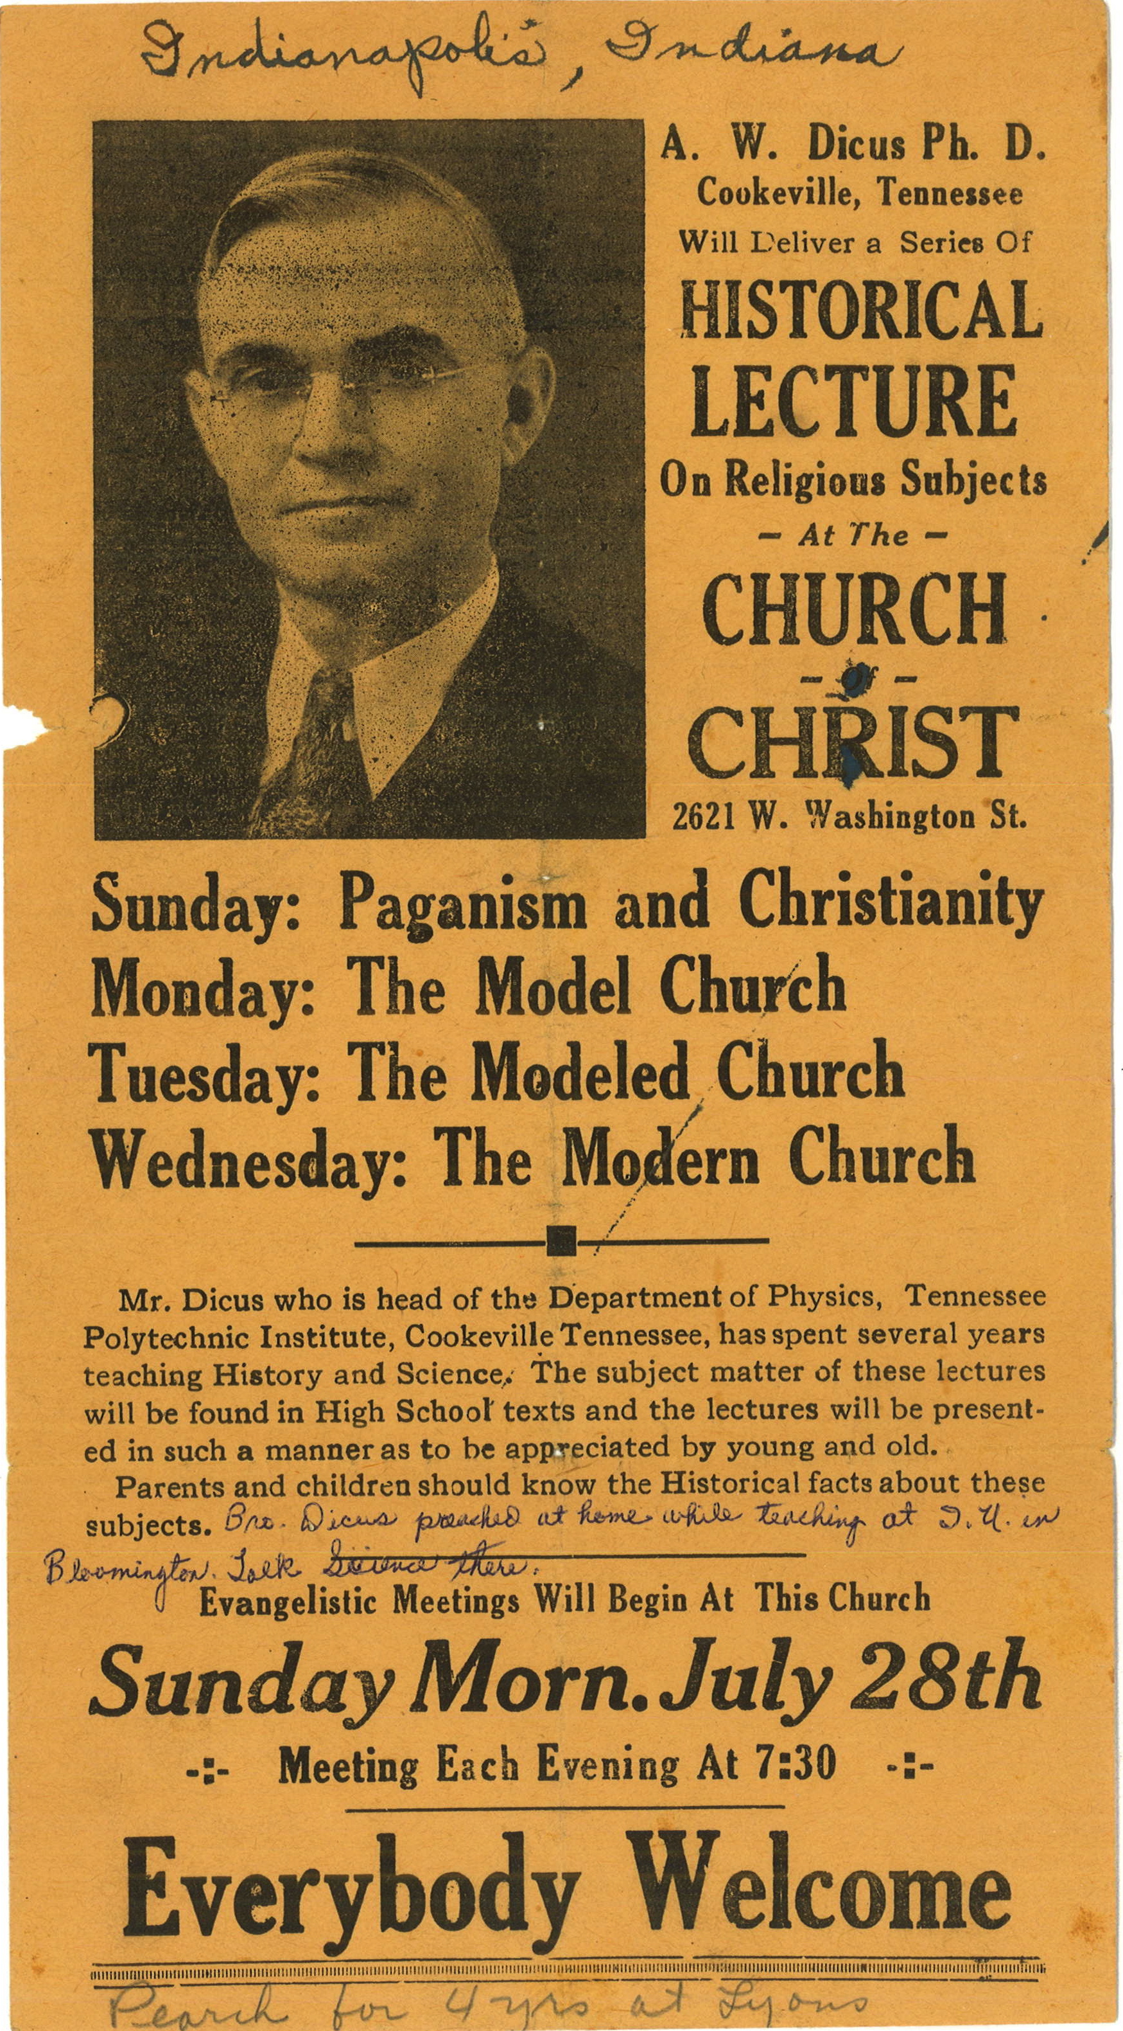
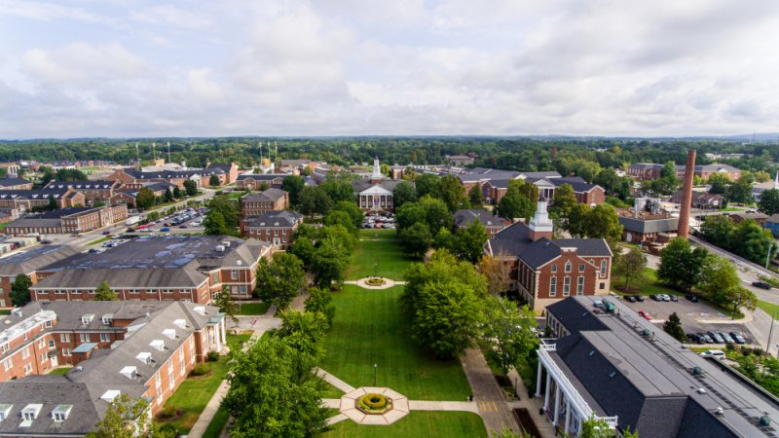
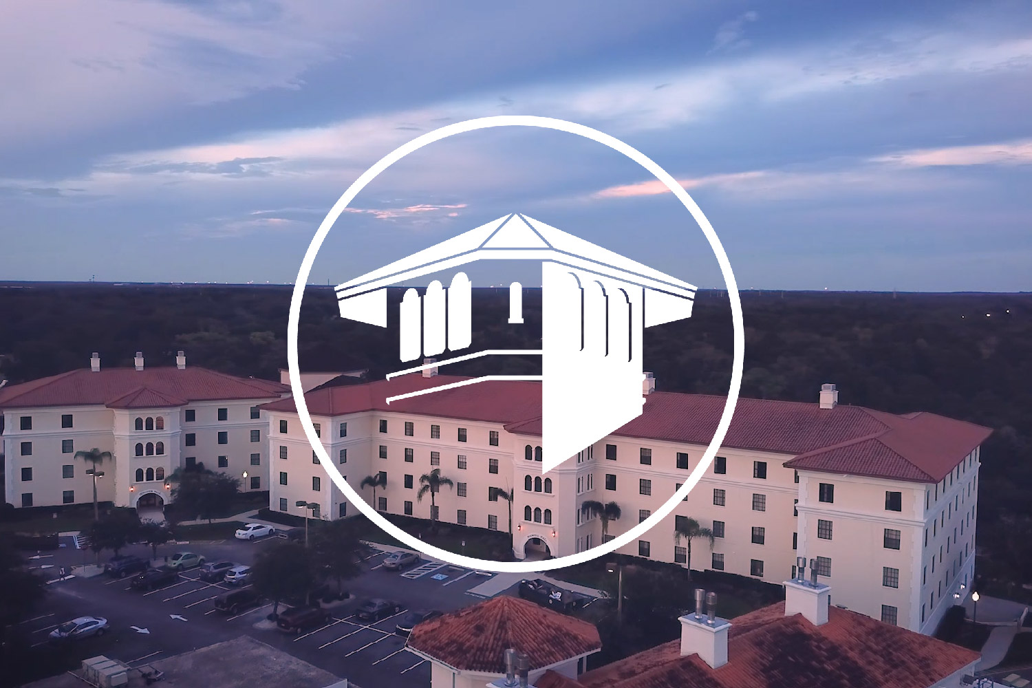
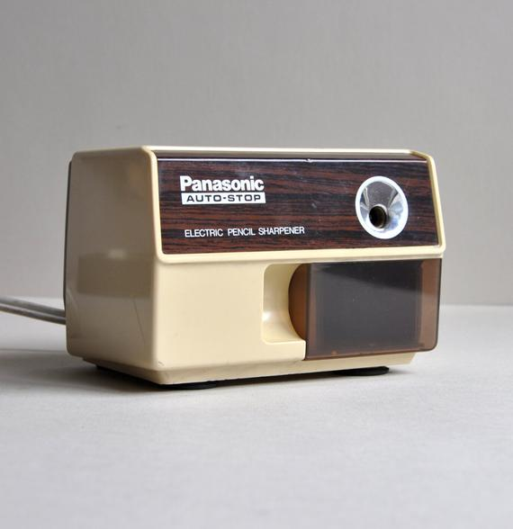
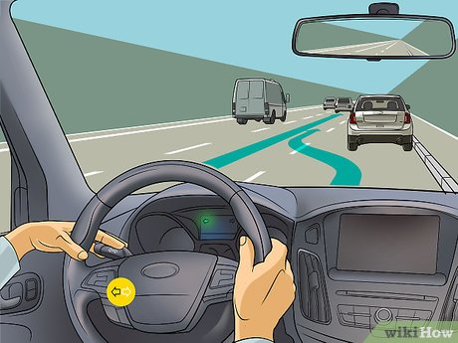
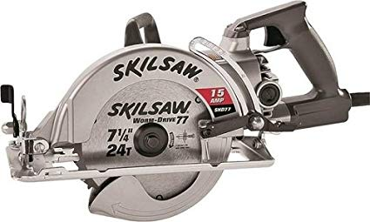
Our God, He Is Alive
A.W. Dicus 1888-1978
Inventor of the automobile turn signal.
Inventor of electric pencil sharpener.
Inventor of the skill saw.
Became head of the science department at Tennessee Tech. Consulted for the US Govt. on nuclear program.
Became dean of FC in 1950
In his late 60s he wrote music

Slide 4
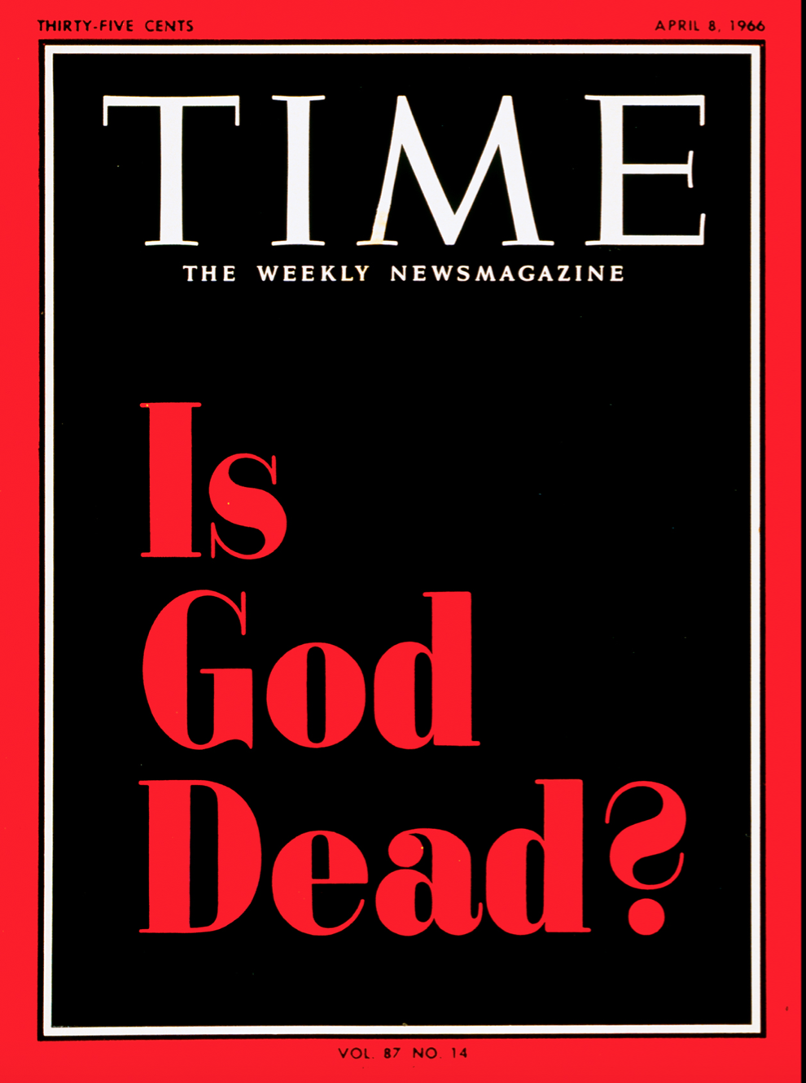
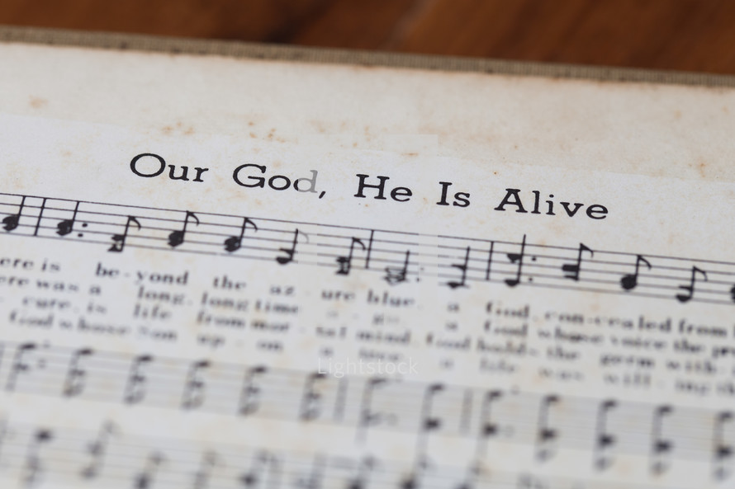
Our God, He Is Alive
A.W. Dicus 1888-1978
He was 68 years old when he wrote Our God, He is Alive.
It was in response to the “God is Dead” movement.
Brother Dicus loved God and was devoted to truth.
“Brother Dicus occasionally would call on the phone to express his appreciation for some point in a lesson. I never had a more appreciative listener.” (Irvin Himmel)

Slide 5
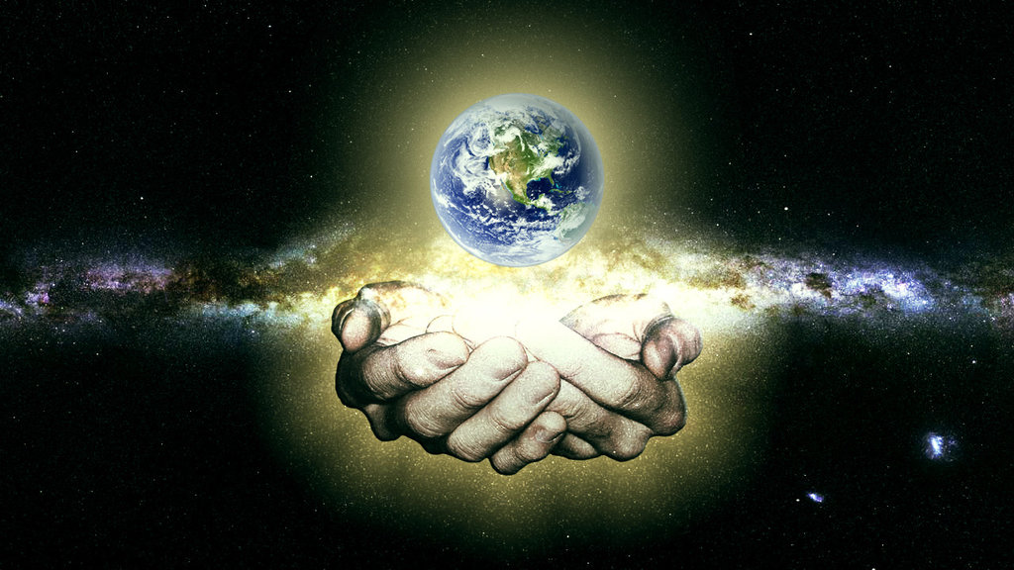
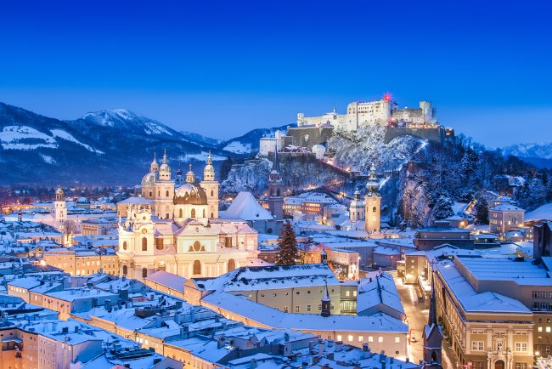
Our God, He Is Alive
There is beyond the azure blue, a God, concealed from human sight, He tinted skies with heavenly hue and framed the worlds with His great might.
Heb. 11:3, Ps. 33:4-15, 19:1-4

Slide 6
Our God, He Is Alive
There is beyond the azure blue, a God, concealed from human sight, He tinted skies with heavenly hue and framed the worlds with His great might.
There was, a long, long time ago, a God whose voice the prophets heard, He is the God that we should know, who speaks from His inspired Word.
2 Pet. 1:19-21, 2 Tim. 3:16-17, Heb. 4:12, 1:1-2

Slide 7
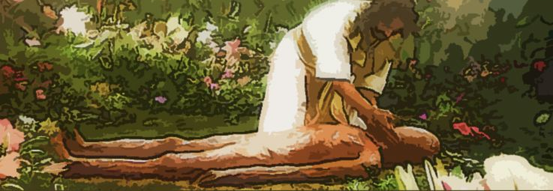
Our God, He Is Alive
There is beyond the azure blue, a God, concealed from human sight, He tinted skies with heavenly hue and framed the worlds with His great might.
There was, a long, long time ago, a God whose voice the prophets heard, He is the God that we should know, who speaks from His inspired Word.
Secure, is life from mortal mind, God holds the germ within His hand, Tho’ men may search, they cannot find, for God alone does understand.
Gen. 2:7, 1:26-28, Ps. 139:13-14

Slide 8
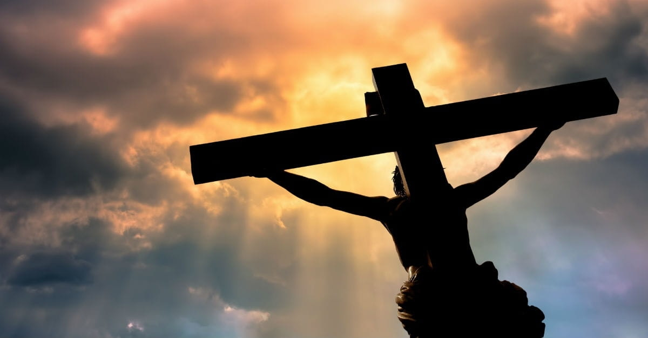
Our God, He Is Alive
There is beyond the azure blue, a God, concealed from human sight, He tinted skies with heavenly hue and framed the worlds with His great might.
There was, a long, long time ago, a God whose voice the prophets heard, He is the God that we should know, who speaks from His inspired Word.
Secure, is life from mortal mind, God holds the germ within His hand, Tho’ men may search, they cannot find, for God alone does understand.
Our God, whose Son upon a tree, a life was willing there to give, that He from sin might set man free, and evermore with Him could live.
Rom. 5:8-9, Jn. 8:31-36, Matt. 25:34

Slide 9
Our God, He Is Alive
There is beyond the azure blue, a God, concealed from human sight, He tinted skies with heavenly hue and framed the worlds with His great might.
There was, a long, long time ago, a God whose voice the prophets heard, He is the God that we should know, who speaks from His inspired Word.
Secure, is life from mortal mind, God holds the germ within His hand, Tho’ men may search, they cannot find, for God alone does understand.
Our God, whose Son upon a tree, a life was willing there to give, that He from sin might set man free, and evermore with Him could live.
There is a God, He is alive, in Him we live, and we survive; From dust our God created man, He is our God, the great I AM.

Slide 10
Our God, He Is Alive
April 12, 1961 Yuri Gagarin was the first into space.
Nikita Khrushchev said afterwards, “Gagarin flew into space, but didn’t see any God there.”
The God is dead movement was alive and well. The Time Magazine would be released a few years later.
But at that time many Americans didn’t believe it as seen in the following…

Slide 11
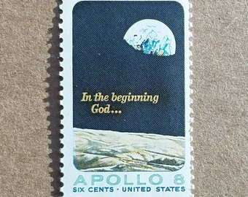
Our God, He Is Alive
December 24, 1968 the crew of Apollo 8 went into outer space and circled the moon. The most televised event of all time!
And before an audience of a billion people the astronauts took turns reading Genesis 1:1-10
“And from the crew of Apollo 8, we close with good night, good luck, a merry Christmas, and God bless all of you - all of you on the good Earth.”

Slide 12
Our God, He Is Alive
Brother Dicus died Sept. 2, 1978 at age 90.
“If the Lord will allow me to get an education, I will use it in service to the Lord.”
Every time we sing this song, he being dead still speaks, and God is glorified by a man who had a vow to keep!
May we use all our talents for God as well!

Slide 13
Our God, He Is Alive
There is beyond the azure blue, a God, concealed from human sight, He tinted skies with heavenly hue and framed the worlds with His great might.
There was, a long, long time ago, a God whose voice the prophets heard, He is the God that we should know, who speaks from His inspired Word.
Secure, is life from mortal mind, God holds the germ within His hand, Tho’ men may search, they cannot find, for God alone does understand.
Our God, whose Son upon a tree, a life was willing there to give, that He from sin might set man free, and evermore with Him could live.
There is a God, He is alive, in Him we live, and we survive; From dust our God created man, He is our God, the great I AM.

Slide 15
Our God, He Is Alive
There is beyond the azure blue, a God, concealed from human sight, He tinted skies with heavenly hue and framed the worlds with His great might.
There was, a long, long time ago, a God whose voice the prophets heard, He is the God that we should know, who speaks from His inspired Word.
Secure, is life from mortal mind, God holds the germ within His hand, Tho’ men may search, they cannot find, for God alone does understand.
Our God, whose Son upon a tree, a life was willing there to give, that He from sin might set man free, and evermore with Him could live.
There is a God, He is alive, in Him we live, and we survive; From dust our God created man, He is our God, the great I AM.

