Slide 2
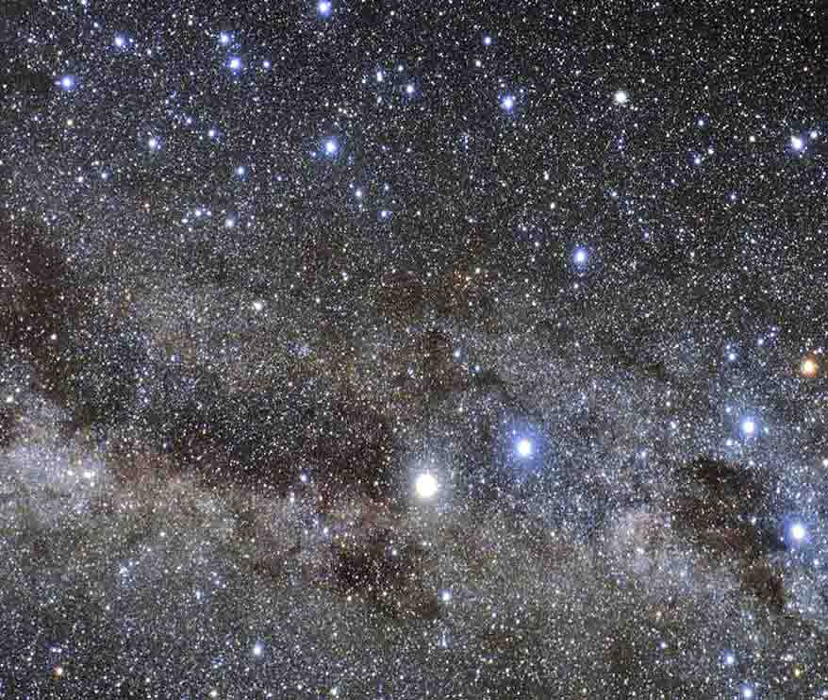
ETERNITY
“perpetuity, eternity” (Davidson, 587)
“1. infinite time; duration without beginning or end.
2. eternal existence, especially as contrasted with mortal life: the eternity of God.
3. Theology. the timeless state into which the soul passes at a person's death.”
http://www.dictionary.com/browse/eternity (6/16)

Slide 3
The beginning
Today

Slide 4
I. “IN THE BEGINNING”
Gen. 1:1, …God created the heavens and the earth.

Slide 5
Ps. 19:1, The heavens declare the glory of God; And the firmament shows His handiwork. 2 Day unto day utters speech, And night unto night reveals knowledge.
3 There is no speech nor language where their voice is not heard.

Slide 6
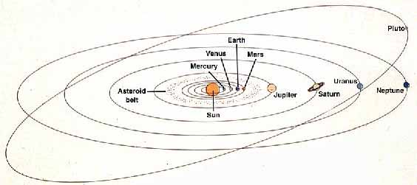
LAWS HOLD THE PLANETS IN ORBIT
LAW EVIDENCES A LAWGIVER
A LAWGIVER MUST EXIST
Gen. 1:1, …God created the heavens and the earth.

Slide 7
Design
1. Design demands a designer.
2. Creation evidences design.
3. Therefore, there must be a Designer of creation.

Slide 8
I. “IN THE BEGINNING”
Man and woman as God created them
Gen. 1:26, Then God said, Let Us make man in Our image, according to Our likeness; let them have dominion over the fish of the sea, over the birds of the air, and over the cattle, over all the earth and over every creeping thing that creeps on the earth. 27 So God created man in His own image; in the image of God He created him; male and female He created them.

Slide 9
I. “IN THE BEGINNING”
Man and woman as God created them
Gen 3:3, But of the fruit of the tree which is in the midst of the garden, God has said, You shall not eat it, nor shall you touch it, lest you die.
7 Then the eyes of both of them were opened, and they knew that they were naked; and they sewed fig leaves together and made themselves coverings.
10 So he said, I heard Your voice in the garden, and I was afraid because I was naked; and I hid myself.
Memory
Conscience
Fear

Slide 10
II. TIME AND ETERNITY

Slide 11
Gen. 1:14, Then God said, Let there be lights in the firmament of the heavens to divide the day from the night; and let them be for signs and seasons, and for days and years; 15 and let them be for lights in the firmament of the heavens to give light on the earth; and it was so. 16 Then God made two great lights: the greater light to rule the day, and the lesser light to rule the night. He made the stars also.
17 God set them in the firmament of the heavens to give light on the earth, 18 and to rule over the day and over the night, and to divide the light from the darkness. And God saw that it was good. 19 So the evening and the morning were the fourth day.

Slide 12
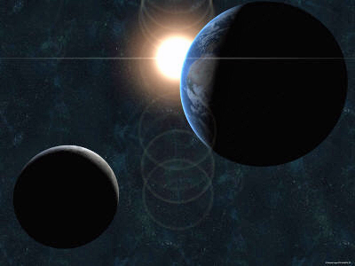
“days and years”

Slide 13
Eternity
Ps. 90:1, Lord, You have been our dwelling place in all generations. 2 Before the mountains were brought forth, or ever You had formed the earth and the world, even from everlasting to everlasting, You are God. 3 You turn man to destruction, and say, Return, O children of men. 4 For a thousand years in Your sight are like yesterday when it is past, and like a watch in the night.

Slide 14
III. GOD “INHABITS” ETERNITY

Slide 15
Isa. 57:15, For thus says the One who is high and lifted up, who inhabits eternity, whose name is Holy: I dwell in the high and holy place, and also with him who is of a contrite and lowly spirit, to revive the spirit of the lowly, and to revive the heart of the contrite. (ESV)

Slide 16
Isa. 57:15, For thus says the One who is high and lifted up, who inhabits eternity, whose name is Holy: I dwell in the high and holy place, and also with him who is of a contrite and lowly spirit, to revive the spirit of the lowly, and to revive the heart of the contrite. (ESV)

Slide 17
III. GOD “INHABITS” ETERNITY
He constantly abides

Slide 18
Ex. 3:13, Then Moses said to God, Indeed, when I come to the children of Israel and say to them, The God of your fathers has sent me to you, and they say to me, What is His name? what shall I say to them? 14 And God said to Moses, I AM WHO I AM. And He said, Thus you shall say to the children of Israel, I AM has sent me to you.
Ps. 90:1, Lord, You have been our dwelling place in all generations.
Ps. 50:12, If I were hungry, I would not tell you; For the world is Mine, and all its fullness.

Slide 19
III. GOD “INHABITS” ETERNITY
He constantly abides
He is omnipresent
2 Chrn. 2:6, But who is able to build Him a temple, since heaven and the heaven of heavens cannot contain Him? Who am I then, that I should build Him a temple, except to burn sacrifice before Him?
Jer. 23:24, Can anyone hide himself in secret places, So I shall not see him? says the LORD; Do I not fill heaven and earth? says the LORD.

Slide 20
III. GOD “INHABITS” ETERNITY
He constantly abides
He is omnipresent
He is omniscient

Slide 21
Mat. 10:30, But the very hairs of your head are all numbered.
Heb. 1:13, And there is no creature hidden from His sight, but all things are naked and open to the eyes of Him to whom we must give account.
Dan. 2:22, He reveals deep and secret things; He knows what is in the darkness, And light dwells with Him.

Slide 22
Isa. 57:15, For thus says the One who is high and lifted up, who inhabits eternity, whose name is Holy: I dwell in the high and holy place, and also with him who is of a contrite and lowly spirit, to revive the spirit of the lowly, and to revive the heart of the contrite. (ESV)

Slide 23
III. GOD “INHABITS” ETERNITY
He constantly abides
He is omnipresent
He is omniscient
He is omnipotent

Slide 24
Dan. 4:35, All the inhabitants of the earth are reputed as nothing; He does according to His will in the army of heaven And among the inhabitants of the earth. No one can restrain His hand Or say to Him, What have You done?
Eph. 3:20, Now to Him who is able to do exceedingly abundantly above all that we ask or think, according to the power that works in us…
Job 42:2, I know that You can do everything, And that no purpose of Yours can be withheld from You.
Matt. 19:26, But Jesus looked at them and said to them, With men this is impossible, but with God all things are possible.

Slide 25
III. GOD “INHABITS” ETERNITY
He constantly abides
He is omnipresent
He is omniscient
He is omnipotent
He is unchangeable

Slide 26
Num. 23:19, God is not a man, that He should lie, Nor a son of man, that He should repent. Has He said, and will He not do? Or has He spoken, and will He not make it good?
Ps. 33:11, The counsel of the LORD stands forever, The plans of His heart to all generations.
Jas. 1:17, Every good gift and every perfect gift is from above, and comes down from the Father of lights, with whom there is no variation or shadow of turning.

Slide 27
III. GOD “INHABITS” ETERNITY
He constantly abides
He is omnipresent
He is omniscient
He is omnipotent
He is unchangeable
He gives life
Jno. 5:26. For as the Father has life in Himself, so He has granted the Son to have life in Himself.

Slide 28
ETERNITY
I. “IN THE BEGINNING”
II. TIME AND ETERNITY
III. GOD “INHABITS” ETERNITY
He constantly abides
He is omnipresent
He is omniscient
He is omnipotent
He is unchangeable
He gives life

Slide 29
The beginning
Today

Slide 30
2 Cor. 4:18 … For the things which are seen are temporary, but the things which are not seen are eternal.

Slide 31
Isa. 40:28, Have you not known? Have you not heard? The everlasting God, the LORD, The Creator of the ends of the earth, Neither faints nor is weary. His understanding is unsearchable. 29 He gives power to the weak, And to those who have no might He increases strength. 30 Even the youths shall faint and be weary, And the young men shall utterly fall, 31 But those who wait on the LORD Shall renew their strength; They shall mount up with wings like eagles, They shall run and not be weary, They shall walk and not faint.

