Slide 1
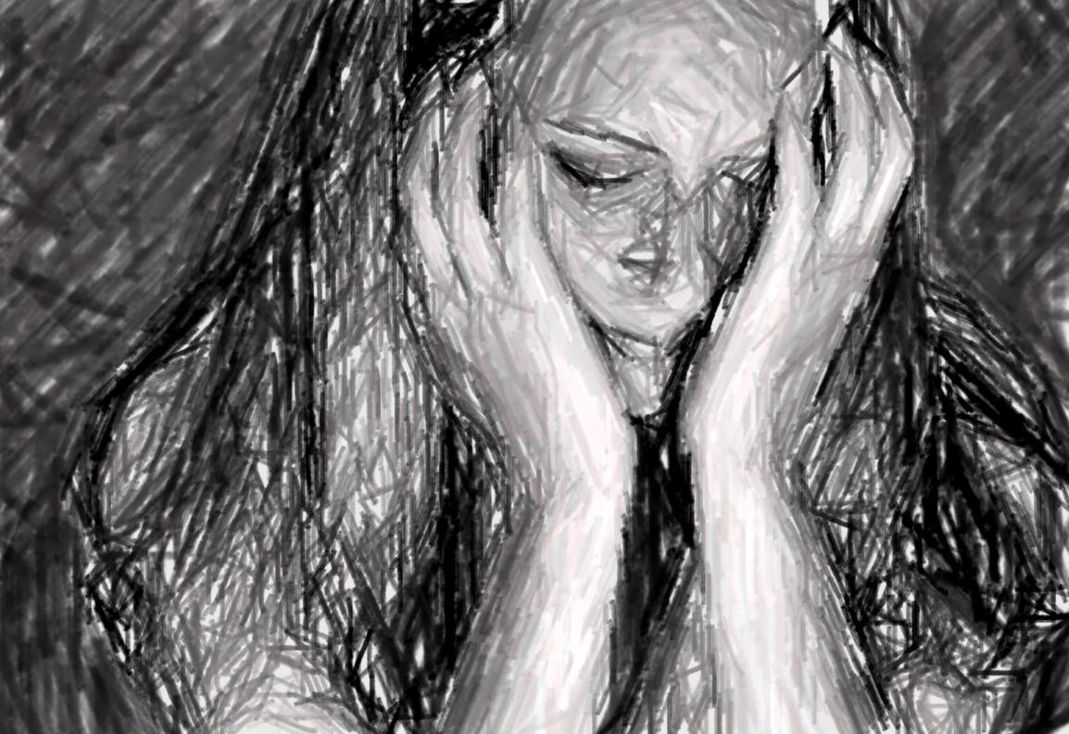
THE TRUTH
Concerning Suffering & Grief

Slide 2
Job Reminisced His Past (29:1-6)
“In the days when God watched over me” (29:2) is defined by Job as before he suffered:
In months past (v. 2)
When God’s lamp was upon Job’s head (v. 3)
When God’s friendly counsel was over him (v. 4)
When God was with him (v. 5)
When his children were around him (v. 5)
When his steps bathed in cream (v. 6)
Further defined when people adorned him with honor (29:7-30)

Slide 3
Charges:
God has taken away my justice (27:2)
God is no longer watching me (29:2)
God no longer shines upon my head (29:3)
God’s friendly counsel is no longer over me (29:4)
God is no longer with me (29:5)
God does not answer me when I cry (30:20, 24)
GOD
JOB

Slide 4
Elihu’s Correct Rebuke (Job 33:8-13)
8 "Surely you have spoken in my hearing, And I have heard the sound of your words, saying,
9 ‘I am pure, without transgression; I am innocent, and there is no iniquity in me.
10 Yet He finds occasions against me, He counts me as His enemy;
11 He puts my feet in the stocks, He watches all my paths.’
12 "Look, in this you are not righteous. I will answer you, For God is greater than man.
13 Why do you contend with Him? For He does not give an accounting of any of His words.

Slide 5
Oppressions (Job 35:9)
Job 35:9-16
Multitude of oppressions (9)
Job understood the world was filled with a multitude of oppressions (24:1-12)
Became perplexed why God’s government would allow the wicked to prosper (12:6; 21:7ff)

Slide 6
No One Says (Job 35:10)
Job 35:9-16
But no one says… (10)
Elihu’s counter is that even the general class of sufferers do not inquire of God where songs can be found in calamity (cf. Acts 16:25)
The oppressor and the oppressed both fail!

Slide 7
Who Teaches (Job 35:11)
Job 35:9-16
Who teaches us more than the beasts (11)
Man was given the capacity to learn and understand
The one who refuses to learn and grow in adversity is like a beast in the animal kingdom
An animal may roar and cry in hardship, but does not appeal to God

Slide 8
Cry Out… (Job 35:12)
Job 35:9-16
There they cry out, but He does not answer (12)
To cry out in complaint is not a prayer for mercy
Take care to not cry against God, but to God
“They blasphemed the God of heaven because of their pains and their sores, and did not repent of their deeds” (Rev. 16:11)

Slide 9
Pride (Job 35:12)
Job 35:9-16
Because of the pride of evil men (12)
Pride—man’s downfall!
A universal plague—even in the oppressed
Leviathan was brought before Job for this very purpose (Job 41:33, 34)
No man would debate, question or challenge Leviathan.
But who created Leviathan?
Is man “duty-bound” to submit to God only if he can “reason out” the moral government of God?

Slide 10
Empty Talk (Job 35:13)
Job 35:9-16
God will not listen to empty talk (13)
How often do men utter empty words when afflicted?
“Why has God brought this upon me?”
“How can a God of love allow so much suffering?”
“It must be God’s will!”
Ecclesiastes 5:1, 2

Slide 11
Call &Wait (Job 35:14-16)
Job 35:9-16
14 Although you say you do not see Him, Yet justice is before Him, and you must wait for Him.
15 And now, because He has not punished in His anger, Nor taken much notice of folly,
16 Therefore Job opens his mouth in vain; He multiplies words without knowledge."
14 Although you say you do not see Him, Yet justice is before Him, and you must wait for Him.
15 And now, because He has not punished in His anger, Nor taken much notice of folly,
16 Therefore Job opens his mouth in vain; He multiplies words without knowledge."

Slide 12
2 Timothy 4:1-5

Slide 13
A. The seriousness in the charge to preach the word

Slide 14
B. The steadfastness in the charge to preach the word

Slide 15
C. The vigilance in the charge to preach the word

Slide 16
D. The suffering in the charge to preach the word

Slide 17
“God And Suffering”

Slide 18
Is There Any Value In Suffering?
Question 1

Slide 19
James 1:2-4
2 My brethren, count it all joy when you fall into various trials,
3 knowing that the testing of your faith produces patience.
4 But let patience have its perfect work, that you may be perfect and complete, lacking nothing.
FIND
| FAITH
| FRUIT

Slide 20
Romans 5:1-4
1 Therefore, having been justified by faith, we have peace with God through our Lord Jesus Christ,
2 through whom also we have access by faith into this grace in which we stand, and rejoice in hope of the glory of God.
3 And not only that, but we also glory in tribulations, knowing that tribulation produces perseverance;
4 and perseverance, character; and character, hope.

Slide 21
Is There Any Value In Suffering?
Question 1
YES!

Slide 22
Is SUFFERING COMPATIBLE WITH A LOVING GOD?
Question 2

Slide 23
Atheists Commonly Use Suffering Against God
Vulture meat is edible (1 Tim. 4:4)!
What have atheists given this child?
God is not in the Catholic Church and has not performed any signs through them (2 Thess. 2:8, 9; 1 Tim. 3:1ff; Matt. 23:9; 1 Pet. 2:9)
Posted by, Yemisi Ilesanmi, freethoughtsblog.com

Slide 24
Atheists Commonly Use Suffering Against God
If evolution and “survival of the fittest” is good, then why is this picture not good to atheists?
If God did cure some people, atheists would still complain that He doesn’t exist because He did not cure all people
Posted by, Yemisi Ilesanmi, freethoughtsblog.com

Slide 25
Atheists Commonly Use Suffering Against God
If their literature is taken seriously, God can never exist if anyone ever suffers and dies
Posted by, Yemisi Ilesanmi, freethoughtsblog.com

Slide 26
Is SUFFERING COMPATIBLE WITH A LOVING GOD?
Question 2
YES!

Slide 27
The Plan To Recover Man: LADEN WITH SUFFERING (Heb. 9:23-28)
23 Therefore it was necessary that the copies of the things in the heavens should be purified with these, but the heavenly things themselves with better sacrifices than these.
24 For Christ has not entered the holy places made with hands, which are copies of the true, but into heaven itself, now to appear in the presence of God for us;
25 not that He should offer Himself often, as the high priest enters the Most Holy Place every year with blood of another—

Slide 28
The Plan To Recover Man: LADEN WITH SUFFERING (Heb. 9:23-28)
26 He then would have had to suffer often since the foundation of the world; but now, once at the end of the ages, He has appeared to put away sin by the sacrifice of Himself.
27 And as it is appointed for men to die once, but after this the judgment,
28 so Christ was offered once to bear the sins of many. To those who eagerly wait for Him He will appear a second time, apart from sin, for salvation.

Slide 29
How Does God Suffer From Man’s Sin?
Sin grieves God (Gen. 6:6, 7)
God does not delight in the death of man (Ezek. 18:29-32; 33:11; 2 Pet. 3:9)
The Father would suffer in the sending of His own Son (Jn. 3:16; Rom. 8:32; 1 Jn. 4:9, 10)
The Son would suffer in doing the will of the Father (Heb. 5:8, 9; 12:2; Mk. 14:36; Lk. 12:50)
The Spirit suffers when men do not heed the plan of God (Deut. 32:39; Ps. 81:13; 95:10; Eph. 4:30; Heb. 10:29)

Slide 30
Undeserved Suffering
Timothy (2 Tim. 4:5)
Abel (Gen. 4:1ff)
Tamar (2 Sam. 13)
Uriah (2 Sam. 11)
“For what credit is it if, when you are beaten for your faults, you take it patiently? But when you do good and suffer, if you take it patiently, this is commendable before God” (1 Pet. 2:20)

Slide 31
Undeserved Suffering
Deserved Suffering
“For what credit is it if, when you are beaten for your faults, you take it patiently? But when you do good and suffer, if you take it patiently, this is commendable before God” (1 Pet. 2:20)
“Have you not brought this on yourself, In that you have forsaken the LORD your God When He led you in the way?” (Jer. 2:17)

Slide 32
Undeserved Suffering
Deserved Suffering
Rejection for working evil (1 Cor. 5:1-10)
Consequential for a lifestyle (Prov. 13:4; 21:17)
Disciplinarian to bring reform (Prov. 19:18; 2 Cor. 2:6-8)

Slide 33
Undeserved Suffering
Deserved Suffering
Circumstantial Suffering
Time and chance (Eccl. 9:11, 12)
Simon (Mk. 15:21)
The man who fell among thieves (Lk. 10:30)
The eighteen (Lk. 13:4, 5)

Slide 34
Undeserved Suffering
Deserved Suffering
Circumstantial Suffering
Providential Suffering
Simon (Mk. 15:21)
Joseph (Gen. 50:19-21)
Job (Jas. 5:11)

Slide 35
Undeserved Suffering
Deserved Suffering
Circumstantial Suffering
Providential Suffering
Empathetic Suffering
“Rejoice with those who rejoice, and weep with those who weep” (Rom. 12:15)
Philippians 2:25-28

Slide 36
Concluding Thoughts
Suffering is a complex issue
The Bible addresses its many forms
Those who desire to live godly will have enhanced suffering placed upon them (2 Tim. 3:12)

Slide 37
Concluding Thoughts
In suffering:
Look to where there is weakness and strength
Ask, “How can I view this trial in perspective of eternity?”
Remember,
that God has suffered from man’s sin
that God does not delight in the death of the wicked
that God has made every provision to save every man

Slide 38
“Will A Man Love God Without Earthly Rewards?”

Slide 39
Will We Prove Satan WRONG?
4 So Satan answered the LORD and said, "Skin for skin! Yes, all that a man has he will give for his life.
5 "But stretch out Your hand now, and touch his bone and his flesh, and he will surely curse You to Your face!"
Job 2:4, 5
“Do not fear any of those things which you are about to suffer. Indeed, the devil is about to throw some of you into prison, that you may be tested, and you will have tribulation ten days. Be faithful until death, and I will give you the crown of life” (Rev. 2:10)

