Slide 1
“Jesus The Son of God”
THE TRUTH CONCERNING
All verses are from the NKJV unless noted.

Slide 2
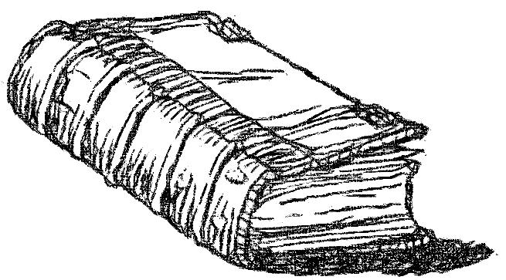
12 He who has the Son has life; he who does not have the Son of God does not have life.
13 These things I have written to you who believe in the name of the Son of God, that you may know that you have eternal life, and that you may continue to believe in the name of the Son of God.
1 John 5:12, 13

Slide 3
"but if I do, though you do not believe Me, believe the works, that you may know and believe that the Father is in Me, and I in Him."
John 10:38

Slide 4
Psalm 2:1-6
1 Why do the nations rage, And the people plot a vain thing?
2 The kings of the earth set themselves, And the rulers take counsel together, Against the LORD and against His Anointed, saying,
3 "Let us break Their bonds in pieces And cast away Their cords from us."
4 He who sits in the heavens shall laugh; The Lord shall hold them in derision.
5 Then He shall speak to them in His wrath, And distress them in His deep displeasure:
6 "Yet I have set My King On My holy hill of Zion."

Slide 5
Psalm 2:1-6
A psalm which is attributed as being from David (Acts 4:25-28)
  Places its origin about 1000 BC
The King is set and firmly placed on Zion (2:6)
  Where His kingdom was founded (Jerusalem)
  Where His laws first went out and were preached
Kingdom would begin with His “rejection” (Lk. 17:20, 25)
  From His initial rejection would come the evidence to convict men of His dominion and their sins!
Notes:
Applied to Jesus as the anointed
Applied to the rejection and opposition to Him

Slide 6
Psalm 2:7-9
7 "I will declare the decree: The LORD has said to Me, ‘You are My Son, Today I have begotten You.
8 Ask of Me, and I will give You The nations for Your inheritance, And the ends of the earth for Your possession.
9 You shall break them with a rod of iron; You shall dash them to pieces like a potter’s vessel.’"
Our Subject!
Notes:
David spoke of the Messiah as being the Son of God 1000 years before Jesus Christ came to earth. Was David right. What does this expression mean? If this ancient Psalm is correct, then we answer our question. So, let’s look at what this expression means and if there is evidence to believe it’s meaning.

Slide 7
MEANING OF: “You are My Son, Today I have begotten You”
Fulfilled in the resurrection!
  Acts 13:33, “God has fulfilled this for us their children, in that He has raised up Jesus. As it is also written in the second Psalm: ‘You are My Son, Today I have begotten You.’”

Slide 8
MEANING OF: “You are My Son, Today I have begotten You”
Fulfilled in the resurrection!
  Romans 1:4 “and declared to be the Son of God with power according to the Spirit of holiness, by the resurrection from the dead.”

Slide 9
MEANING OF: “You are My Son, Today I have begotten You”
“In it, as the first step in the process which was completed in the Ascension, the manhood of Jesus was lifted above the limitations and weaknesses of earth, and began to rise to the throne. The day of His resurrection was, as it were, the day of the birth of His humanity into royal glory” (Expositor’s Bible Commentary)

Slide 10


What is the
EVIDENCE
That Jesus lived and died?

Slide 11
SKEPTICS …
Deny Jesus even existed
Claim that only those who believed in Him wrote about Him
  But in doing so, they admit there were some, in those times, who were convinced Jesus was real!
Notes:
But in doing so, they admit there were some, in those times, who were convinced Jesus was real!
Usually people who are written about are “real people”
Yet even those who opposed Christianity wrote about Jesus
Do people today from various backgrounds write about the same person, genealogy, teachings and actions from someone who currently does not exist?

Slide 12

Evidence That Jesus Lived & Died
The four gospel writers and apostles
  “The book of the genealogy of Jesus Christ, the Son of David, the Son of Abraham” (Matt. 1:1)
  “The former account I made, O Theophilus, of all that Jesus began both to do and teach, until the day in which He was taken up…” (Acts 1:1, 2)
Notes:
See Matthew 1:1

Slide 13
Evidence That Jesus Lived & Died
The four gospel writers and apostles
  “Inasmuch as many have taken in hand to set in order a narrative of those things which have been fulfilled among us, just as those who from the beginning were eyewitnesses…it seemed good to me also, having had perfect understanding of all things from the very first, to write to you an orderly account, most excellent Theophilus” (Lk. 1:1-3)
Notes:
See Matthew 1:1

Slide 14
Evidence That Jesus Lived & Died
The four gospel writers and apostles
Paul (from an enemy to a friend)
  “Indeed, I myself thought I must do many things contrary to the name of Jesus of Nazareth. This I also did in Jerusalem, and many of the saints I shut up in prison, having received authority from the chief priests; and when they were put to death, I cast my vote against them. And I punished them often in every synagogue and compelled them to blaspheme…” (Acts 26:9, 10)

Slide 15
Evidence That Jesus Lived & Died
The four gospel writers and apostles
Paul (from an enemy to a friend)
  “although I was formerly a blasphemer, a persecutor, and an insolent man; but I obtained mercy because I did it ignorantly” (1 Tim. 1:13)
  Paul’s persecution was not based on a denial of the existence of Jesus, but rather, the denial of the nature of Jesus!

Slide 16
Evidence That Jesus Lived & Died
The four gospel writers and apostles
Paul (from an enemy to a friend)
  “But they were hearing only, ‘He who formerly persecuted us now preaches the faith which he once tried to destroy’” (Gal. 1:23)
  Embraced His Deity, “And He is before all things, and in Him all things consist” (Col. 1:17)

Slide 17
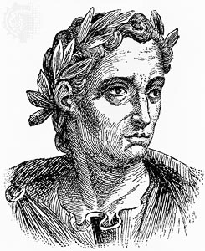
Evidence That Jesus Lived & Died
The four gospel writers and apostles
Paul (from an enemy to a friend)
Extra-biblical writers
  Pliny the Younger, AD 111, “They affirmed, however, the whole of their guilt; or their error, was, that they were in the habit of meeting on a certain fixed day before it was light, when they sang in alternate verses a hymn to Christ as to a god…” (Pliny, Letters to Trajan, X, 96)

Slide 18
Josephus, Antiquities of the Jews, 18.3.3
“Now there was about this time Jesus, a wise man, if it be lawful to call him a man; for he was a doer of wonderful works — a teacher of such men as receive the truth with pleasure. He drew over to him both many of the Jews and many of the Gentiles. He was [the] Christ. And when Pilate, at the suggestion of the principal men among us, had condemned him to the cross, those that loved him at the first did not forsake him, for he appeared to them alive again the third day, because the divine prophets had foretold these and ten thousand other wonderful things concerning him; and the sect of Christians, so named from him, are not extinct at this day.”

Slide 19
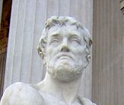
Evidence That Jesus Lived & Died
Tacitus, AD 116, “ Nero fastened the guilt and inflicted the most exquisite tortures on a class hated for their abominations, called Christians by the populace. Christus, from whom the name had its origin, suffered the extreme penalty during the reign of Tiberius at the hands of one of our procurators, Pontius Pilatus” (Tacitus, Annals, 15:44)

Slide 20
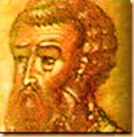
Evidence That Jesus Lived & Died
Mara Bar-Serapion, ~AD 73, “What are
we to say, when the wise are dragged
by force by the hands of tyrants…For
what benefit did the Athenians obtain
by putting Socrates to death, seeing that they received as retribution for it famine and pestilence? Or the people of Samos by the burning of Pythagoras, seeing that in one hour the whole of their country was covered with sand?”
Notes:
puh-THA-guh-rus

Slide 21
Evidence That Jesus Lived & Died
Mara Bar-Serapion, ~AD 73, “…Or the Jews by the murder of their Wise King, seeing that from that very time their kingdom was driven away from them?... Nay, Socrates did ‘not’ die, because of Plato; nor yet Pythagoras, because of the statue of Hera; nor yet the Wise King, because of the new laws which he enacted.” (http://en.wikisource.org/wiki/Ante-Nicene_Fathers /Volume_VIII/Memoirs_of_Edessa_And_Other_Ancient_Syriac_Documents/A_Letter_of_Mara,_Son_of_Serapion#cite_note-6)
Notes:
puh-THA-guh-rus

Slide 22
What Is The
EVIDENCE
That He Rose Again?
“For You will not leave my soul in Sheol, Nor will You allow Your Holy One to see corruption” (Ps. 16:10)

Slide 23
Acts 1:1-3
1 The former account I made, O Theophilus, of all that Jesus began both to do and teach,
2 until the day in which He was taken up, after He through the Holy Spirit had given commandments to the apostles whom He had chosen,
3 to whom He also presented Himself alive after His suffering by many infallible proofs, being seen by them during forty days and speaking of the things pertaining to the kingdom of God.

Slide 24
A fraud could not raise himself
A fraud could not be raised by God

Slide 25
Evidence
The tomb was empty
  Stolen?
  Exited on own free-will?

Slide 26
Why The Body Was Not Stolen
Matthew 27:57-28:15
  Proper precaution was taken to prevent such an act –A guard of professional roman soldiers
    The disciples were too few and timid at this time to seek to steal His body (Jn. 20:19)
    Never do we find the Jews confronting the disciples to give the body back
    Thieves would not properly fold grave garments (Jn. 20:6, 7)
    If the guard did fall asleep, they would not know how the body left the tomb
Notes:
Even the enemies admit the tomb was empty when they charge the body was stolen.

Slide 27
Evidence
The tomb was empty
  Stolen?
  Exited on own free-will?

Slide 28
Evidence
The testimony of the witnesses
  False witnesses
  Mistaken witnesses
  Credible witnesses

Slide 29
They Cannot Be False Witnesses
Affirmed things which could easily have been falsified
  Advocated public details which could have been openly denied (Matt. 27:50-54)
    Tearing of the veil
    Resurrected saints going into Jerusalem
    Confession and fear of centurion and guards
  Claimed to work miracles through the risen savior (Acts 3:2, 12-16; 4:16)
No marks of dishonesty

Slide 30
Benjamin Franklin
“That Jesus rose from the dead, if not true, was the most unpopular and unwelcome story that any man or set of men could have told at the time in which they lived. The idea, that these timid men would have had the boldness and determination to face the world, Jews and pagans, and declare persistently that Jesus rose from the dead, knowing it to be false, is the very climax of absurdity” (The Gospel Preacher, Vol. 1, p. 22)

Slide 31
Proverbs 21:6
“Getting treasures by a lying tongue Is the fleeting fantasy of those who seek death.”
  What treasures would the disciples have gained by lying?
  Nothing advantageous to their physical lives in advocating the resurrected Christ (1 Cor. 15:30-32)
  Insisted the resurrection even during trial and suffering—what they stated in the first is what they stated in the last!

Slide 32
ACTS 13:29-33
29 "Now when they had fulfilled all that was written concerning Him, they took Him down from the tree and laid Him in a tomb.
30 "But God raised Him from the dead.
31 "He was seen for many days by those who came up with Him from Galilee to Jerusalem, who are His witnesses to the people.
32 "And we declare to you glad tidings—that promise which was made to the fathers.
33 "God has fulfilled this for us their children, in that He has raised up Jesus. As it is also written in the second Psalm: ‘You are My Son, Today I have begotten You.’

Slide 33
ACTS 17:31, 32
31 "because He has appointed a day on which He will judge the world in righteousness by the Man whom He has ordained. He has given assurance of this to all by raising Him from the dead."
32 And when they heard of the resurrection of the dead, some mocked, while others said, "We will hear you again on this matter."

Slide 34
ACTS 26:8
“Why should it be thought incredible by you that God raises the dead?”

Slide 35
Evidence
The testimony of the witnesses
  False witnesses
  Mistaken witnesses
  Credible witnesses

Slide 36
Could The Witnesses Be
Mistaken?

Slide 37
1. There are too many witnesses
Acts 26:26, “For the king, before whom I also speak freely, knows these things; for I am convinced that none of these things escapes his attention, since this thing was not done in a corner.”
  1 Corinthians 15:1ff

Slide 38
2. There are too many days
Acts 1:3, “to whom He also presented Himself alive after His suffering by many infallible proofs, being seen by them during forty days and speaking of the things pertaining to the kingdom of God.”

Slide 39
3. Appearances with dialogue and teaching
Acts 1:3, “to whom He also presented Himself alive after His suffering by many infallible proofs, being seen by them during forty days and speaking of the things pertaining to the kingdom of God.”
  Luke 24:13-35; John 21

Slide 40
4. Eating With Him
Luke 24:41-43
41 But while they still did not believe for joy, and marveled, He said to them, "Have you any food here?“
42 So they gave Him a piece of a broiled fish and some honeycomb.
43 And He took it and ate in their presence.

Slide 41
5. In The Daylight (Jn. 21:4-7)
4 But when the morning had now come, Jesus stood on the shore; yet the disciples did not know that it was Jesus.
5 Then Jesus said to them, "Children, have you any food?" They answered Him, "No."
6 And He said to them, "Cast the net on the right side of the boat, and you will find some." So they cast, and now they were not able to draw it in because of the multitude of fish.
7 Therefore that disciple whom Jesus loved said to Peter, "It is the Lord!" …

Slide 42

Evidence
The testimony of the witnesses
  False witnesses
  Mistaken witnesses
  Credible witnesses

Slide 43
Evidence
Prophecy Link
Is. 53:9
Jesus
Died
Buried
Raised
Ps. 22; Dan. 9:26; Zech. 12:10; Is. 53:8
Ps. 16:10; Is. 53:10
“According To The Scriptures” (1 Cor. 15:1-4)

Slide 44
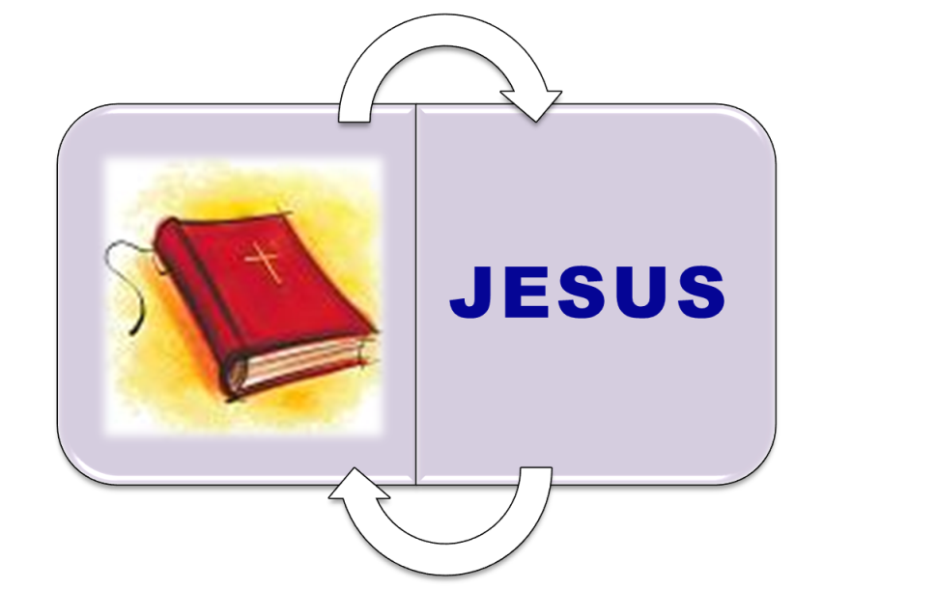
Evidence
Prophecy Link
  Tied To Scriptures
    “Then He said to them, ‘These are the words which I spoke to you while I was still with you, that all things must be fulfilled which were written in the Law of Moses and the Prophets and the Psalms concerning Me’” (Lk. 24:44)
Notes:
Both stand and fall together
Cannot embrace one and reject the other

Slide 45
Evidence
Prophecy Link
  The scriptures authorize His actions
  His actions authenticate the scriptures
    If Jesus did not rise:
      All scripture is broken
      Apostles are false witnesses (1 Cor. 15:15)
      Faith is futile and sins remain (1 Cor. 15:17)
      All the dead have perished (1 Cor. 15:18)
      Our state is miserable (1 Cor. 15:19)

Slide 46
1 Corinthians 15:20
“But now Christ is risen from the dead, and has become the firstfruits of those who have fallen asleep.”

Slide 47
Psalm 2:10-12
10 Now therefore, be wise, O kings; Be instructed, you judges of the earth.
11 Serve the LORD with fear, And rejoice with trembling.
12 Kiss the Son, lest He be angry, And you perish in the way, When His wrath is kindled but a little. Blessed are all those who put their trust in Him.
Notes:
Re-emphasize Acts 17:30-32

