Slide 2


Christ & The Church
Concerning

Slide 3

Snapshots Concerning Christ
His Resurrection
  “he, foreseeing this, spoke concerning the resurrection of the Christ, that His soul was not left in Hades, nor did His flesh see corruption” (Acts 2:31)
The Faith
  “And after some days, when Felix came with his wife Drusilla, who was Jewish, he sent for Paul and heard him concerning the faith in Christ” (Acts 24:24)

Slide 4
Snapshots Concerning Christ
Concerning His Second Coming
  “Now, brethren, concerning the coming of our Lord Jesus Christ and our gathering together to Him, we ask you” (2 Thess. 2:1)
A Great Mystery
  “This is a great mystery, but I speak concerning Christ and the church” (Eph. 5:32)
LET’S Explore This!

Slide 5
Ephesians 5:30-32
Concerning Christ And The Church
30 For we are members of His body, of His flesh and of His bones.
31 "For this reason a man shall leave his father and mother and be joined to his wife, and the two shall become one flesh."
32 This is a great mystery, but I speak concerning Christ and the church.
The mystery is the relationship that exists between Christ and His people being like the relationship that exists in marriage!

Slide 6
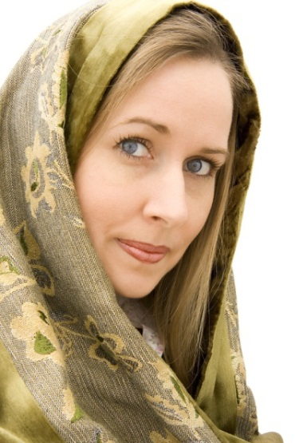

Genesis 2 Model
MAN
WOMAN
SACRIFICE BLOOD
AND BONE
DEEP SLEEP
WORK
“and He brought her to the man” (2:22)
EFFECT
PRESENTATION
“This is now bone of my bones And flesh of my flesh; She shall be called Woman, Because she was taken out of Man” (2:23)
“And the LORD God caused a deep sleep to fall on Adam…the rib which the LORD God had taken from man He made into a woman” (2:21-22)

Slide 7
Ephesians 5 Model
CHRIST
CHURCH
SACRIFICE BLOOD
AND BONE
CROSS
DEATH
“that He might present her to Himself a glorious church, not having spot or wrinkle or any such thing, but that she should be holy and without blemish” (5:27)
WORK
EFFECT
PRESENTATION
“just as Christ also loved the church and gave Himself for her” (5:25)
“For we are members of His body, of His flesh and of His bones” (5:30)

Slide 8
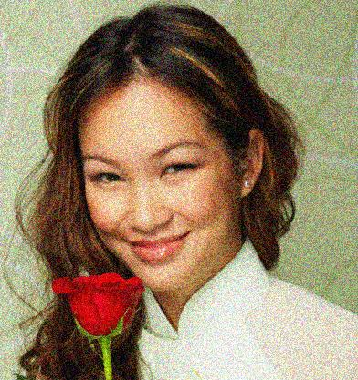
When God Made Woman
God Made Woman to be with Man
In doing such…God made Man and Woman to be with God in the church
  “that He might present her to Himself a glorious church” (Eph. 5:27)
  “But did He not make them one, Having a remnant of the Spirit? And why one? He seeks godly offspring. Therefore take heed to your spirit, And let none deal treacherously with the wife of his youth. For the LORD God of Israel says That He hates divorce…”
  (Mal. 2:15, 16)

Slide 9
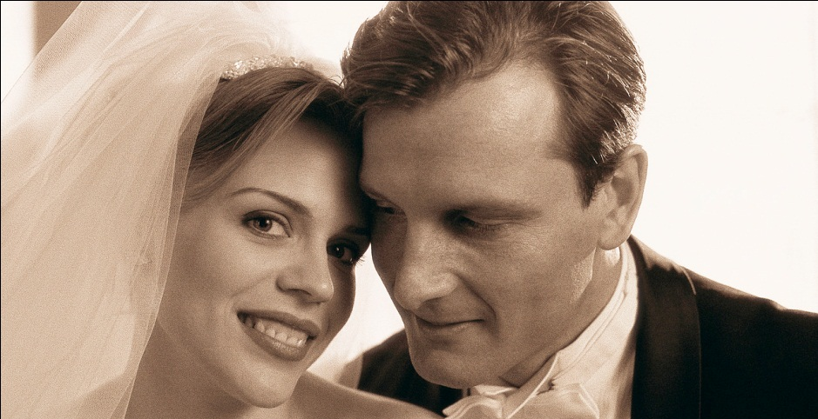
The EFFECT This Mystery Should Have On Our Minds
A revolutionary view of marriage
  All should honor marriage as a
  godly thing (Heb. 13:4)
  Man should love and honor
  the woman as he would his own
  flesh and in the pattern of Christ
  Woman should love and respect the man in the pattern of the church
Care on how we present ourselves to God
  As Christ’s bride (2 Cor. 11:2; Col. 1:28)
  Is Jesus pleased with our actions, conversations, manners, worship, faithfulness, decisions, etc.
A high view of the church
  Acts 20:28

Slide 10
The Mystery Is REVEALED
It is no longer a mystery if we read the word
Those who separate Christ from the Church do not respect this relationship
  “preach Christ and not the church” is false worship
  Would a good husband let another despise his bride?
    What we do to the church is what we do to Christ (Matt. 25:40, 45)
  Was Eve worth the cost to Adam (Gen. 2:18, 21-25)?
    Is the church worth the cost to Jesus?

Slide 11
Ephesians 5:22-32
22 Wives, submit to your own husbands, as to the Lord.
23 For the husband is head of the wife, as also Christ is head of the church; and He is the Savior of the body.
24 Therefore, just as the church is subject to Christ, so let the wives be to their own husbands in everything.
25 Husbands, love your wives, just as Christ also loved the church and gave Himself for her,
26 that He might sanctify and cleanse her with the washing of water by the word,
27 that He might present her to Himself a glorious church, not having spot or wrinkle or any such thing, but that she should be holy and without blemish.
28 So husbands ought to love their own wives as their own bodies; he who loves his wife loves himself.
29 For no one ever hated his own flesh, but nourishes and cherishes it, just as the Lord does the church.
30 For we are members of His body, of His flesh and of His bones.
31 "For this reason a man shall leave his father and mother and be joined to his wife, and the two shall become one flesh."
32 This is a great mystery, but I speak concerning Christ and the church.

Slide 12
1a. Christ is the Head of the Church (5:23)
Raised from the dead (Eph. 1:20)
Seated at the right hand (Eph. 1:20)
Far above everything else (Eph. 1:21)
Everything is under His feet (1:22)
Head over all things to the church (1:22, 23)
  “And He is the head of the body, the church, who is the beginning, the firstborn from the dead, that in all things He may have the preeminence” (Col. 1:18)
  Make Christ first in all things!

Slide 13
Ephesians 5:22-32
22 Wives, submit to your own husbands, as to the Lord.
23 For the husband is head of the wife, as also Christ is head of the church; and He is the Savior of the body.
24 Therefore, just as the church is subject to Christ, so let the wives be to their own husbands in everything.
25 Husbands, love your wives, just as Christ also loved the church and gave Himself for her,
26 that He might sanctify and cleanse her with the washing of water by the word,
27 that He might present her to Himself a glorious church, not having spot or wrinkle or any such thing, but that she should be holy and without blemish.
28 So husbands ought to love their own wives as their own bodies; he who loves his wife loves himself.
29 For no one ever hated his own flesh, but nourishes and cherishes it, just as the Lord does the church.
30 For we are members of His body, of His flesh and of His bones.
31 "For this reason a man shall leave his father and mother and be joined to his wife, and the two shall become one flesh."
32 This is a great mystery, but I speak concerning Christ and the church.

Slide 14

1b. The Church is the Body
“All authority has been given to Me in heaven and on earth” (Matt. 28:18)
Nourishment (Col. 2:18, 19)
Unity (Eph. 4:11-16)
Fullness of Christ is seen in the church (Eph. 1:23)
Christ = Head
Church = Body
Body must take teaching, direction, guidance from the head!

Slide 15
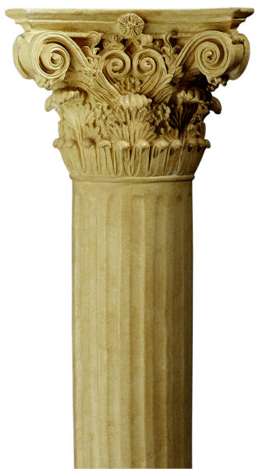
The Church Doesn’t Establish What Is True, But Is The Support Of What is True!
TRUTH
“but if I am delayed, I write so that you may know how you ought to conduct yourself in the house of God, which is the church of the living God, the pillar and ground of the truth” (1 Tim. 3:15)

Slide 16
Ephesians 5:22-32
22 Wives, submit to your own husbands, as to the Lord.
23 For the husband is head of the wife, as also Christ is head of the church; and He is the Savior of the body.
24 Therefore, just as the church is subject to Christ, so let the wives be to their own husbands in everything.
25 Husbands, love your wives, just as Christ also loved the church and gave Himself for her,
26 that He might sanctify and cleanse her with the washing of water by the word,
27 that He might present her to Himself a glorious church, not having spot or wrinkle or any such thing, but that she should be holy and without blemish.
28 So husbands ought to love their own wives as their own bodies; he who loves his wife loves himself.
29 For no one ever hated his own flesh, but nourishes and cherishes it, just as the Lord does the church.
30 For we are members of His body, of His flesh and of His bones.
31 "For this reason a man shall leave his father and mother and be joined to his wife, and the two shall become one flesh."
32 This is a great mystery, but I speak concerning Christ and the church.

Slide 17
2a. Christ is the Savior of the Body (5:23)
Jesus saves!
  “And she will bring forth a Son, and you shall call His name Jesus, for He will save His people from their sins” (Matt. 1:21)
  “For their is born to you this day in the city of David a Savior, who is Christ the Lord” (Lk. 2:11)
  “For the Son of Man has come to seek and to save that which was lost” (Lk. 19:10).

Slide 18
Luke 2:25-32
25 And behold, there was a man in Jerusalem whose name was Simeon, and this man was just and devout, waiting for the Consolation of Israel, and the Holy Spirit was upon him.
26 And it had been revealed to him by the Holy Spirit that he would not see death before he had seen the Lord’s Christ.
27 So he came by the Spirit into the temple. And when the parents brought in the Child Jesus, to do for Him according to the custom of the law,
28 he took Him up in his arms and blessed God and said:
29 "Lord, now You are letting Your servant depart in peace, According to Your word;
30 For my eyes have seen Your salvation
31 Which You have prepared before the face of all peoples,
32 A light to bring revelation to the Gentiles, And the glory of Your people Israel.

Slide 19
2b. The Church is the Saved (5:23)
The church does not save Christ
  No man saves the church
  Christ does not promise to save anything today other than the church
God chose to save us in Christ, in the church
  “And the Lord added to the church daily those who were being saved” (Acts 2:47)
  Can there be a Savior without any saved?
    Stripping the church from being the “saved” reduces Christ from being Savior!
  If the church is not the saved, then Christ is not the Savior of anyone today

Slide 20
Ephesians 5:22-32
22 Wives, submit to your own husbands, as to the Lord.
23 For the husband is head of the wife, as also Christ is head of the church; and He is the Savior of the body.
24 Therefore, just as the church is subject to Christ, so let the wives be to their own husbands in everything.
25 Husbands, love your wives, just as Christ also loved the church and gave Himself for her,
26 that He might sanctify and cleanse her with the washing of water by the word,
27 that He might present her to Himself a glorious church, not having spot or wrinkle or any such thing, but that she should be holy and without blemish.
28 So husbands ought to love their own wives as their own bodies; he who loves his wife loves himself.
29 For no one ever hated his own flesh, but nourishes and cherishes it, just as the Lord does the church.
30 For we are members of His body, of His flesh and of His bones.
31 "For this reason a man shall leave his father and mother and be joined to his wife, and the two shall become one flesh."
32 This is a great mystery, but I speak concerning Christ and the church.

Slide 21
3. Christ Loves the Church
(5:25, 28, 29)
What is the significance of Christ’s death for the church?
  Demonstrates His love and value placed upon it (cf. Rom. 5:6-8)
  Shows heaven’s purchased price (Acts 20:28)
    Jesus valued the church as worth more than His physical life

Slide 22
Ephesians 5:22-32
22 Wives, submit to your own husbands, as to the Lord.
23 For the husband is head of the wife, as also Christ is head of the church; and He is the Savior of the body.
24 Therefore, just as the church is subject to Christ, so let the wives be to their own husbands in everything.
25 Husbands, love your wives, just as Christ also loved the church and gave Himself for her,
26 that He might sanctify and cleanse her with the washing of water by the word,
27 that He might present her to Himself a glorious church, not having spot or wrinkle or any such thing, but that she should be holy and without blemish.
28 So husbands ought to love their own wives as their own bodies; he who loves his wife loves himself.
29 For no one ever hated his own flesh, but nourishes and cherishes it, just as the Lord does the church.
30 For we are members of His body, of His flesh and of His bones.
31 "For this reason a man shall leave his father and mother and be joined to his wife, and the two shall become one flesh."
32 This is a great mystery, but I speak concerning Christ and the church.

Slide 23
4. Members of His Body (5:30-32)
Man To Woman
Christ To Church
Man
Sleep
Woman
Christ
Death
Church
Joined One flesh
Members of His body, flesh and bones

Slide 24
How Can We Be Members Of His Body Today?
Christ To Church
Christ
Death
Church
Baptism Is Into Death
“Or do you not know that as many of us as were baptized into Christ Jesus were baptized into His death?” (Rom. 6:3)
Members of his body, flesh and bones
“that He might sanctify and cleanse her with the washing of water by the word” (Eph. 5:26)

Slide 25
MUST BE FAITHFUL TO HIM
How Can We Be Members Of His Body Today?
Christ To Church
Christ
Death
Church
Baptism Is Into Death
14 And God both raised up the Lord and will also raise us up by His power. 15 Do you not know that your bodies are members of Christ? Shall I then take the members of Christ and make them members of a harlot? Certainly not! 16 Or do you not know that he who is joined to a harlot is one body with her? For "the two," He says, "shall become one flesh.“ 17 But he who is joined to the Lord is one spirit with Him.
Members of his body, flesh and bones
1 Cor. 6:14-17

Slide 26
Concerning Christ And The Church
Is Christ concerning to you?
  He was of great concern to New Testament saints
  Are you concerned whether you are in Christ or not?
  Does your marriage to Christ concern you?
  Does His rule/law concern you (Rom. 7:4)?

Slide 27
Concerning Christ And The Church
Is the church concerning to you?
  She was of great concern to early disciples
  Does it matter if you are in the right church or not (Eph. 5:31)?
    Jesus only built one church for there to be “two” who are joined!
    Does the worship of the church concern you?
    Does the work of the church concern you?
    Do your responsibilities in the church concern you?
    Does the presentation of the church concern you?
      You contribute to the state of the church here!

Slide 28
They Concern Christ!
Whether These Things Concern You Or Not….

Slide 29
2 Thessalonians 1:8-12
⁸ in flaming fire taking vengeance on those who do not know God, and on those who do not obey the gospel of our Lord Jesus Christ.
⁹ These shall be punished with everlasting destruction from the presence of the Lord and from the glory of His power,
¹⁰ when He comes, in that Day, to be glorified in His saints and to be admired among all those who believe, because our testimony among you was believed.

Slide 30
2 Thessalonians 1:8-12
¹¹ Therefore we also pray always for you that our God would count you worthy of this calling, and fulfill all the good pleasure of His goodness and the work of faith with power,
¹² that the name of our Lord Jesus Christ may be glorified in you, and you in Him, according to the grace of our God and the Lord Jesus Christ.

Slide 31
“that He might present her to Himself a glorious church, not having spot or wrinkle or any such thing, but that she should be holy and without blemish”
(Eph. 5:27)
Fine Linen = Righteous Acts
  “And to her it was granted to be arrayed in fine linen, clean and bright, for the fine linen is the righteous acts of the saints” (Rev. 19:8)

Slide 32

“that He might present her to Himself a glorious church, not having spot or wrinkle or any such thing, but that she should be holy and without blemish”
(Eph. 5:27)
Sin Blemishes The Holy Garments (2 Pet. 2:12-15)
  Speaking evil of things we don’t understand (v. 12).
  Count it pleasure to carouse in the daytime (v. 13).
  Carousing in deceit (v. 13).
  Eyes full of adultery that cannot cease from sin (v. 14).
  Heart trained in covetous practices (v. 14).
  Forsaking the right way (v. 15).
  Loving wages of unrighteousness (v. 15).

