Slide 1
After Becoming a Christian…
What Should I Do Now?
Acts 11:19-24
Notes:
Revised 7/13/2017
SCRIPTURE READING: Acts 11:19-24. The baptisms we have seen are a testimony of the grace of God and something to rejoice in. Brian, Danielle, Madysen and Jaycie are, like all of us who have previously obeyed the blessed gospel, are vessels of mercy. With that, we need to take Barnabas’ message to heart, “…encouraged them all that with purpose of heart they should continue with the Lord” Acts 11:23. New Converts need that kind of encouragement. What should you do now that you are a Christian?
You should with purpose of heart continue with the Lord. To have “purpose of heart” is to have a ready resolve, plan, goal to continue with the Lord. It not merely an understanding that I need to continue, but a ready resolve, “I will continue with the Lord.” “He who says he abides in Him ought himself also to walk just as He walked” (1 Jn. 2:6). It will require a ready resolve and inner strength to continue with the Lord when you are with your friends, when you are tempted to do evil, when you become discouraged with others. The devil will come for you where ever your defenses are the weakest. What can you do to do what Tyler mentioned in his Nehemiah class to make your wall stout and secure?
You might not be a new convert, but this lesson applies to you as well. Fundamentals are always needed for new converts and veterans alike lest our fire is put out by the rain of the world (See Rev. 2:1-7).

Slide 2
Some Christian Descriptions
children of God, children of light, dear children, obedient children, imitators of God, friends, brothers and sisters, sheep, saints, soldiers, stewards, fellow citizens, lights in the world, elect of God, ministers, servants, disciples, heirs, joint-heirs, branches, members of one body, living stones, epistles, temples, beloved, followers, overcomers, victors, conquerors, soldiers, etc.
Notes:
These words convey a broad spectrum to the identity of who a Christian is and it should make the point that being baptized is merely the beginning.

Slide 3
1. Continue Steadfastly in Worship
“And they continued steadfastly in the apostles' doctrine and fellowship, in the breaking of bread, and in prayers.”
Acts 2:42
Notes:
What did these new converts do? This word “steadfastly” cuts to the core of your purpose. It is defined as:
1) to adhere to one, be his adherent, to be devoted or constant to one
2) to be steadfastly attentive unto, to give unremitting care to a thing
3) to continue all the time in a place
4) to persevere and not to faint
5) to show one’s self courageous for
6) to be in constant readiness for one, wait on constantly
If you find yourself frequently missing worship, you might want to ask if you are steadfast. Use your attendance as one gauge for your “purpose of heart.” Do you look for excuses to miss? Do you place other things above the meeting times of the church? Do you find the world creeping into your life and choking congregational time out? Hebrews 10:24, 25.

Slide 4
2. Live No Longer for Yourself
“For the love of Christ compels us, because we judge thus: that if One died for all, then all died; {15} and He died for all, that those who live should live no longer for themselves, but for Him who died for them and rose again.”
2 Corinthians 5:14-15
Notes:
Recognize that your you died to the world in baptism and chose to live for Christ. Jesus died for you so that you will live for Him. He taught that we must live life cross-bearing. Luke 14:26 "If anyone comes to Me and does not hate his father and mother, wife and children, brothers and sisters, yes, and his own life also, he cannot be My disciple.
27 "And whoever does not bear his cross and come after Me cannot be My disciple.
When Jesus uttered these words, the disciples knew very clearly what Jesus meant in the image of bearing a cross. Anyone bearing a cross in the first century was a walking dead man. We must die to self in order to live for Christ.
“For if you live according to the flesh you will die; but if by the Spirit you put to death the deeds of the body, you will live” (Rom. 8:13).

Slide 5
3. Put Christ Before All Others
Matt.10:34-39 “Do not think that I came to bring peace on earth. I did not come to bring peace but a sword. {35} For I have come to ‘set a man against his father, a daughter against her mother, and a daughter-in-law against her mother-in-law’; {36} and ‘a man's enemies will be those of his own household.’ {37} He who loves father or mother more than Me is not worthy of Me. And he who loves son or daughter more than Me is not worthy of Me. {38} And he who does not take his cross and follow after Me is not worthy of Me. {39} He who finds his life will lose it, and he who loses his life for My sake will find it.”
Notes:
Jesus is asking nothing of you that He himself did not do. At times, his own family members had become his enemies. Your purpose of heart must predetermine that even if my family members walk away, run away, fall away from Christ, that I will continue with Him. You must resolve that your actions are not based on their but on Christ’s word. Jesus calls you out to have a love and faith that is larger than any personal relationship which you may have on earth.
John 6:66-69.

Slide 6
4. Walk in “Newness of Life”
“Therefore we were buried with Him through baptism into death, that just as Christ was raised from the dead by the glory of the Father, even so we also should walk in newness of life.”
Romans 6:4
Notes:
The newness of life begins now. If you want to live in a new heavens and earth when Jesus comes again, you must walk in newness of life now.

Slide 7
Newness of Life In Christ
Baptized into Christ (6:3)
Baptized into His death (6:3)
Buried with Him (6:4)
United with Him (6:5)
Crucified with Him (6:6)
Died with Christ (6:8)
Live with Him (6:8)
Romans 6
Notes:
There is sometimes talk about having a personal relationship with Christ. Romans 6:3-8 defines that personal relationship does it not? Baptism is where your “personal” relationship with Christ began, not before and not without it. You partook of Him and His torture, death, and resurrection when you were baptized. Paul wanted these Romans to understand that and so we need to see it also.
William Barclay illustrated it this way, “We cannot live our physical life unless we are in the air, and the air is in us; unless we are in Christ, and Christ is in us, we cannot live the life of God.” “To them [the saints, v. 26] God willed to make known what are the riches of the glory of this mystery among the Gentiles: which is Christ in you, the hope of glory” (Col. 1:27). So we are baptized INTO Christ, we are WITH Christ, and we have Christ IN us.
“Abide in Me, and I in you. As the branch cannot bear fruit of itself, unless it abides in the vine, neither can you, unless you abide in Me” (Jn. 15:4).
Keep in mind that when Paul wrote the Romans, he was not writing them to convince them that baptism was essential for salvation (which his words prove); they already understood that. He was writing to them to show that since their sins were forgiven in Christ, that they needed to walk that way pleasing Christ—that they are no longer slaves of sin, but slaves of Christ (6:1, 2, 17, 18). “Walk” is a metaphor for the manner of life we live. It is to be lived knowing that we were forgiven of all past sins.

Slide 8
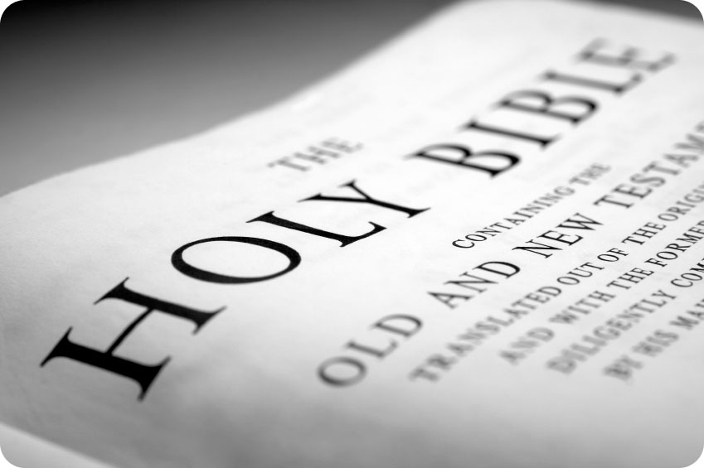
A New Pursuit
Newness of Life…
Seeking the Things Above
“If then you were raised with Christ, seek those things which are above, where Christ is, sitting at the right hand of God. {2} Set your mind on things above, not on things on the earth.”
Colossians 3:1, 2
Notes:
Our minds are now elevated above this world and enter into the place where Christ reigns as king. “If” is not used here to convey doubt, but rather is a first class conditional clause meaning “since then you were raised,” and they were very well raised with Christ when they were baptized (Col. 2:12). Rather than finding pleasure in earthly pursuits, their minds (their yearning, affection, pondering) is in the things that come from Christ’s rule.

Slide 9
A New Pursuit
Newness of Life…
Seeking the Things Above
Personal study time with the Bible
Preparation for public study time with the Bible
Complete lessons each week
Bring your own Bible to worship
Ask for help when you are stuck
Study to learn; learn to live
Notes:
2 Timothy 2:
14 Remind them of these things, charging them before the Lord not to strive about words to no profit, to the ruin of the hearers.
15 Be diligent to present yourself approved to God, a worker who does not need to be ashamed, rightly dividing the word of truth.
16 But shun profane and idle babblings, for they will increase to more ungodliness.

Slide 10
A New Man
Newness of Life…
Conforming to Christ’s Image
Colossians 3:9-10, “Do not lie to one another, since you have put off the old man with his deeds, {10} and have put on the new man who is renewed in knowledge according to the image of Him who created him.”
Notes:
Conforming to Christ’s image means that you control your tongue. Refrain from slandering your brethren, gossip, and lying. “Therefore, putting away lying, "Let each one of you speak truth with his neighbor," for we are members of one another” (Eph. 4:25).
It is sad to say it but “We're a nation of liars. But I mean that in the kindest sense” Neil Cavuto . May it not describe the church!
“Liars share with those they deceive the desire not to be deceived” Sissela Bok, Swedish born American Philosopher.
“He who permits himself to tell a lie once, finds it much easier to do it a second and a third time till at length it becomes habitual.” Thomas Jefferson
“In human relationships, kindness and lies are worth a thousand truths.” Graham Greene [That is, people often buy into lies by the kindness of the liar.]
“If you would win a man to your cause, first convince him that you are his sincere friend. Therein is a drop of honey which catches his heart, which, say what he will, is the highroad to his reason” (Abraham Lincoln)

Slide 11
A New Man
Newness of Life…
Kindness, Humility, Meekness…
Colossians 3:12-15, “…holy and beloved, put on tender mercies, kindness, humility, meekness, longsuffering; ^{{13}} bearing with one another, and forgiving one another, if anyone has a complaint against another; even as Christ forgave you, so you also must do. ^{{14}} But above all these things put on love, which is the bond of perfection. ^{{15}} And let the peace of God rule in your hearts, to which also you were called in one body; and be thankful.”

Slide 12
5. Be Dead to Sin, But Alive to God
“Likewise you also, reckon yourselves to be dead indeed to sin, but alive to God in Christ Jesus our Lord.”
SIN
GOD
Romans 6:11
Notes:
Wanted Dead and Alive

Slide 13
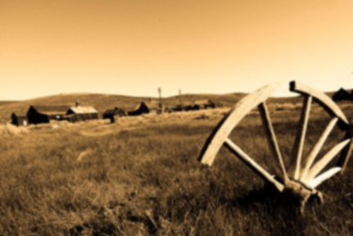
Dead & Alive
Romans 6:11, “Likewise you also, reckon yourselves to be dead indeed to sin, but alive to God in Christ Jesus our Lord.”
Notes:
Not only does God want us dead (to sin) but he wants alive (to God).
Colossians 3:5-7, “Therefore put to death your members which are on the earth: fornication, uncleanness, passion, evil desire, and covetousness, which is idolatry. 6 Because of these things the wrath of God is coming upon the sons of disobedience, 7 in which you yourselves once walked when you lived in them.”
We are to live. Paul previously said, “For you died, and your life is hidden with Christ in God” (Col. 3:3).
“I have been crucified with Christ; it is no longer I who live, but Christ lives in me; and the life which I now live in the flesh I live by faith in the Son of God, who loved me and gave Himself for me” (Gal. 2:20). –Summary chart follows.

Slide 14
After Becoming a Christian…
What Should I Do Now?
Continue steadfastly in worship
Live no longer for yourself
Put Christ before all others
Walk in newness of life
Be dead to sin and alive to God

Slide 15
for the Unseen Things
(2 Corinthians 4:18), “While we do not look at the things which are seen, but at the things which are not seen. For the things which are seen are temporary, but the things which are not seen are eternal.”
Notes:
Don’t get too caught up in what is seen. This follows the command to set your mind on things above.
“The design of this is to show in what way the afflictions which they endured became in their view light and momentary. It was by looking to the glories of the future world, and thus turning away the attention from the trials and sorrows of this life. If we look directly at our trials — if the mind is fixed wholly on them, and we think of nothing else — they often appear heavy and long. Even comparatively light and brief sufferings will appear to be exceedingly difficult to bear. But if we can turn away the mind from them, and contemplate future glory; if we can compare them with eternal blessedness, and feel that they will introduce us to perfect and everlasting happiness, they will appear to be transitory, and will be easily borne. And Paul here has stated the true secret of bearing trials with patience. It is to look at the things which are unseen. ” (Albert Barnes)

Slide 16
Spend Time With the Word of God; not the wickedness of men
(1 Peter 2:1-3), “Therefore, laying aside all malice, all deceit, hypocrisy, envy, and all evil speaking, {2} as newborn babes, desire the pure milk of the word, that you may grow thereby, {3} if indeed you have tasted that the Lord is gracious.”
The Bible is a Book of “Do Not” as well as “Do”
What should we not do?
What should we do?
malice
deceit
hypocrisy
envy
evil speaking
Notes:
“Lay aside” versus “desire”…
Malice – is an attitude that is characterized as ill-will with the desire to injure another without just cause. It is unashamed evil. This is portrayed to us in the examples of Cain and Abel (Gen. 4:8); Saul toward David (1 Sam. 18:8, 9); Shimei toward David (2 Sam. 16:5-8) and countless others
Deceit – falsehood, craftiness. I’ve know Christians I thought were very spiritual minded at one time turn out to be very worldly and deceitful. It is not that they come out and tell a bald face lie. But they feel comfortable to lead you to believing a lie without actually lying to evade their duty as a Christian. One such man tried to excuse himself for not attending services on Super Bowl Sunday by responding his son’s window was broken. Such was not the reason for him not coming to worship, but was simply stated to lead the listener to the wrong belief. Or when they were questioned where they were for Bible study mentioning we were in Tacoma. Well that leads the Christian to believe they went to the church in Tacoma, but in reality they did not worship in Tacoma, but were simply driving through Tacoma.
Hypocrisy—is acting and is not genuine. It covers wicked will with a righteous appearance. God wants us to be true and hypocrisy flies in the face of truthfulness. A graphic description of it would be how Jacob pretended to be Esau when in fact he was Jacob. If we pretend to be Christians on Sunday, but then walk the way of the world, talk with the language of the world and are entertained by the entertainment of the world, then we are walking hypocrites.
Hypocrits sing “Oh how I love Jesus” but then in works deny the name of Jesus. It is not that they again deny him openly. They may no longer drink to get drunk but they drink casually with the world. They may not curse with clarity as they did before, but they employ euphemism. They bless God on Sunday and curse their brother or sister in gossip and slander on Mondays. All along they deceive others and in fact are being deceived. 2 Timothy 3:13, “But evil men and impostors will grow worse and worse, deceiving and being deceived.”
Envy – is jealousy and is what motivated the Jews to crucify Jesus as well as seek occasion to kill Paul (Mk. 15:10; Acts 13:45; Acts 17:5).
Evil Speaking – this word in the original is found only here and 2 Cor. 12:20 where it is translated “backbitings” and carries with it the idea of defamation of another through slander.
Again, “and said, ‘Assuredly, I say to you, unless you are converted and become as little children, you will by no means enter the kingdom of heaven’” (Matt. 18:3).

Slide 17
Do And Do Not, Christian!
“Therefore lay aside all filthiness and overflow of wickedness, and receive with meekness the implanted word, which is able to save your souls” (Jas. 1:21)
“The night is far spent, the day is at hand. Therefore let us cast off the works of darkness, and let us put on the armor of light” (Rom. 13:12)
“that you put off, concerning your former conduct, the old man which grows corrupt according to the deceitful lusts, and be renewed in the spirit of your mind, and that you put on the new man which was created according to God, in true righteousness and holiness” (Eph. 4:22-24)

Slide 18
Do And Do Not, Christian!
“Therefore, putting away lying, ‘Let each one of you speak truth with his neighbor,’ for we are members of one another” (Eph. 4:25)
“Let him who stole steal no longer, but rather let him labor, working with his hands what is good, that he may have something to give him who has need” (Eph. 4:28)
“Let no corrupt word proceed out of your mouth, but what is good for necessary edification, that it may impart grace to the hearers” (Eph. 4:29)
“Let all bitterness, wrath, anger, clamor, and evil speaking be put away from you, with all malice. And be kind to one another, tenderhearted, forgiving one another, just as God in Christ forgave you” (Eph. 4:31, 32)
Notes:
As you desire the milk of the word, try to seek out passages that instruct you in what not to do and the solution of what to do. The Bible is the solution to bad human behavior. It identifies what is evil as well as what is to be good, what to abstain from and what to fill your life with.

Slide 19
Make Worship an Absolute Priority
(Hebrews 10:24-25), “And let us consider one another in order to stir up love and good works, {25} not forsaking the assembling of ourselves together, as is the manner of some, but exhorting one another, and so much the more as you see the Day approaching.”
Notes:
The worship of the church, is a measurement of your faithfulness. Where you lack in worship, you lack in stirring up your brethren for good. Where you lack in worship, you lack in honoring God. Where you lack here, you will lack there in eternity.
BTW, ask yourself, is your attendance better today than it was last year, or perhaps when you first believed?

Slide 20
Spend Much Time in Prayer
(1 Thessalonians 5:17), “Pray without ceasing.”
(Hebrews 7:25), “Therefore He is also able to save to the uttermost those who come to God through Him, since He always lives to make intercession for them.”

Slide 21
Do As Much As You Possibly Can!
(1 Corinthians 15:10), “But by the grace of God I am what I am, and His grace toward me was not in vain; but I labored more abundantly than they all, yet not I, but the grace of God which was with me.”
(1 Corinthians 15:58), “Therefore, my beloved brethren, be steadfast, immovable, always abounding in the work of the Lord, knowing that your labor is not in vain in the Lord.”

Slide 22
Run Away From…
What is the least or minimum I have to do to be saved?
Are midweek services essential?
How little do I have to give?
Leaving Bible at the building
Church-hopping
Scheduling worship around other things
Should schedule other things to not conflict with worship
Super bowl over services
Notes:
Did Jesus or Paul display these attitudes?

Slide 23
NOW THAT YOU ARE A CHRISTIAN
PRESS ON!
“Not that I have already attained, or am already perfected; but I press on, that I may lay hold of that for which Christ Jesus has also laid hold of me” (Phil. 3:12)
Notes:
It’s not time to regress but progress. It’s not time to shrink back in fear but push forward. It’s not time to become complacent but press on!

