Slide 2
The king’s banquet
Daniel 1
Notes:
Sermon notes are here: F:\Users\Hoss\OneDrive\preaching\SERMONS\WORD Sermons

Slide 3
Faith Under Trial
1
Daniel 1:3-7

Slide 4
What Could have Defiled Daniel?
Intoxicating Drink
Proverbs 31:4, 5; 23:29-35; Isa. 28:7
Eating meat offered to idols
Num. 25:2; Deut. 32:37, 38; Acts 15:20
Eating Unclean Meat
Hos. 9:3; Lev. 11; Deut. 14

Slide 5
The Choice of Faith
2
Daniel 1:8-13
Is resolute
Does not die with denials

Slide 6
1 Corinthians 10:13
No temptation has overtaken you except such as is common to man; but God is faithful, who will not allow you to be tempted beyond what you are able, but with the temptation will also make the way of escape, that you may be able to bear it.

Slide 7
The Reward of Faith
3
Daniel 1:14-21

Slide 8
Hebrews 11:6
But without faith it is impossible to please Him, for he who comes to God must believe that He is, and that He is a rewarder of those who diligently seek Him.

Slide 9
Psalm 18:30
As for God, His way is perfect; The word of the LORD is proven; He is a shield to all who trust in Him.

Slide 10
Daniel 1 outline
Faith Under Trial (1:1-7)
The choice of faith (1:8-13)
The Reward of Faith (1:14-21)

Slide 11
Applications From the King’s Banquet
Daniel 1

Slide 12
The Importance of Raising Godly children
1
“And you, fathers, do not provoke your children to wrath, but bring them up in the training and admonition of the Lord.”
Ephesians 6:4

Slide 13
The importance of Withstanding Evil while away from home
2
“Train up a child in the way he should go, And when he is old he will not depart from it.”
Proverbs 22:6

Slide 14
Being Right & Real!
John 4:23, 24 | James 4:8 | Philippians 1:15-18 | Psalm 51:6

Slide 15
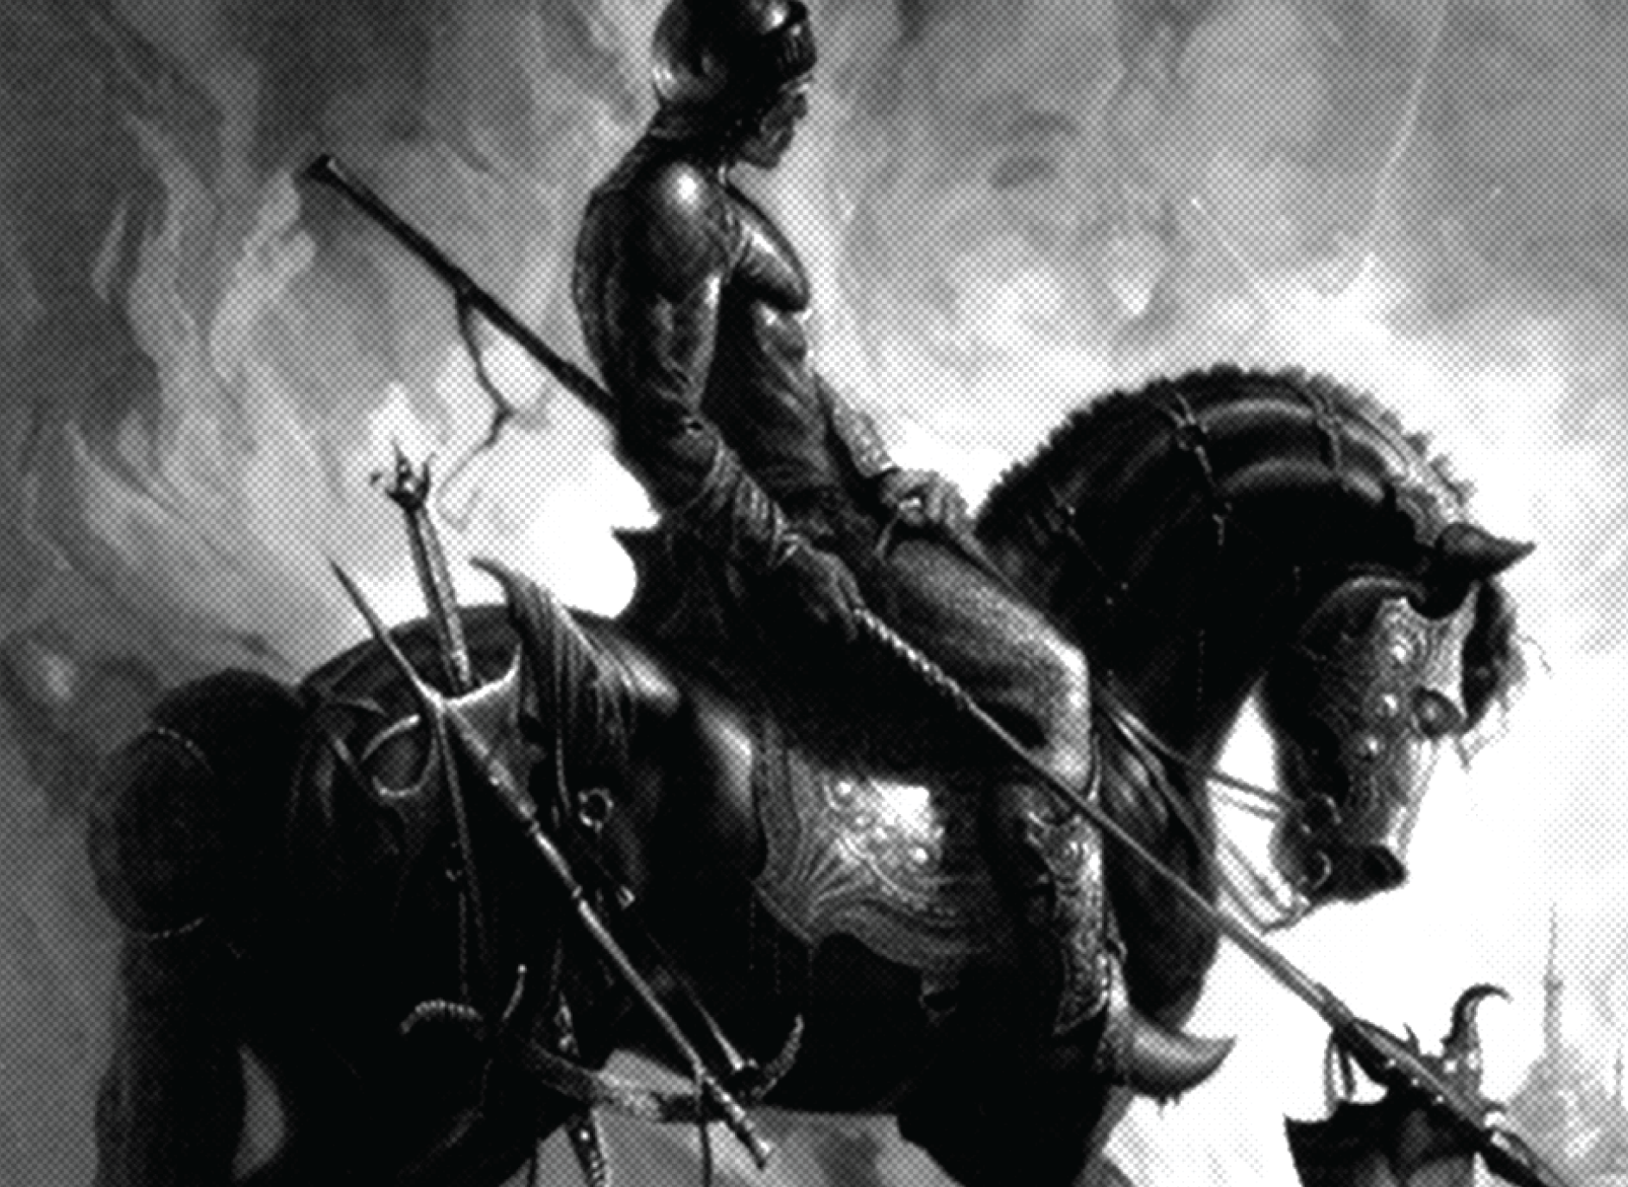
Ephesians 6
10 Finally, my brethren, be strong in the Lord and in the power of His might.
11 Put on the whole armor of God, that you may be able to stand against the wiles of the devil.

Slide 16
Ephesians 6
12 For we do not wrestle against flesh and blood, but against principalities, against powers, against the rulers of the darkness of this age, against spiritual hosts of wickedness in the heavenly places.
13 Therefore take up the whole armor of God, that you may be able to WITHSTAND in the evil day, and having done all, to STAND.

Slide 17
The importance of making righteous decisions
3
“He who is faithful in what is least is faithful also in much; and he who is unjust in what is least is unjust also in much.”
Luke 16:10

Slide 18
The importance of personal accountability
4
“So then each of us shall give account of himself to God.”
Romans 14:12
Psalm 10:13 | 2 Corinthians 5:10 | Hebrews 4:13

Slide 19
The Importance of Courage
5
"But the cowardly, unbelieving, abominable, murderers, sexually immoral, sorcerers, idolaters, and all liars shall have their part in the lake which burns with fire and brimstone, which is the second death."
Revelation 21:8; cf. Matthew 10:28

Slide 20
Philippians 1:27-30
27 Only let your conduct be worthy of the gospel of Christ, so that whether I come and see you or am absent, I may hear of your affairs, that you stand fast in one spirit, with one mind striving together for the faith of the gospel,
28 and not in any way terrified by your adversaries, which is to them a proof of perdition, but to you of salvation, and that from God.

Slide 21
Philippians 1:27-30
29 For to you it has been granted on behalf of Christ, not only to believe in Him, but also to suffer for His sake,
30 having the same conflict which you saw in me and now hear is in me.

