Slide 1
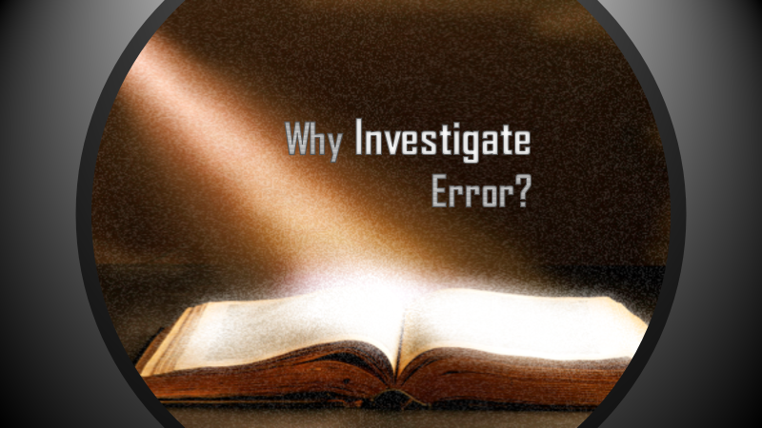

Slide 2
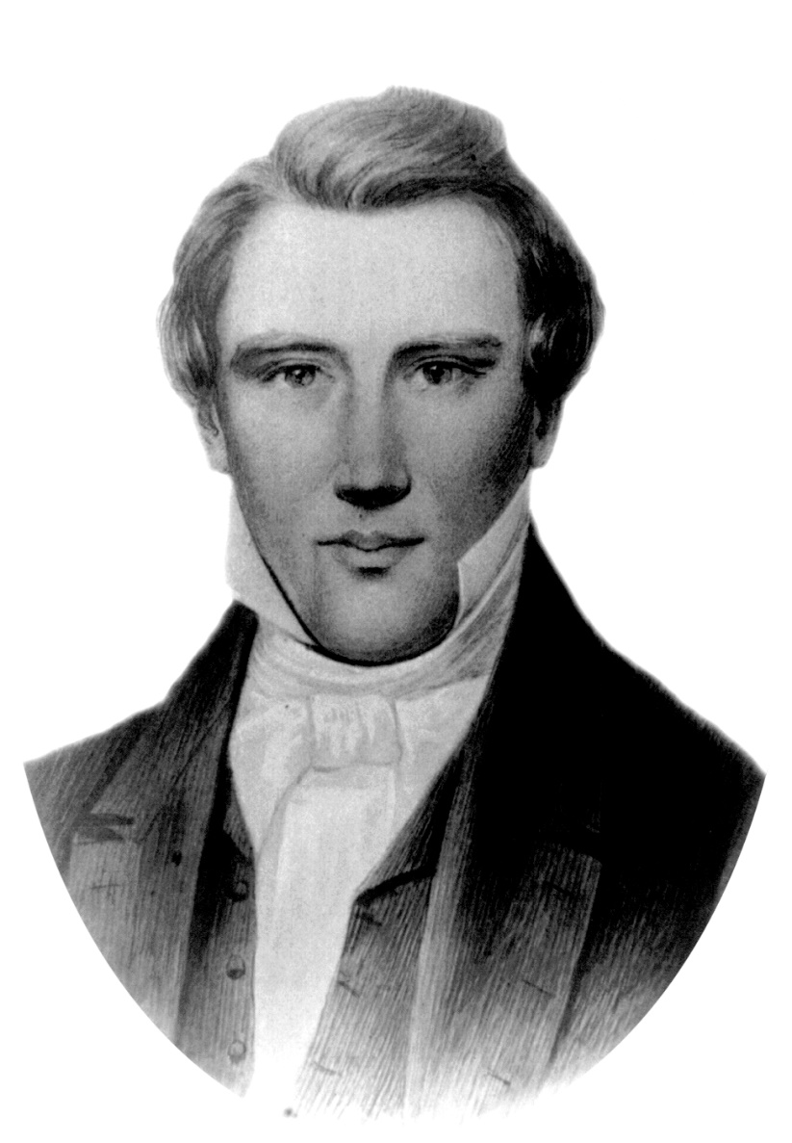
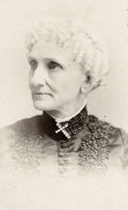
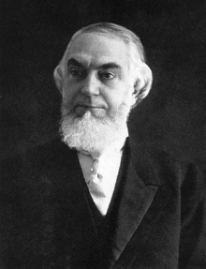
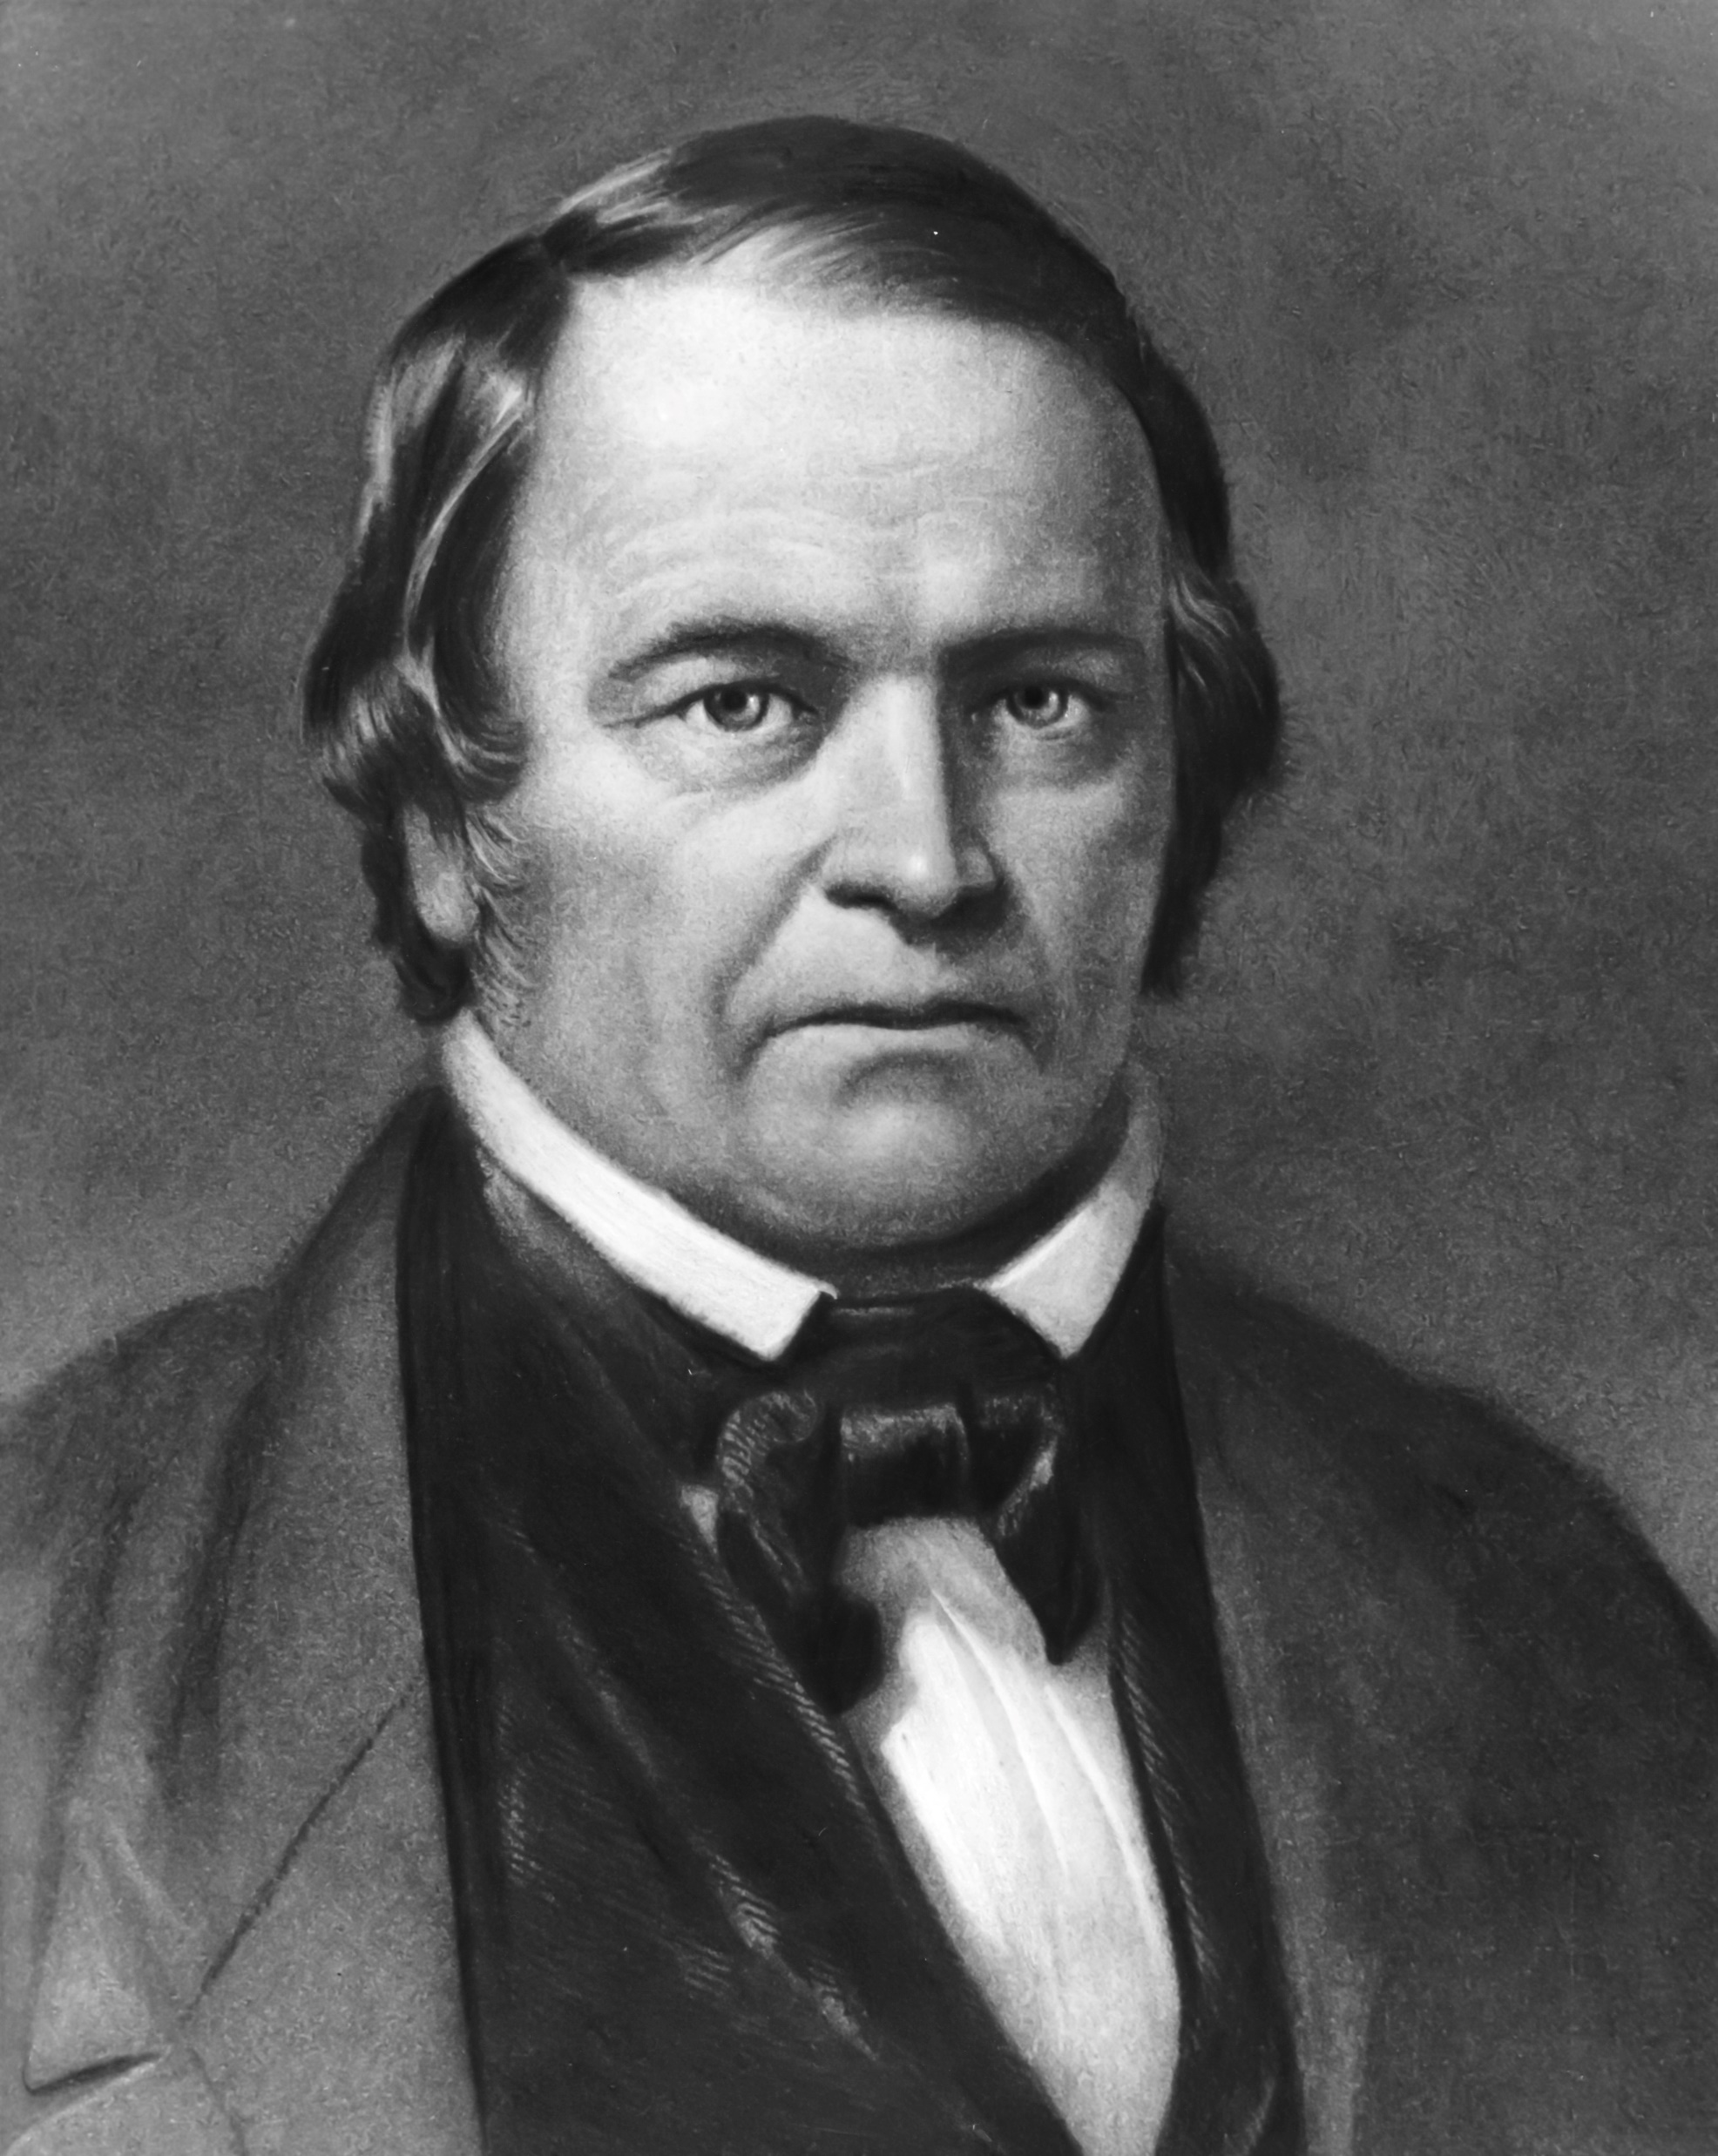
Why Investigate Error?
This Photo is licensed under CC BY-NC-ND
This Photo is licensed under CC BY-SA
This Photo is licensed under CC BY-SA
This Photo is licensed under CC BY-SA

Slide 3
CATHOLICISM | ADVENTISM | RUSSELLISM | MORMONISM
LUTHERANISM | JEHOVAH’S WITNESSES | BAPTIST | CHURCH-GROWTH MOVEMENT
“ For if he who comes preaches another Jesus whom we have not preached, or if you receive a different spirit which you have not received, or a different gospel which you have not accepted—you may well put up with it!” –2 Cor. 11:4
^{FAKE RELIGION}
^{& The Motive To Investigate It}

Slide 4

What Is My Primary Reason For Examining Any False Religion?
To better understand other religions?
To guard against being deceived with fake religion?
To guard against holding up the hands of those in error?
To rescue the lost?
To keep the saved, saved?
To prove my love to Christ?

Slide 5
“Teacher, which [is] the great commandment in the law?"”
22:36 (NKJV)
MATTHEW 22:34-38

Slide 6
Deuteronomy
“You shall love the LORD your God with all your heart, with all your soul, and with all your mind.”
MATTHEW 22:34-38
Framework

Slide 7
9 "Only take heed to yourself, and diligently keep yourself, lest you forget the things your eyes have seen, and lest they depart from your heart all the days of your life. And teach them to your children and your grandchildren,
10 "especially concerning the day you stood before the LORD your God in Horeb, when the LORD said to me, ‘Gather the people to Me, and I will let them hear My words, that they may learn to fear Me all the days they live on the earth, and that they may teach their children.’
DEUTERONOMY 4:9, 10

Slide 8
SEEK HIM – 4:29
LOVE HIM – 6:5
SERVE HIM – 10:12
OBSERVE HIS JUDGMENTS – 26:16
The Bible’s Definition of:
“OBEDIENCE”
“With All Your Heart”
Deuteronomy

Slide 9
Lk. 2:7
maternal
Acts 1:14
disciple

Slide 10
Lk. 2:7
maternal
Acts 1:14
disciple
And it was told Him by some, who said, “Your mother and Your brothers are standing outside, desiring to see You.”
But He answered and said to them, "My mother and My brothers are these who hear the word of God and do it.”
(Luke 8:20, 21)

Slide 11
Lk. 2:7
maternal
Acts 1:14
disciple
And it happened, as He spoke these things, that a certain woman from the crowd raised her voice and said to Him, “Blessed is the womb that bore You, and the breasts which nursed You!”
But He said, “More than that, blessed are those who hear the word of God and keep it!”
(Luke 11:27, 28)

Slide 12
Deuteronomy 13
Testing Error Is A Test Of Our Love
How willing is this person to pursue God when the duty to truth hurts the most?
“With All Your Heart”
Deuteronomy

Slide 13

SEEK HIM – 4:29
LOVE HIM – 6:5
SERVE HIM – 10:12
OBSERVE HIS JUDGMENTS – 26:16
The Bible’s Definition of:
“OBEDIENCE”
JOHN 14:
23 Jesus answered and said to him, "If anyone loves Me, he will keep My word; and My Father will love him, and We will come to him and make Our home with him.
24 "He who does not love Me does not keep My words…

