Slide 3
“AS FOR ME AND MY HOUSE”
Scripture taken from the New King James Version®. Copyright © 1982 by Thomas Nelson. Used by permission. All rights reserved.

Slide 4
JOSHUA’S PATHWAY TO LEADERSHIP
faithful FOLLOWSHIP – 1:1, 6-8
forged FELLOWSHIP – 1:9
formed LEADERSHIP – 1:10, 24:14, 15, 31

Slide 5
the BREAKDOWN of a NATION
“Righteousness exalts a nation,
But sin is a reproach to any people.”
Proverbs 14:34

Slide 6
Children Need Fathering
FATHERS!
EPHESIANS 6:4

Slide 7
LEADERSHIP LESSONS
FATHERS
BE STRONG AND COURAGEOUS!

Slide 8
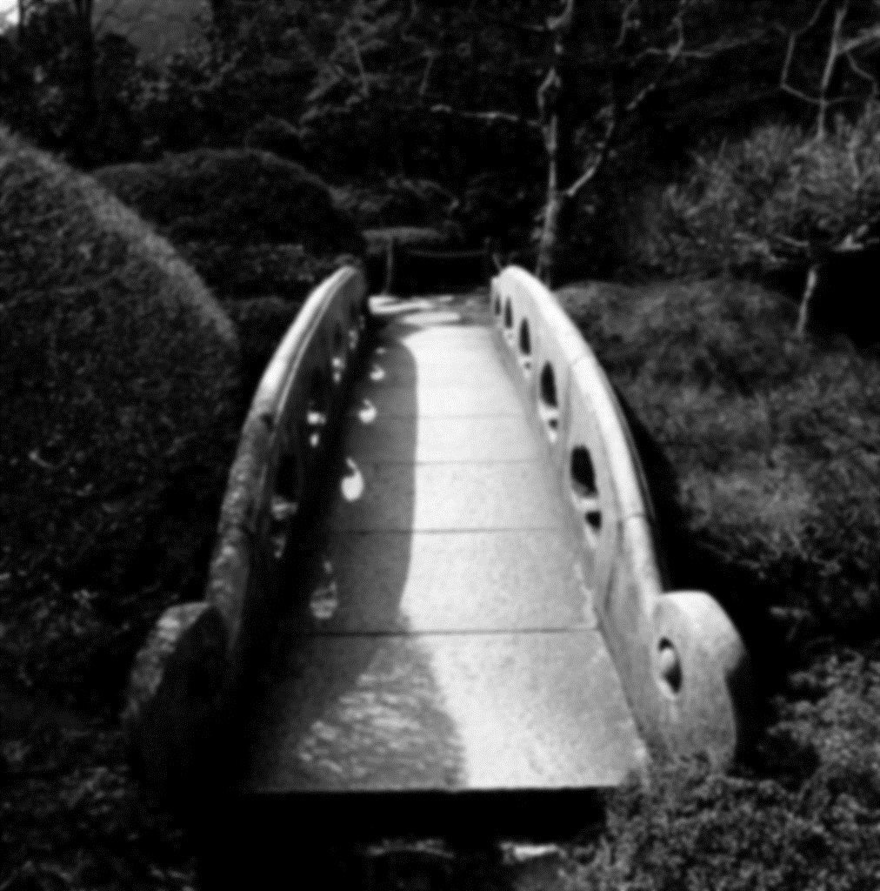
Male Leadership Deficit
“They are bridges to the future. Nations that are populated largely by immature, immoral, weak-willed, cowardly, and self-indulgent men cannot and will not long endure. These types of men include those who sire and abandon their children; who cheat on their wives; who lie, steal, and covet; who hate their countrymen; and who serve not God but money” (James Dobson)

Slide 9
(Ezek. 22:30)
?
“So I sought for a man among them who would make a wall, and stand in the gap before Me on behalf of the land, that I should not destroy it; but I found no one.”
Notes:
How can a society deteriorate to where “a man” who can stand in the gap is not only an endangered species, but is altogether extinct? What did Jehovah find when He scanned the human landscape of Israel? He found prophets who were like a lion tearing prey. They perpetuated falsehoods in the name of God. He also found priests who were profane and could not distinguish between holy and unholy things. When Jehovah looked at the rulers, He saw much of the same —men as wolves, tearing their prey to get personal gain. When He looked at people, He saw oppressors, robbers, as well as a people who abused the poor (Ezek. 22:23-29).
Jehovah found all kinds of sin and sinners, but could not find a real man in the prophets, priests, rulers, or the populace. How could this be? Fundamentally, godly men became extinct because men at one point, whether gradual or rapid, had stopped leading their children in paths of righteousness; righteousness continued to shrink away from the people and sin, like a cancerous tumor, continued to grow.
This was a society devoid of any leader of righteousness, there was not a Moses, not a Joshua, not a David, not a Samuel, not a Daniel that could lead and influence the people for good. Rather it was a society laden with lust, ravaged with savage appetites, broken with infidelity, overflowing with idolatry and adultery; a society full of drunken beasts who pursued what was unlawful.
This was Jeremiah’s complaint against the people (see Jer. 5:1-9). I wish the men of America would wake up to this point. If you are not going to lead in righteousness, then you are going to follow and pursue unrighteousness. The men who were at this time were stout and organized when it came to filling up houses of harlots, they were strong in steadfast in pursuing their neighbors’ wives, but that robust quality could not be tamed and trained in righteousness. Where did it lead them? Into being rejected by their Creator and buried in a Babylonian grave of captivity and oppression.

Slide 10
COURAGE to train your children

Slide 11
1 John 2:13, 14
1
13 I write to you, fathers, Because you have known Him who is from the beginning. I write to you, young men, Because you have overcome the wicked one. I write to you, little children, Because you have known the Father.
14 I have written to you, fathers, Because you have known Him who is from the beginning. I have written to you, young men, Because you are strong, and the word of God abides in you, And you have overcome the wicked one.
2
3

Slide 12
COURAGE to train your children
COURAGE to discipline
COURAGE to watch for danger

Slide 13
Where Fathers Can Lead:
Peer pressure (1:10)
Seeking the wisdom of God (2:1-9)
Discerning the right path (2:10-15)
Honoring the Lord (3:1-12)

Slide 14
Where Fathers Can Lead:
Calm during terror (3:25, 26)
Sound business practices (3:27, 28; 10:4; 20:17)
Avoiding sexual immorality (5:15-23)
Avoiding envy (3:31ff)
Avoiding debt (6:1-5; 22:7)

Slide 15
COURAGE to train your children
COURAGE to discipline
COURAGE to watch for danger
COURAGE to stand alone

Slide 16
“In the fear of the LORD there is strong confidence, And His children will have a place of refuge” (Prov. 14:26)
FATHERS
SPEAK CONFIDENTLY!

Slide 17
The next GENERATION Inherits Everything!
our world
our positions
our name
our reputation
our pursuits
Notes:
Ecclesiastes 2:18, 19. Everything we have, every position of authority, every skill and trade on this planet will be turned over to the next generation.

Slide 18
Subdue and Tend:
The spirit – Proverbs 25:28
“Whoever has no rule over his own spirit Is like a city broken down, without walls.”
The body – 1 Thessalonians 4:4, 5
“That each of you should know how to possess his own vessel in sanctification and honor, not in passion of lust…”
The house – 1 Timothy 3:4
“One who rules his own house well…”

