Slide 1
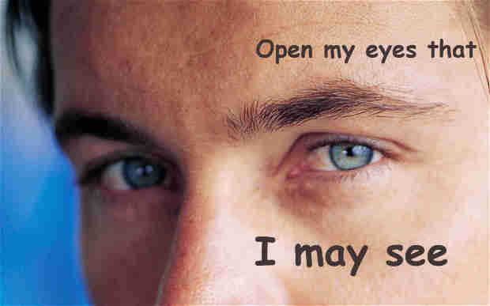
Scripture Reading: Psalm 119:17-24
(Part 2)

Slide 2
Review (Part 1)
Spiritual blindness, John 9:39-41
Invisible God has made Himself visible---
His presence through Creation
His character and will through Christ
We see with eyes of faith

Slide 3
Faith in the unseen
God’s providence and sovereignty
Faith that Christ acts to guard our souls
Lift our eyes and see God’s help
Army of God
2 Kings 6:13-18
(Review Part 1)

Slide 4
Part 2
Unity, 2 Timothy 3:16
66 books, 40 men, written over 1500 years
Different backgrounds, places, and languages
Harmony in structure, theme, and doctrine
Wondrous Things from God’s Law
Psalm 119:18

Slide 5
Part 2
Fulfilled prophecy, Isaiah 41:21-24; 42:9; 46:10
Eyes opened, Lk. 24:44-45
Fulfilled in Christ, Acts 3:18 (2 Peter 1:20-21)
Wondrous Things from God’s Law
Psalm 119:18

Slide 6
Part 2
Plan of Redemption
God’s plan, 1 Corinthians 2:9; Galatians 4:4-5
For all the world, Matthew 28:18-20
Wondrous Things from God’s Law
Psalm 119:18

Slide 7
Part 2
Protection against sin
Obey with whole heart, Psalm 119:9-11
Truth that leads to eternal life, Psa. 119:160
Jesus, John 1:14, 17; 14:6
Light and life, John 8:12, 31-32
Wondrous Things from God’s Law
Psalm 119:18

Slide 8
Part 2
By His Word, John 20:14-16 (Rom. 10:17)
Fix our eyes on Jesus, Luke 4:20
Author of our faith
Finisher of our faith
Jesus
Hebrews 2:9 Hebrews 12:1-4

Slide 9
We Pray to God to See Us and to Act Isaiah 37:14-20; Luke 18:6-8
Part 2
When spiritual enemies surround us
Pray for relief, Matthew 26:39
Pray for enemies, Matthew 5:44 (Isaiah 37:20)
Sickness and death, Isaiah 38:1-6; James 5:13-14

Slide 10
Part 2
Like Balaam, the rebellious should fall down before God “with eyes wide open” (Numbers 24:2-4, 15-16)

Slide 11
Part 2
“Blessed are those who have not seen and yet have believed.” (John 20:29)

