Slide 1
Lessons From Job

Slide 2
Purpose of Book: To demonstrate God’s absolute sovereignty over all things; To elicit unwavering trust in Him
Written For: All people; especially those who are suffering

Slide 3
Prior to Affliction
Job 1:1-8
Job & His family
Incredibly blessed
“…blameless and upright…feared God and shunned evil.”

Slide 4
Satan Enters Scene
Job 1:6-12
Satan insinuates Job serves God because of divine protection (vs. 10)
Satan permitted to test Job (1:12-20)
Job retains his integrity, 1:21-22
How would YOU have handled this situation?

Slide 5
Satan Re-Enters the Scene, 2:1-10
‘If Job’s body were afflicted, he would curse…’, 2:1-5
Satan permitted to smite Job with horrible disease, 2:7-8
Words from Job’s wife, 2:9-10
How would have YOU handled this situation?

Slide 6
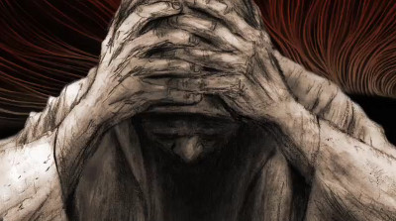
Job’s Complaint
Chapter 3
10:1-3
Can you tell Job is hurting?!

Slide 7
The arrival of Job’s Friends
Seven days of silent sympathy, 2:11-13
Eliphaz told Job that the innocent do not suffer, (4:1-21) implying that Job must be guilty. He called Job foolish (5:1-7), and he encouraged Job not to reject God’s discipline (5:17-27).

Slide 8
The arrival of Job’s Friends
Bildad told Job that God does not reject the blameless (8:1-22), and God puts out the light of the wicked (18:1-21). He accused Job was wicked and blameworthy.
Zophar told Job that he deserves worse (11:1-20), and wicked men like him will suffer (20:1-29).

Slide 9
Elihu’s Entrance
(Chapter 32-37)
33:12-14; God is greater than man!
34:10-12; 21; God is not evil, He knows what we go through
35:1-8; 16, Who are we in comparison to God!?

Slide 10
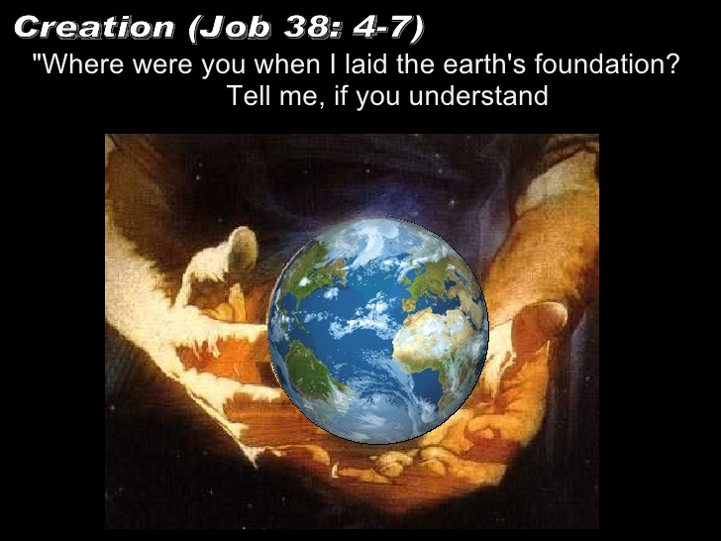
The Lord Answers
Chapter 38-39
38:1-11; Where were you, Job?

Slide 11
Job’s Confession
40:3-5; 42:1-6
The Lord’s rebuke of Eliphaz, Bildad, and Zophar
Commands offering of sacrifices, 42:7-9

Slide 12
Job Prays & Is Comforted
42:10-17
Blessings were “more than his beginning...”

Slide 13
What can YOU take-away?
God ALWAYS knows what we are going through, Heb. 4:15-16; Job 35:21
Through trials and tests, seek God for Wisdom, James 1:5-6
We do not always know why, but remain faithful like Job, 13:15
Why me? Why not wicked men? Job 21:7-9; 30
Let us not become self-righteous, Job 32:1-2; 42:6

Slide 14
Job 42:1-6
God is omnipotent (42:2a) He can do all things.
God is sovereign (42:2b) His will is always accomplished. No purpose of God can be removed.
God is omniscient (42:3) While our knowledge is limited, God knows all things at all times.
God is independent (42:4) He does not need anything from us. We are the dependent party!
God has revealed himself (42:5) God has revealed himself to us through His creation, and His Word.
God is holy (42:6) He expects us to come before him in humility and repentance.

Slide 15
Will tests in life make us:
BITTER or BETTER
God rewarded Job for his faithfulness,
Would you be found faithful today?

Slide 16
Become a child of God TODAY!
Hear the gospel – Romans 10:17
Believe the gospel of Christ – Hebrews 11:6
Confess faith – Romans 10:9-10
Repent of sins – Acts 17:30
Be baptized – Mark 16:16
Live faithful all the days of your life – 2 Timothy 2:1-5
IF you are a child of God, and have sinned, NOW is the time for correction!

