Slide 1
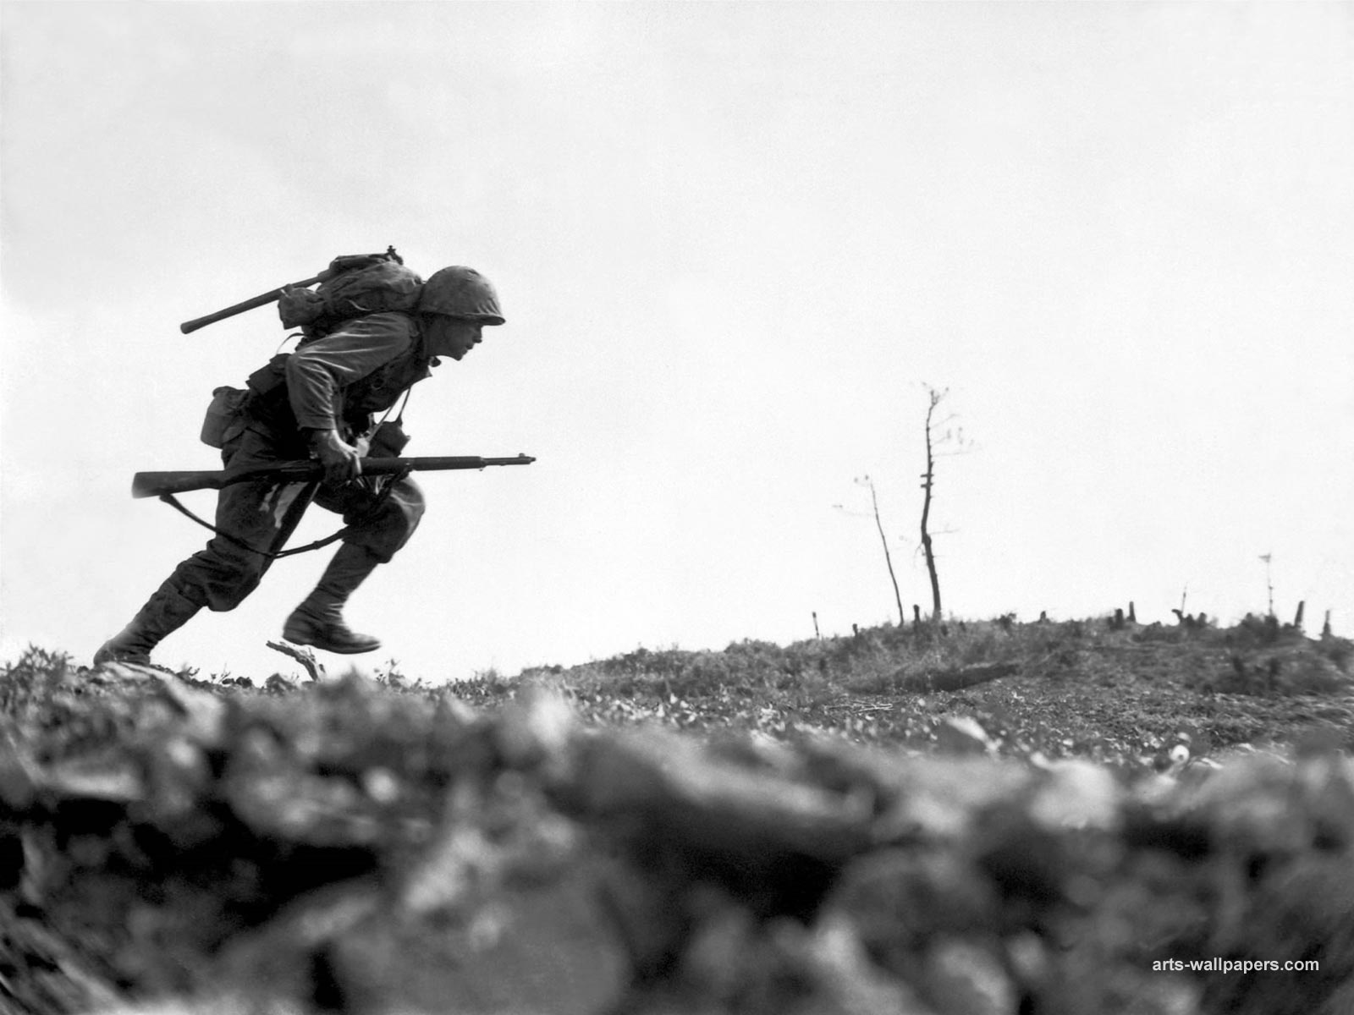
Spiritual Warfare

Slide 2
Introduction
Are you in a war today? Yes, we all are!
  GOOD vs. EVIL
If you are a child of God, you are a soldier of Christ!
Have you forgotten you are a solider?
Do you want to be a soldier for Christ?
Remember 3 A’s: our Adversary, our Armor, and our Aim

Slide 3
Ephesians 6:10-13
¹⁰ Finally, my brethren, be strong in the Lord and in the power of His might. ¹¹ Put on the whole armor of God, that you may be able to stand against the wiles of the devil. ¹² For we do not wrestle against flesh and blood, but against principalities, against powers, against the rulers of the darkness of this age, against spiritual hosts of wickedness in the heavenly places. ¹³ Therefore take up the whole armor of God, that you may be able to withstand in the evil day, and having done all, to stand.

Slide 4
Ephesians 6:14-20
¹⁴ Stand therefore, having girded your waist with truth, having put on the breastplate of righteousness, ¹⁵ and having shod your feet with the preparation of the gospel of peace; ¹⁶ above all, taking the shield of faith with which you will be able to quench all the fiery darts of the wicked one. ¹⁷ And take the helmet of salvation, and the sword of the Spirit, which is the word of God; ¹⁸ praying always with all prayer and supplication in the Spirit, being watchful to this end with all perseverance and supplication for all the saints— ¹⁹ and for me, that utterance may be given to me, that I may open my mouth boldly to make known the mystery of the gospel, ²⁰ for which I am an ambassador in chains; that in it I may speak boldly, as I ought to speak.

Slide 5
We can only stand strong in the Lord’s power, Eph. 6:10
It is God’s armor that protects us, Eph. 6:11, 2 Cor. 10:4
Our battle is ultimately against spiritual forces of evil in the world (led by the Devil), Eph. 6:11

Slide 6
Ephesians 6:14-18
14 – “..gird your waist with Truth”
  Truth holds all things in place, truth must be at the core!
14 – “..put on the breastplate of righteousness”
  Righteousness and righteous living will be our protector
15 – “..shod your feet with the preparation of the gospel of peace”, Our feet guide us….
  Compare this to Romans 10:14-15

Slide 7
Ephesians 6:14-18
16 – “..taking the shield of faith”
  Without the shield, the soldier WILL suffer
  Without faith, we cannot please God; we will suffer (Heb. 11:6)
17 – “..take the helmet of salvation”
  Hope of salvation preserves us from the battles we will fight
  Without this salvation, we have no reason to suffer as a soldier, 2 Tim 2:3
17 – “..the sword of the spirit”
  We attack the enemy with the sword (Word of God) Heb. 4:12-13
  It can prick the hearts of humanity because it is a sharp sword!
  We must bring the sword of out of the holder to be effective…
18 – “..praying always”

Slide 8
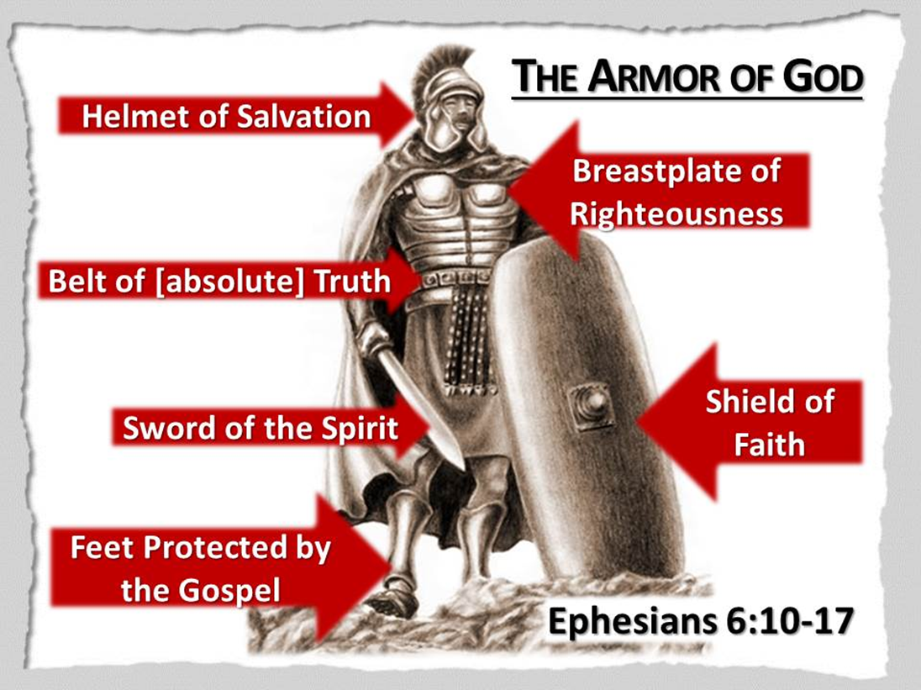

Slide 9
Armor of God For What Purpose?
“…To stand against the wiles of the devil.”, Eph. 6:11
  Our enemy is the devil! 1 Peter 5:8
Without this armor, we will not stand strong
Only those in Christ are armed to fight the enemy
  Let us not fight against Christ, nor our brothers and sisters

Slide 10
How Do I Acquire this Armor?
Understand that the Word of God is truth, John 17:17
Chose righteous living TODAY by living the way God demands, James 1:19-25; Col. 3:5; Phil. 4:8-9; Eph. 4:31-32
Learn, Read, Study the gospel of peace, James 1:21, let it lead you
Have faith in God, Christ, His plan of salvation
Be Saved TODAY
Use your new armor and sword to be victorious in Christ
Don’t forget to pray!

Slide 11
Are you a solider for Christ TODAY?
Are you a soldier for the Devil TODAY?
Who will you decide to fight for?
We know the victor of this war, Chose to be on the winning side
Victory is found in Christ, and Him alone. HE is the winner of this war 1 John 5:4

