Slide 1
Hard Words To Say

Slide 2
Why is this lesson important?
Our words are important, Prov. 18:21; James 3:6-12
Will can / will be judged by our speech
We must choose our words carefully, Prov. 21:23
The Christian must set a good example for others, our words are a way we demonstrate this example
Some words are hard to say!

Slide 3
Word #1 “NO”
Why can “NO” be hard to say?
Difficult to say in times of temptation, 2 Sam. 11..But doable! Gen. 39:7-12, 21
A desire becomes more important than following commands, Gen. 3
Can be afraid of conflict, Pilate in Jn. 19:5-16

Slide 4
Word #1 “NO”
Why can “NO” be hard to say?
Fear of being punished
Fear of being different, 1 John 2:15-17
Because it is sometimes easier to say “YES”

Slide 5
Word #2 “I’m Sorry”
Why can “I’m Sorry” be hard to say?
Feelings of anger are held on too tight
Too prideful to admit fault, Prov. 16:18
It is easier to blame, than to admit fault, Gen. 3:11-12, 15;

Slide 6
Word #2 “I’m Sorry”
Why can “I’m Sorry” be hard to say?
We try to reduce our errors
“I’m Sorry” admits I was wrong
We must accept the truth..2 Sam.12:13; 24:10
Have some integrity! Prov. 11:3

Slide 7
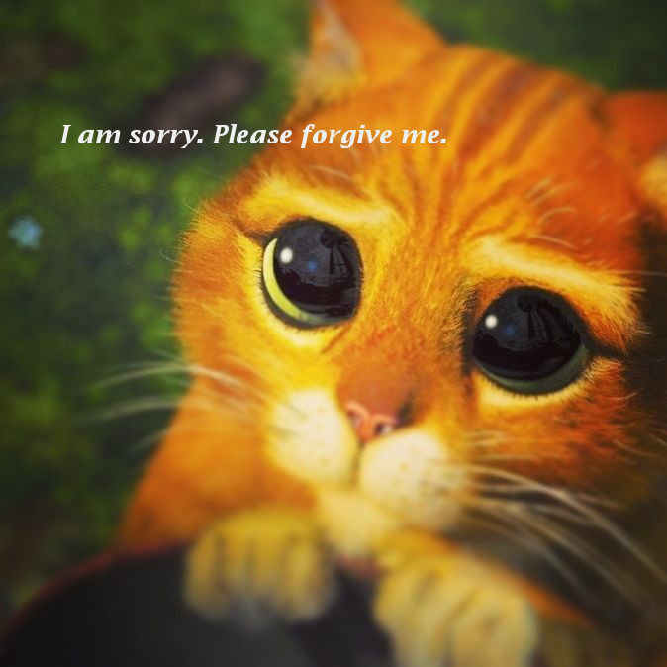

Slide 8
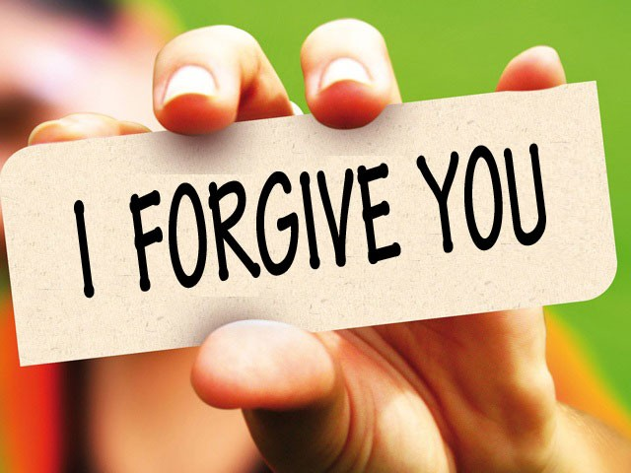
Word #3 “I Forgive You”
Why Is “I forgive you” hard to say?
It can be hard to forgive
BUT, it is necessary, Matt. 6:14-15
Luke 17:3-4
Eph. 4:31-32
Mark 11:25
“I forgive you” means we
have to let go...this can be hard!

Slide 9
Word #4 “Thank You”
Why is “Thank you” hard to say?
Not saying this means you are not appreciative
Are YOU ungrateful? YOU have so much to be grateful for! John 3:16
1 Chron. 16:34; Ps. 7:17; 1 Cor. 1:4; Eph. 5:4; Phil. 4:6; Col. 3:15; 1 Thess. 5:18

Slide 10
IF YOU ARE NOT A CHRISTIAN:
SAY “NO!” to sin, and your past way of living, Rom. 6, Eph. 5:8-13
SAY “I’M SORRY” to God, repent and be baptized, Acts 2:38
He WILL FORGIVE you, 1 Jn. 1:9; Matt. 6:14-15
Be THANKFUL for this salvation, Col. 1:12

