Slide 1




Philippians 3:7-16
The Possibility of Faithfulness
Notes:
To view this presentation, first, turn up your volume and second, launch the self-running slide show.

Slide 2

Impossibility of Apostasy
“Beware, brethren, lest there be in any
of you an evil heart of unbelief in
departing from the living God”
(Hebrews 3:12)
Therefore let him who things he stands take heed lest he fall. (1 Corinthians 10:12)
Notes:
To view this presentation, first, turn up your volume and second, launch the self-running slide show.

Slide 3

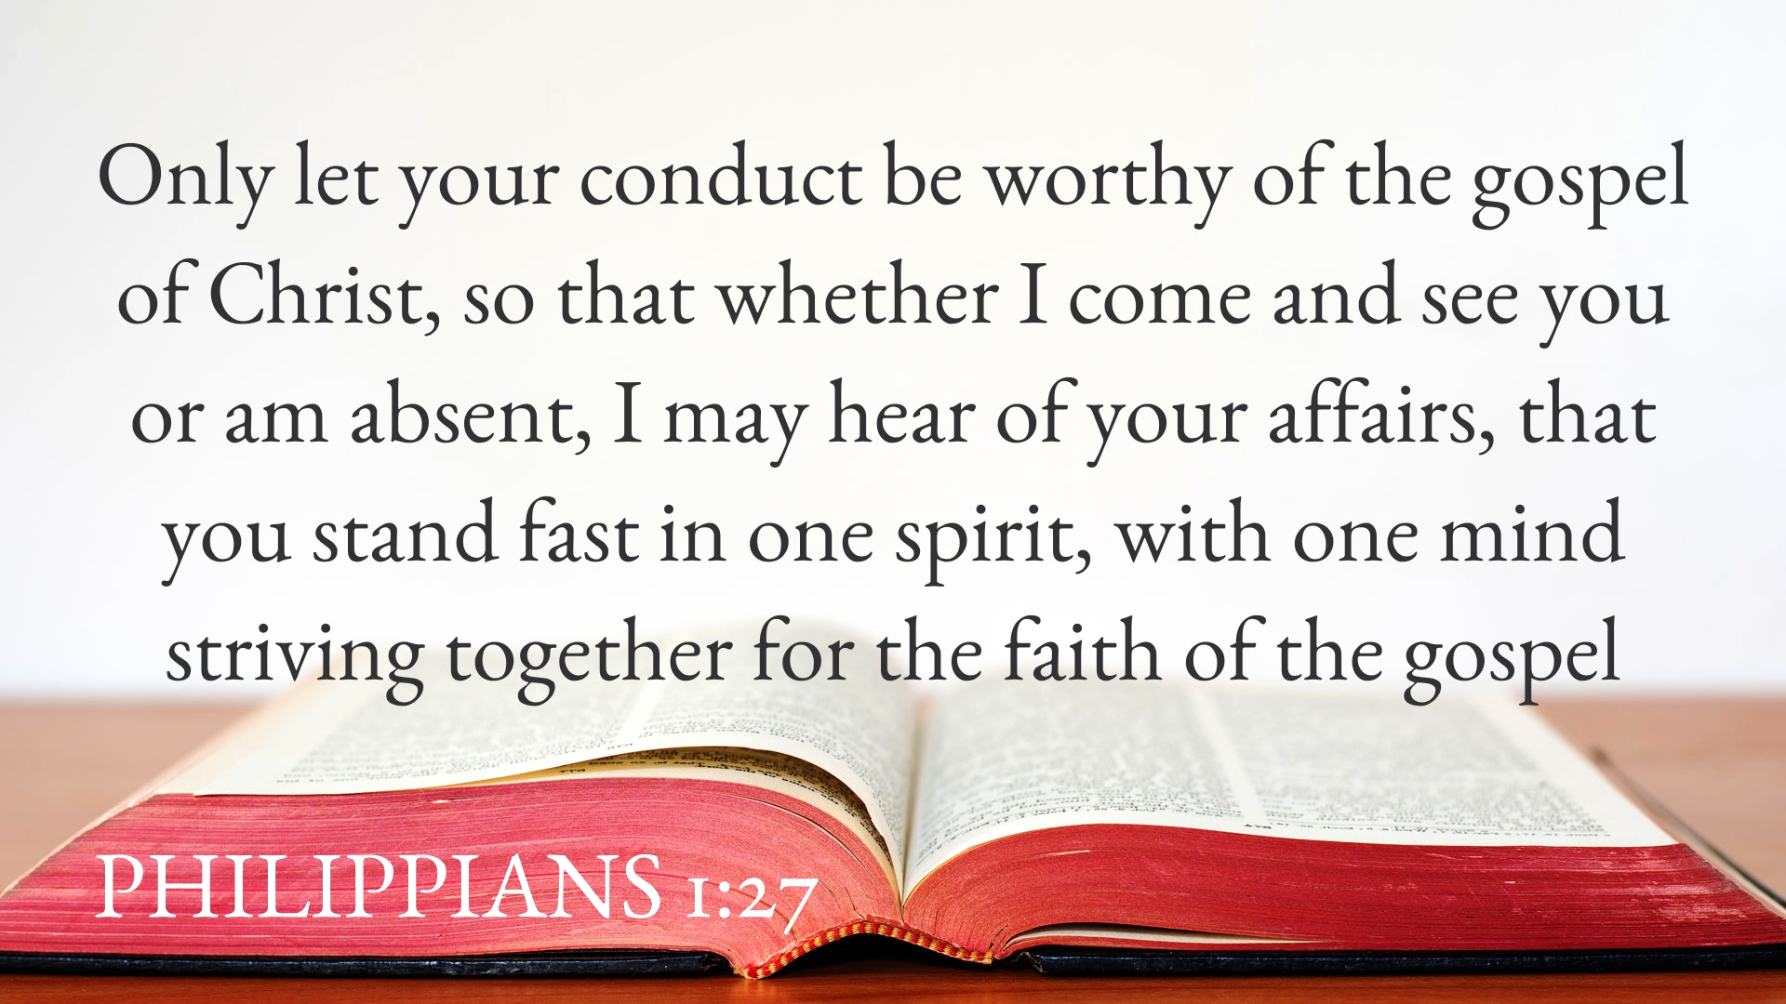


Slide 4
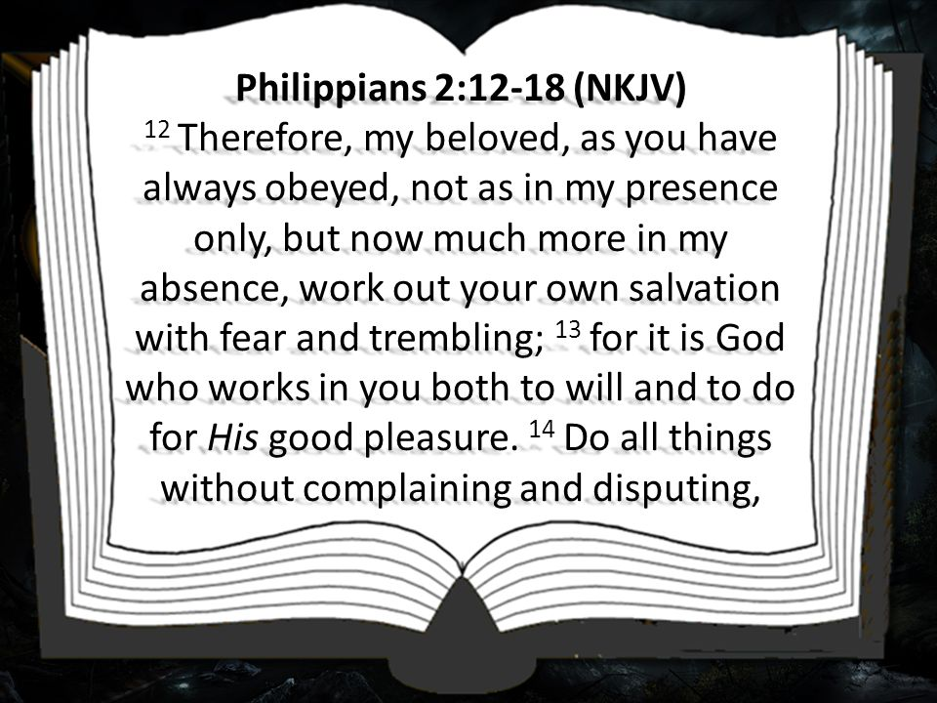
4

Slide 5




Put no confidence in the flesh
Philippians 3:3-11
Notes:
Presentations are a powerful communication medium.

Slide 6
Unwavering Priorities
Philippians 3:7-11 (Matt. 6:33, 24)
Gain for me, 3:7
Loss for Christ, 3:7-8; Luke 14:33
No Confidence in the Flesh
6
Notes:
To view this presentation, first, turn up your volume and second, launch the self-running slide show.

Slide 7
Unwavering Priorities
That I may gain Christ, 3:8
  Walk as He walked, 1 John 2:3-6
  Keep His word, John 14:21-24
  Do not love the world, 1 John 2:15
  If not…destruction, Philippians 3:18-19
No Confidence in the Flesh
7
Notes:
To view this presentation, first, turn up your volume and second, launch the self-running slide show.

Slide 8
Set Your Goals
Philippians 3:9-11
To be found in Him, 3:9; Col. 2:6
  In Him (Romans 3:24; 8:1; 6:11)
    Not my own righteousness (from law)
    Righteousness through faith (from God)
No Confidence in the Flesh
Notes:
To view this presentation, first, turn up your volume and second, launch the self-running slide show.

Slide 9
Set Your Goals
Philippians 3:9-11
That I may know Him, 3:10
  Know the power of His resurrection,
  Romans 6:4-9, 10-12
  Fellowship of His sufferings, Gal. 2:20
No Confidence in the Flesh
Notes:
To view this presentation, first, turn up your volume and second, launch the self-running slide show.

Slide 10
Set Your Goals
Philippians 3:9-11
Attain to the resurrection, 3:11
  Arrive, achieve with effort, Acts 26:15;
  John 5:28-29; Philippians 3:21
  Be with the Lord, Phil. 1:21, 23
No Confidence in the Flesh
Notes:
To view this presentation, first, turn up your volume and second, launch the self-running slide show.

Slide 11
Philippians 3:12-14
Faithful will see Christ, 1 John 3:2
Not Yet…Paul was not finished
Our Blessed Assurance
11
Notes:
To view this presentation, first, turn up your volume and second, launch the self-running slide show.

Slide 12
Philippians 3:12-14
I have not already attained (seize)
  Not yet apprehended, 3:13 (win),
  1 Cor. 9:24
  Blessed reward, 1 Peter 1:9
Our Blessed Assurance
Notes:
To view this presentation, first, turn up your volume and second, launch the self-running slide show.

Slide 13
Philippians 3:12-14
I am not already perfected
  God’s work not complete, so Paul
  would not stop working, Heb. 6:1
    You have work to do, Phil. 2:12-14
    Elijah, 1 Kings 19:9, 15-16
Our Blessed Assurance
Notes:
To view this presentation, first, turn up your volume and second, launch the self-running slide show.

Slide 14
Philippians 3:12-14
I press on to lay hold of the prize
of eternal life, 3:13-14
  Forget yesterday, 1 Timothy 1:12-14
  Reach forward…press toward goal,
  1 Corinthians 9:26-27
Our Blessed Assurance
Notes:
To view this presentation, first, turn up your volume and second, launch the self-running slide show.

Slide 15
Philippians 3:12-14
I press on to lay hold of the prize
of eternal life, 3:13-14
  Confidence of your salvation is shown
  by pressing forward with assurance,
  Philippians 2:12; Hebrews 6:10-12
Our Blessed Assurance
Notes:
To view this presentation, first, turn up your volume and second, launch the self-running slide show.

Slide 16
Philippians 3:15-16
Mature in your faith, 3:15;
Hebrews 5:12-14; 2 Peter 3:18
Have the same mind as Paul, 3:15;
Colossians 3:2
-Guided by God’s revealed word
Practical Application
Notes:
To view this presentation, first, turn up your volume and second, launch the self-running slide show.

Slide 17
Philippians 3:15-16
Continue to live faithfully, 3:16;
Hebrews 3:14; 4:11
As you began, Galatians 5:6-7
By the same rule, 2 Corinthians 5:7
Same mind: Of Christ, Phil. 2:5 (1-4)
Practical Application
Notes:
To view this presentation, first, turn up your volume and second, launch the self-running slide show.

Slide 18
2 Timothy 4:7-8
The Possibility of Faithfulness
18
Notes:
To view this presentation, first, turn up your volume and second, launch the self-running slide show.

