Slide 1
“I have overcome the world”
Part 1
Revelation 12:7-12
John 16:33

Slide 2
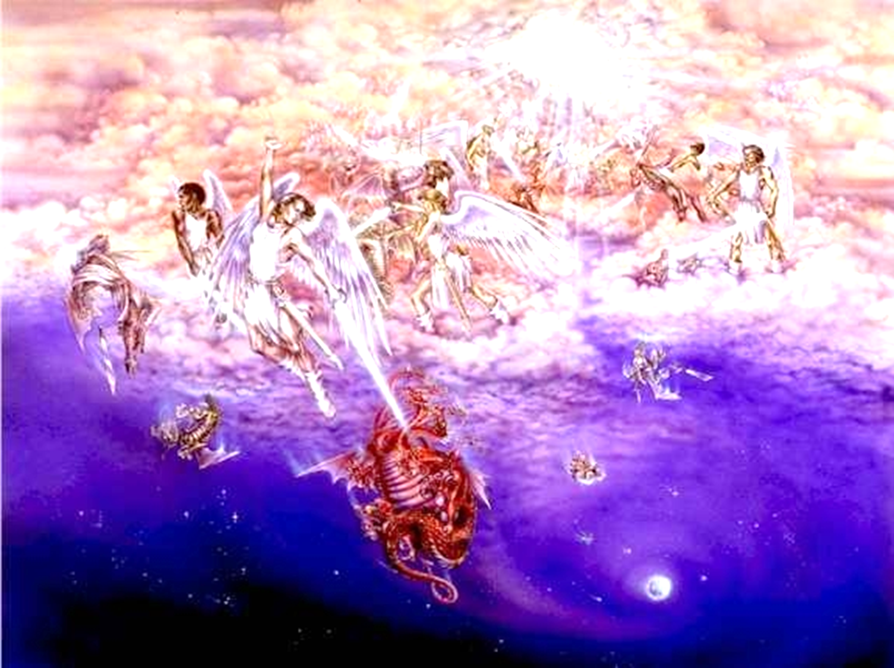
“Now is the judgment of this world; now the ruler of this world will be cast out.”
(John 12:31)
Art by Pat Marvenko Smith ©
www.revelationillustrated.com
Revelation 12:7-10
Part 1

Slide 3
Jesus has overcome the world
He has overcome SATAN, 1 John 3:8 (Revelation 12:8-9)
Crucifixion “cast out” Satan, John 12:27-31; Hebrews 2:14-15
NOW: We resist the devil, James 4:7; 1 Peter 5:8-9
John 16:33
Part 1

Slide 4
Jesus has overcome the world
He has overcome SIN, 2 Corinthians 5:18-21; 1 Peter 2:23-24 (Isaiah 53:4-6)
“Condemned sin in the flesh,” Romans 8:3 (1-4)
NOW: We overcome sin through Him, Romans 6:5-11
John 16:33
Part 1

Slide 5
Jesus has overcome the world
He has overcome DEATH, John 11:25-26; Rev. 1:18
Physical death in resurrection, 11:25; 1 Cor. 15:20
Spiritual death in salvation, 11:26; Romans 6:21-23
NOW: In Christ, we are “free from the law of sin and death,” Romans 8:1-2
John 16:33
Part 1

Slide 6
Jesus has overcome the world
He has overcome the DARKNESS of IGNORANCE, ERROR AND IMMORALITY, John 1:4-5; Eph. 4:17-20
Light bringing salvation, Luke 2:29-32 (Matthew 4:16)
Light of the world, John 8:12 (9:5)
Path to God, John 14:6
NOW: We walk in the light and are cleansed, 1 John 1:6-7; Ephesians 4:20-24
John 16:33
Part 1

Slide 7
Jesus has overcome the world
Overcomes every FALSE DOCTRINE, 1 John 4:1-4
Christ is mightier, 4:4-6 (Galatians 1:8-9)
NOW: We will not be deceived by error, 1 John 2:12-14
John 16:33
Part 1

Slide 8
Jesus has overcome the world
Victory over Satan, sin and death is through Christ, 1 Corinthians 15:50-57
We share in His victory! Revelation 22:17
John 16:33
Part 1

