Slide 1

Peddling the Gospel
2 Corinthians 2:17

Slide 2
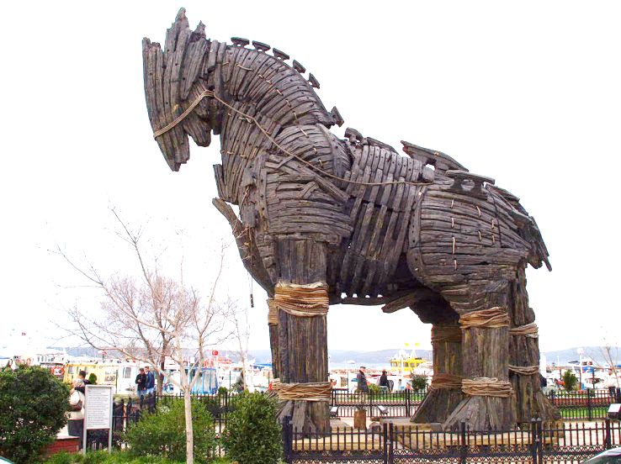
Peddling the Gospel
2 Corinthians 2:17
Marketing the Gospel
Adulterate for gain
Hucksters
Deceitful, 2 Cor. 4:2
Philippians 3:17-19
2 Corinthians 11:3-4

Slide 3
First Century Gospel Preaching
Luke 14:23
Thessalonian model, Acts 17:2-4; 1 Thess. 2:1-13
  Use access to reason and persuade from Scriptures
  Not with: Error, uncleanness, deceit, pleasing men, flattery, a pretext for greed, for the glory of men
  With: The gospel, pleasing God, gentle, our own lives, worked blamelessly, exhortation, comfort, imploring lives worthy of God

Slide 4
Churches are Marketing the Gospel
“Offer food, fun and frolic, and they will come.”
  The gospel draws the lost to Christ, John 6:44-45
  Jesus and apostles did not use such tactics,
  1 Corinthians 2:1-5
  What about Jesus feeding the multitudes?
  Mark 6:30-36; John 6:26

Slide 5
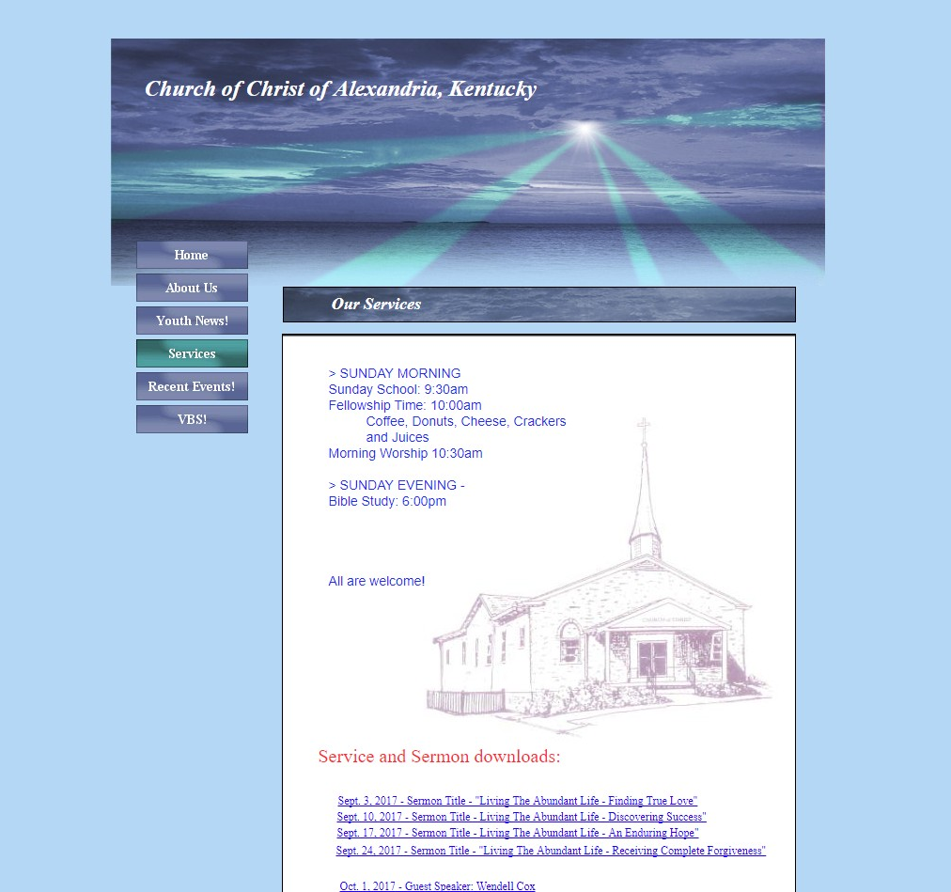
The
Social Gospel
“Fellowship Time” Coffee, Donuts, Cheese, Crackers and Juices
5

Slide 6
The
Social Gospel
Fuquay-Varina church of Christ
(Raleigh, NC)
Special Activities
  Teen Weekend
  Carolina Bible Camp
  Craft-Away Weekend
  Various Sports and Games
  http://fuquaychurch.com/special-activities/
“Non-institutional”
“Conservative” church of Christ
6

Slide 7
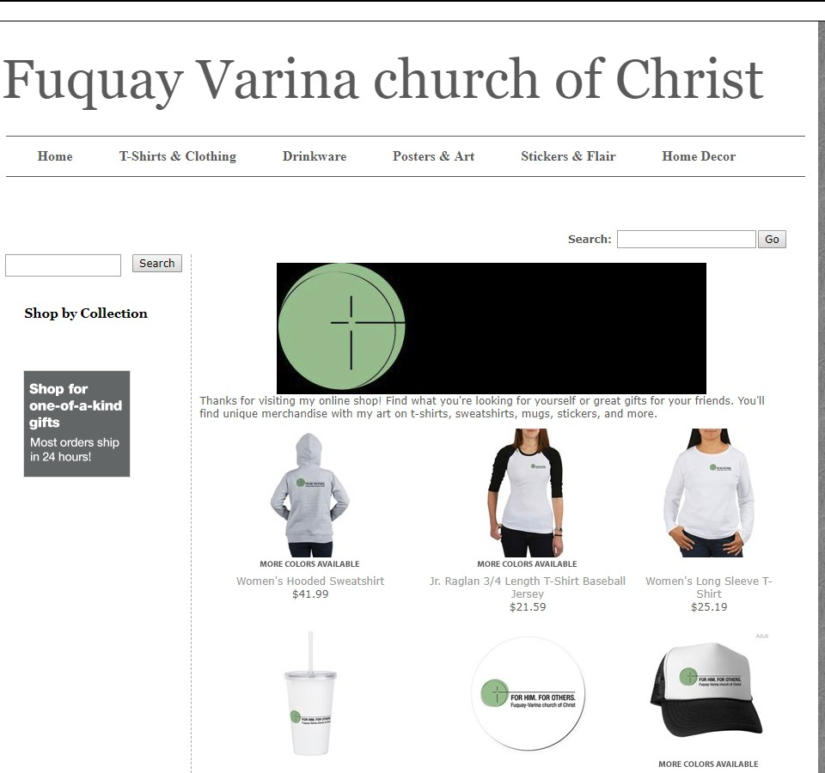
The
Social Gospel
FOR HIM. FOR OTHERS.
Fuquay-Varina church of Christ
7

Slide 8
Churches are Marketing the Gospel
“Change the name, and they will come.”
  Church belongs to Christ, Matthew 16:18; Romans 16:16
  Denominations have changed their names:
    1st Church of God (Evansville IN): “Mount Pleasant Church”
    Nazarene Church (Newburgh IN): “Eagle’s Way Church”
  Churches of Christ have changed their names:
    Oak Hills Church of Christ: “Oak Hills Church”
    “The church meets here,” “Christians meet here,” etc.

Slide 9
Churches are Marketing the Gospel
“Touch their emotions, and they will come.”
  Nostalgia
    “Finding the Way Back to Mayberry”
    Bible classes based on The Andy Griffith Show
  Trust in the Lord, not your heart, Jeremiah 17:9-10; Proverbs 14:12

Slide 10
Churches are Marketing the Gospel
“Dramatize it, and they will come.”
  Go preach; Not “Go, produce a drama,” 2 Timothy 4:2
    Paul was appointed a preacher, apostle and teacher,
    not a performer, 2 Timothy 1:11
    Preaching makes disciples; Watching a play makes theatre, Acts 13:42-44; 14:21-22

Slide 11
Churches are Marketing the Gospel
“Don’t condemn sin, and they will come.”
  Say things like…
    “We are all broken people desperately in need of grace.” (Romans 5:1-2; 8:1-2)
    “God judges…we don’t.” (John 7:24)
    “We are an accepting church.” (2 John 9-11)

Slide 12
Why Are Such Things Being Done?
Marketing
the Gospel
What people want, 2 Tim. 4:3-4 Luke 9:23 (Acts 26:9)
False views of the church
They are popular, 1 Samuel 8:5-7 (Numbers 14:6-10)
“You can’t argue with success”
1 Samuel 15:22-23

Slide 13
Defending It
Marketing
the Gospel
“Just being wise about spreading the gospel.” Matthew 10:16
  Without Bible authority,
  wisdom is earthly and vain, Galatians 1:6-9
  Gospel preaching is God’s wisdom, 1 Corinthians 1:21

Slide 14
Defending It
Marketing
the Gospel
“These are just expediencies to spread the gospel.”
  Not when they change the force and effect of God’s command
  Must first be authorized,
  1 Corinthians 10:23
    Eating donuts is not preaching
    Language school is not preaching

Slide 15
Defending It
Marketing
the Gospel
“You’re a traditionalist, an alarmist, and an extremist.”
  God-given way is right, and endures test of time, Jeremiah 6:16
  It is right to call for Bible authority, and to oppose error,
  Romans 16:17; Jude 3; 1 John 4:1
  Give us Scripture, not name-calling

Slide 16
Defending It
Marketing
the Gospel
“You don’t seem to care for the lost; You are too negative and too condemning.”
  As positive as Jesus is about truth
  As negative as Jesus is about error
  God: Nadab, Abihu and Uzzah, Leviticus 10:1-2; 2 Samuel 6:6-7
  Jesus: Sadducees, Matthew 22:29

Slide 17
“For we are not, as so many, peddling the word of God; but as of sincerity, but as from God, we speak in the sight of God in Christ.”
(2 Corinthians 2:17)
We Must Never Peddle the Gospel

