Slide 1
Spirituality and Pure Religion
Colossians 2:20-23
Part 1

Slide 2
Spirituality?
Spirituality may refer to almost any kind of meaningful activity, especially a “search for the sacred.” It may also refer to personal growth, blissful experience, or an encounter with one’s own “inner dimension.” (Wikipedia)

Slide 3
Viewed as Contradictory
Spiritual
Religious
Positive
Journey of self-discovery
Emotionally fulfilling
Rewarding
Negative
Legalistic
Cold
Demanding
Destructive

Slide 4
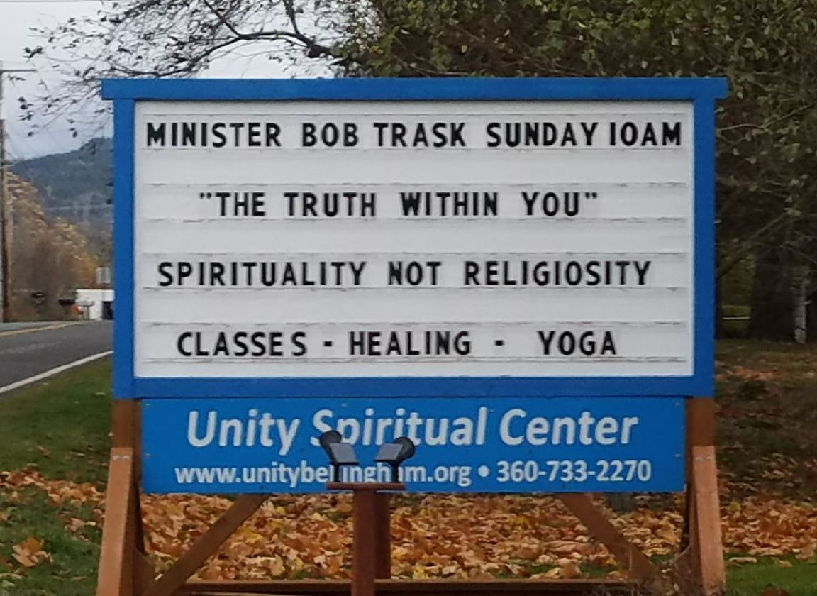

Slide 5
Unity Spiritual Center (Bellingham WA)
“We are a community of spiritual travelers, each finding our own truth through learning, service and the unselfish giving of love.”

Slide 6
Unity Spiritual Center (Bellingham WA)
“Our theology is simple: through forgiveness and expressing love we heal ourselves and become potentials for peace in the world.”

Slide 7
Unity Spiritual Center (Bellingham WA)
“We believe that Jesus has been misunderstood by many religions. A careful study of his life shows he lived for us rather than died for us. He was a teacher who asked that we become more like him.”

Slide 8
Unity Spiritual Center (Bellingham WA)
“Rather than demanding that people suffer, he said: “I am come that they might have life, and that they might have it more abundantly.”
www.unitybellingham.org

Slide 9
Unity Spiritual Center (Bellingham WA)
“We are a spiritual center, committed to nourishing joyful lives through positive thoughts, words and actions”.

Slide 10
Unity Spiritual Center (Bellingham WA)
“Unity is a positive, practical, non-denominational center based on the spiritual ideals taught by Jesus and all other enlightened spiritual leaders.”
www.unitybellingham.org/about-unity

Slide 11
Bible: Harmony between Spiritual and Religious
Conflict of competing principles
Col. 2:20-3:1
Eph. 1:3
World
Christ

Slide 12
Material, 1 Cor. 9:11; Romans 15:27
Natural, 1 Cor. 15:44-49
Temporary, 2 Cor. 4:16-18
Immortal spirit
Image of God, Genesis 1:26-27; 2:7
In heavenly places, Ephesians 1:3; 2:5-7
Spiritual Things Contrasted With…

Slide 13
What Does it Mean to be Spiritual?
Loving God, Deut. 6:5; Matthew 22:37
Obedience, Joshua 22:5; John 14:15
Loving God (spiritual) is not against obedience (religious action)

Slide 14
What Does it Mean to be Spiritual?
Guided by revelation, 1 Cor. 2:10-16
Natural man, 1 Corinthians 2:14
Lives by human reasoning alone, 1 Cor. 1:18, 23 (Jer. 10:23; Prov. 16:25)

Slide 15
What Does it Mean to be Spiritual?
Buddha
Jesus
“Believe nothing, no matter where you read it, or who said it, no matter if I have said it, unless it agrees with your own reason and your own common sense.”
“I am the way, the truth, and the life. No one comes to the Father except through Me.” John 14:6 (4:23-24)

Slide 16
What Does it Mean to be Spiritual?
Guided by revelation, 1 Cor. 2:10-16
Spiritual man, 1 Corinthians 2:15-16
Accepts the Spirit’s revelation, 2:13
Judges all things with the mind of Christ, 1 Corinthians 1:18, 21, 24, 31

Slide 17
Part 1 - 17

Slide 18
What Does it Mean to be Spiritual?
Submissive to God’s law, Romans 8:5-8; Galatians 5:16-24
Spiritually minded sets mind on gospel (given by Spirit, Rom. 8:1-4)
Submits to God’s law, Romans 8:6-7
Leads to life and peace (Col. 3:2)

Slide 19
What Does it Mean to be Spiritual?
Submissive to God’s law, Romans 8:5-8; Galatians 5:16-24
Carnally minded sets mind on flesh
Hostile to God and His truth
Leads to death, Romans 8:6-8

Slide 20
The Spiritual Person
Delights in the law of God
Meditates on it constantly
Lives by it consistently
Blessed for it always
The righteous, godly person
-Psalm 1:1-3, 6

