Slide 1
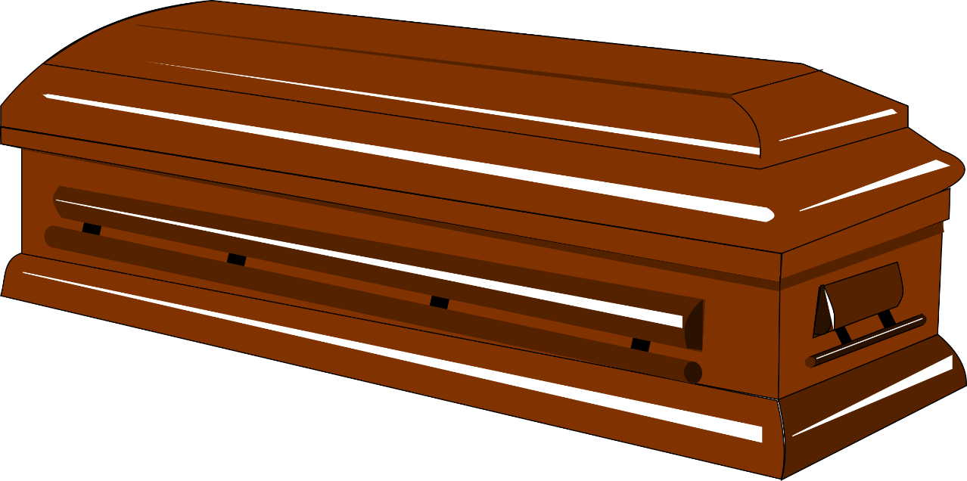
Bible Truth About Death
Ecclesiastes 7:1-4

Slide 2
Views of Life and Death
Materialist: Death ends existence (Ecclesiastes 9:2-6)
Dualist: Humans are flesh and spirit, Genesis 2:7 (2 Corinthians 4:16)
Our faith is informed by the Bible, Romans 10:17; 2 Cor. 5:6-8; Luke 6:46

Slide 3
Dual Beings
Flesh decays, Genesis 3:19; Ecclesiastes 12:7; 2 Corinthians 4:16
Immortal spirit continues to exist, Ecclesiastes 12:7; Luke 16:22-23
Genesis
1:27; 2:7

Slide 4
DEATH: Separation OF SPIRIT FROM BODY
Spirit leaves the body, Luke 23:46; Acts 7:59-60
Spirit animates body, Genesis 2:7
Spirit survives death, Matthew 10:28
James 2:26

Slide 5
After Death
Hades
Realm of departed spirits (Acts 2:27)
Righteous comforted in Paradise, Luke 16:22, 25
Unrighteous in flames of torments and anguish, Luke 16:23-24

Slide 6
After Death
Resurrection
(John 5:28-29)
Hades gives up the dead – bodies raised incorruptible, 1 Corinthians 15:50-55 (Revelation 20:13)

Slide 7
After Death
Judgment
(Hebrews 9:27)
No altering outcome after death, Luke 16:26; Matthew 25:34, 41, 46

Slide 8
Attitudes Toward Death
Sorrowful for sinners, 1 Thessalonians 4:13
No hope
Sinners should fear death, Luke 23:39-41
Fear God, whom all will stand before in judgment after death, Matthew 10:28; Hebrews 10:30-31; 12:29

Slide 9
Attitudes Toward Death
Should prompt immediate repentance, Romans 2:4-6
Problem: Sin hardens hearts
Many refuse to fear God and death, Romans 2:5 (1:28, 32)

Slide 10
Attitudes Toward Death
Anticipated and full of comfort by the righteous, 1 Thessalonians 4:13 (18)
Gateway to glory, 2 Timothy 4:8; Revelation 14:13; 2 Peter 1:10-11
Renewed, not discouraged, 2 Corinthians 4:16-18; 5:1-5

Slide 11
Attitudes Toward Death
“Precious in the sight of the LORD is the death of His saints.”
Psalm 116:15

Slide 12
Attitudes Toward Death
Use your time wisely, James 4:13-17
Live by God’s will because life is uncertain and brief, 4:13-16
Do the good you know you should do, 4:17

Slide 13
The House of Mourning
Confront our mortality (2)
Opportunity to be wise and to prepare (7:3-4)
Day of death better than day of birth (7:1)
-Are you ready to die?-
-Are you ready to live?- Acts 3:19; Galatians 2:20
Ecclesiastes 7:1-4

