Slide 1

Broken Vows:
The Sacrifice of Fools
Ecclesiastes 5:1-7

Slide 2
Deuteronomy 23:21
When you make a vow to the LORD your God, you shall not delay to pay it; for the LORD your God will surely require it of you, and it would be sin to you.

Slide 3
What is a Vow?
Solemn promise, voluntarily made
Bind oneself to an act, service or condition
  To God, 1 Samuel 1:10-11 (Hannah)
  To others, 1 Kings 1:29-30 (David to Bathsheba)
To dedicate or devote, Proverbs 20:25
Test of integrity, Numbers 30:1-2

Slide 4
Should We Make Vows?
Voluntary, not mandatory (Deut. 23:22-23)
  Paul took a vow, Acts 18:18
  Other Christians did, Acts 21:23-24, 26
  God took an oath, Luke 1:73 (Hebrews 6:16-18)

Slide 5
Should We Make Vows?
Do not forswear (declare excessively), Matthew 5:33-37; James 5:12
Calling God as our witness is not sin,
2 Corinthians 1:23; Philippians 1:8

Slide 6
We Must Not Make Rash Vows
Ecclesiastes 5:2; Proverbs 20:25
Deliberate and careful, Judges 11:30-31, 34-36
Keep the vows you make, Ecclesiastes 5:4-6
Fundamental issues: Accountability to God and integrity before men

Slide 7
Pay Your Vows to God
Psalm 50:14
Obligates you to God, Psalm 56:12-13
  God hears and knows our vows, Psalm 61:5; Genesis 28:18-22; 31:13
  A mark of fearing God, Psalm 22:25

Slide 8
Vows Made / Vows Broken
To be a faithful Christian, Romans 6:4-6;
Philippians 3:7; Galatians 2:20
  Why is the vow to be faithful to Christ broken? Mark 4:16-19
    Persecution / Worldly cares / Deceitfulness
    of money / Desire other things

Slide 9
Vows Made / Vows Broken
To be a true worshiper of God, John 4:23-24
  To faithfully attend worship services
  Why is this vow broken?
    Lack of thankfulness/devotion, Luke 17:17-19
    Every excuse under the sun seems sufficient
    to break our vow to put Jesus first

Slide 10
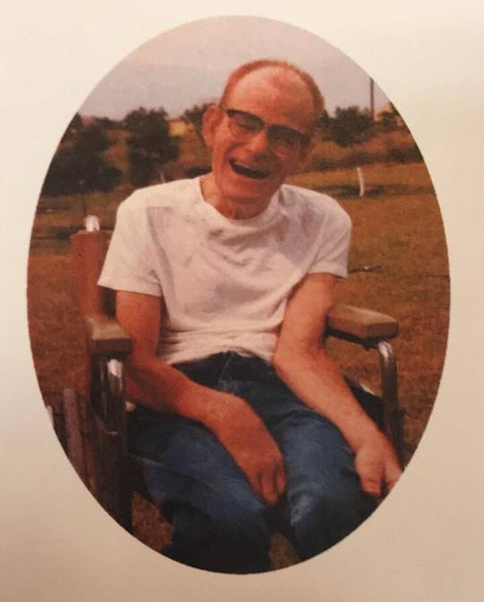
“Wayne suffered from Cerebral Palsy his whole life. But he never let that get in the way of his service to God. He often times in his youth would push his wheelchair by himself down the side of the highway to make it to worship services. Throughout his life he always made the effort to
Wayne Williams

Slide 11
“spread the good news to those that took care of him. He was known for memorizing the Bible in English and Spanish by listening to it on his CD player. What things do we count as a burden that prevent us from serving God in the way in which we are called to do?” (Michael Baker, Facebook, 4/2018)
Wayne Williams

Slide 12
Vows Made / Vows Broken
To be a true worshiper of God, John 4:23-24
  To give to God as we are prospered
  (cf. Jacob: Genesis 28:18-22)
  Why is this vow broken?
    Fail to first give ourselves to the Lord,
    2 Corinthians 8:5

Slide 13
Vows Made / Vows Broken
To be a faithful worker, Ephesians 4:15-16
  Why is this vow broken?
    Misplaced priorities, Matthew 6:33-34;
    Luke 10:41-42

Slide 14
Vows Made / Vows Broken
To be a faithful spouse, Malachi 2:14; Matthew 19:4-6
  Why are marriage vows broken?
    Selfishness and refusal of God-given roles
    and responsibilities, Ephesians 5:22-25

Slide 15
Broken Vows
The sacrifice of fools, Ecclesiastes 5:1, 4
God forgives broken vows, Psalm 51:17
Remember the Lord and, with thanksgiving, pay what you have vowed, Jonah 2:8-9

