Slide 1
Do You See Yourself in God’s Mirror?
James 1:21-25

Slide 2
Why do we use mirrors?
2

Slide 3
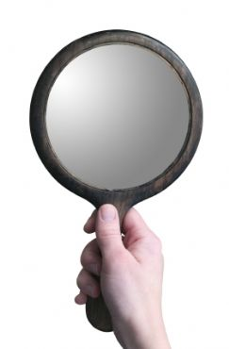
How do you use God’s mirror?
Do you remember what you see?
Yes…if you put away sin, 1:21
Yes…if you hear and obey, 1:22, 25
No…if you do not do what you see is needed, 1:23-24
No…if you see others, but not yourself
James 1:21-25

Slide 4
Before Conversion…
PAUL
1 Timothy 1:12-16
Conscientious, Acts 23:1
Zeal without knowledge, Acts 26:9; Galatians 1:13-14; Philippians 3:4-7
Sinner, 1 Timothy 1:13
4

Slide 5
After Conversion…
PAUL
1 Timothy 1:12-16
Obedient, Acts 26:19-20 (9:6-8; 22:15-16)
Lived by faith, Galatians 2:20
Heavenly values and goals, Philippians 3:7-11
Went the distance, 2 Timothy 4:6-8
5

Slide 6
Forgot What He Saw
FELIX
Acts 24:22-27
Had knowledge, 24:22
Heard the gospel, 24:24-25
Needed, terrified, repeatedly
Refused to obey, 24:25-27
Selfish advantage (convenience)
Died in sin

Slide 7
Are You Like Paul?
Learn and admit your sin
Self-inspection, 2 Corinthians 13:5
Use God’s word, 1 Cor. 2:13-16 2 Timothy 3:16-17 Hebrews 4:12

Slide 8
Are You Like Felix?
Hear truth, and frightened by it
Do not obey it, Romans 2:5-6
Other motives and concerns, Mark 4:18-19
Listen to Bible to serve yourself

Slide 9
“If you know these things, blessed are you if you do them.” (John 13:17)
Be doers of the work of God instead of forgetful hearers (James 1:25)

