Slide 1

Grow in the Grace and Knowledge of Our Lord
2 Peter 3:18

Slide 2
Grow in the grace and knowledge of the Lord
Nutrition 1 Peter 2:1-3
Exercise 1 Timothy 4:7-8
Endure 2 Timothy 2:1-7
Spiritual
Growth

Slide 3
Growth in the Grace of our Lord
Proper attitudes toward brethren
  “Beloved” (2 Peter 3:1, 8, 14, 17)
  Esteemed, dear, favorite, Romans 12:10
  Repetitious reminders, 3:1; 1:12-15
  Open hearts, 2 Corinthians 6:11-12; Galatians 6:1; Philippians 2:3-4; Colossians 4:5-6

Slide 4
Growth in the Grace of our Lord
Be diligent to be found by the Lord in peace when He returns, 2 Peter 3:14
  Eager to remove sin’s stain (unblemished and unblameable), 2 Timothy 2:15
  Gracious living that is holy and honorable leads to eternal peace, Romans 2:10

Slide 5
Growth in the Grace of our Lord
Accept the apostles’ teachings instead of twisting them, 2 Peter 3:15-17
  Warned against selfish use of Scriptures (not gracious)
  Be steadfast in truth, not entrenched in the errors and traditions of men

Slide 6
Growth in the KNOWLEDGE of our Lord
About the Judgment Day, 2 Peter 3:7
  Acts 17:31…
    Appointed by God / Assured
  2 Corinthians 5:10…
    All of us
    Receive according to our lives on earth

Slide 7
Growth in the KNOWLEDGE of our Lord
About what causes error, 2 Peter 3:1-16
  Selfish desires, 3:3
  Willful ignorance, 3:5
  Thinking God is like us, 3:8-9 (Isaiah 55:8-9)
  Twisting Scriptures, 3:16

Slide 8
Growth in the KNOWLEDGE of our Lord
About repentance, 2 Peter 3:8-10
  What it is, 2 Corinthians 7:10
  What causes it, 2 Corinthians 7:10
    Goodness of God, Romans 2:4
    Severity of God, Luke 13:5 (2 Peter 3:9)
  What it causes, 2 Corinthians 7:11

Slide 9
Growth in the KNOWLEDGE of our Lord
About Christ’s return, 2 Peter 3:10-13
  Day of ending (wrath), 3:10-12
  Day of beginning (reward), 3:13

Slide 10
Growth in the KNOWLEDGE of our Lord
About spiritual growth, 2 Peter 3:18
  Nutrition, exercise, and endurance
  Diligent, holy living, 3:14
  Acknowledge God’s longsuffering as an opportunity to grow, not a reason for neglect, 3:15 (Hebrews 6:11-12)

Slide 11
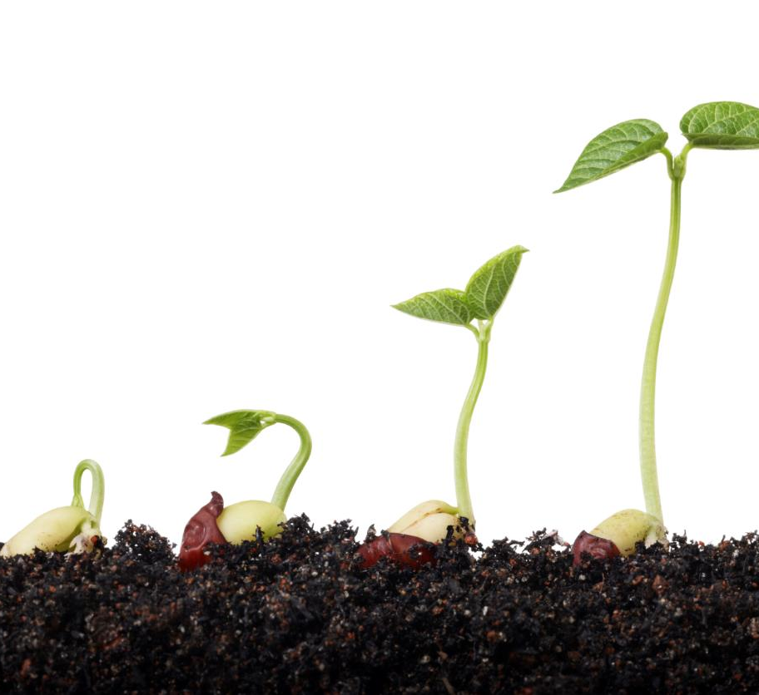
“For though by this time you ought to be teachers, you need someone to teach you again the first principles of the oracles of God; and you have come to need milk and not solid food.”
(Hebrews 5:12)

Slide 12

“To Him be the glory both now and forever. Amen.”
(2 Peter 3:18)

