Slide 1
The Kingdom of God
Luke 9

Slide 2
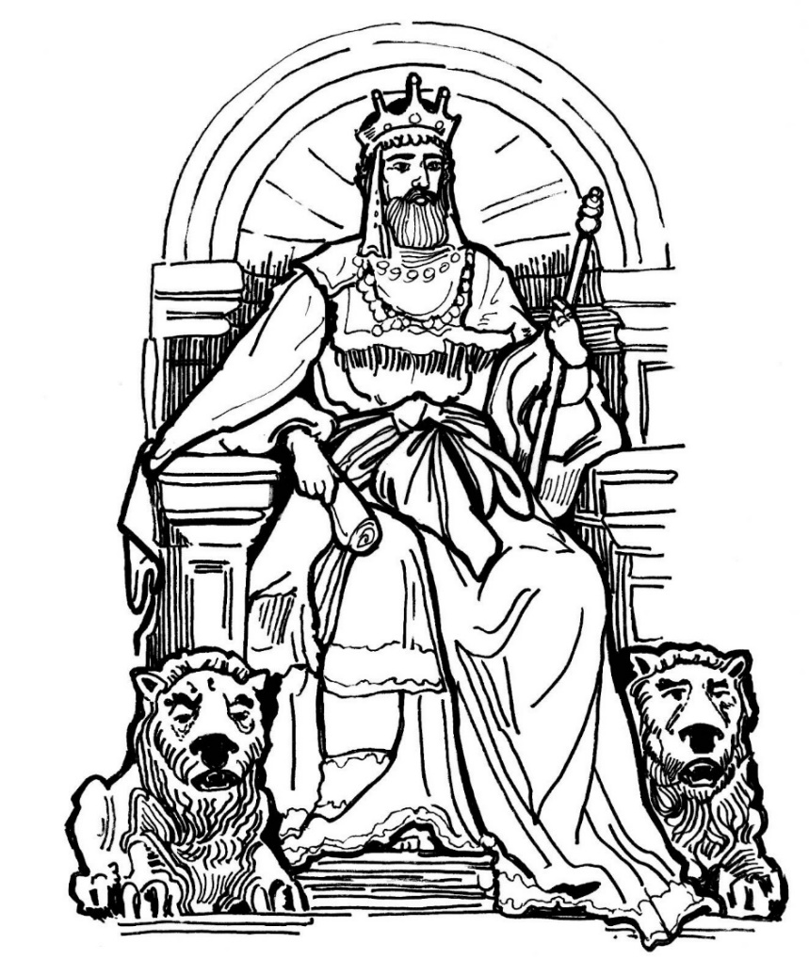
The King and His Kingdom
Holy hill of Zion, Psalm 2:6-7
Right hand of God, Psalm 110:1-3
Child given rule, Isaiah 9:6-7
Everlasting kingdom, Daniel 2:44
Given His kingdom, Daniel 7:13-14
2 Sam. 7:12-14

Slide 3
The King and His Kingdom
Child born to Mary, Luke 1:30-33
Jesus is king over God’s kingdom, Acts 2:32-36; 17:7 (Eph. 1:20-21)
His kingdom is His church, Matthew 16:18-19

Slide 4
Luke
4:43-44

Slide 5
The Gospel of the Kingdom
Preach the kingdom, Luke 9:60 (2, 11)
Central to gospel preaching, Acts 8:4-5, 12
De-emphasizing the church to attract people is a counterfeit gospel (Galatians 1:8-9)
Nullifying the kingdom as a way to get people into the kingdom is absurd! 1 Peter 2:9-10
Not ashamed of the gospel, Romans 1:16
5

Slide 6
The Gospel of the Kingdom
See the kingdom, Luke 9:27
(To know, be aware, perceive, be sure), Luke 9:47
Kingdom’s approach and arrival, Mark 9:1 (Acts 1:8; 2:1ff)
6

Slide 7
The Gospel of the Kingdom
See the kingdom, Luke 9:27
Essential to know, discern, perceive and experience the kingdom …or we die in our sins, John 3:3-5
Nature of the kingdom, Luke 9:43-45 (17:20-21)
Position in the kingdom, Luke 9:46-48; 1 Pet. 4:7-11
Beware of pride, Luke 9:49-56 (Matthew 5:3)
7

Slide 8
The Gospel of the Kingdom
Fit for the kingdom, Luke 9:62
Totally committed are suited for the kingdom, Luke 9:23
Priority, Matthew 6:33
Seek, set and sustain, Colossians 3:1-3
8

Slide 9
The Citizens of the Kingdom
Delivered from Satan’s kingdom, Colossians 1:13
Conveyed (transferred) into the kingdom of the Son, Acts 2:47
9

Slide 10
The Citizens of the Kingdom
Blessings in God’s kingdom, Revelation 1:6, 9 (Hebrews 12:22)
God’s blessings, Psalm 132:13-18
Kingdom blessings, Matthew 5:3-10
10

Slide 11
The Citizens of the Kingdom
Hope for the everlasting kingdom, 2 Peter 1:10-11
Kingdom inhabited by the righteous, Romans 14:16-17 (Philippians 3:9)
Heaven: Righteousness dwells forever, 2 Peter 3:13 (2 Timothy 4:8)
11

Slide 12
The King and His Kingdom
Son of God now reigns over His kingdom, Hebrews 1:8-9
We must hear the king, Luke 9:35

