Slide 1

Will You Destroy or Strengthen Your Marriage?
Genesis 2:18-25

Slide 2
Marriage Under Attack
Unbelief and irreverence, Hebrews 13:4
Worldliness
Selfishness
Materialism
Forces of darkness

Slide 3

Feminism
Calculated to weaken and destroy your marriage

Slide 4
What is Feminism?
Suffrage, equal rights and opportunities
Core belief of feminism:
  Sexism exists: Misogyny is enduring, pervasive, systemic, cultural, and ingrained
  Activism is aimed at ending sexism, patriarchy, and misogyny.
  -“The Definition of Feminism: What Does Feminism Mean?”

Slide 5
Radical feminism
Motherhood is a penalty (Shulamith Firestone)
In her book, “The Dialectic of Sex: The Case for Feminist Revolution” (1970), Firestone argued the traditional family structure is at the core of women’s oppression

Slide 6
Radical feminism
“Unless revolution uproots the basic social organization, the biological family—the vinculum through which the psychology of power can always be smuggled—the tapeworm of exploitation will never be annihilated,” Firestone wrote.

Slide 7
Radical feminism
“She elaborated, with characteristic bluntness: “Pregnancy is barbaric” …and childhood is “a supervised nightmare.”
-“Death of a Revolutionary,” Susan Faludi,
The New Yorker, April 15, 2013

Slide 8
Modern FEMINISM
“Feminism is an interdisciplinary approach to issues of equality and equity based on gender, gender expression, gender identity, sex, and sexuality as understood through social theories and political activism.

Slide 9
Modern FEMINISM
“Historically, feminism has evolved from the critical examination of inequality between the sexes to a more nuanced focus on the social and performative constructions of gender and sexuality.

Slide 10
Modern FEMINISM
“Feminist theory now aims to interrogate inequalities and inequities along the intersectional lines of ability, class, gender, race, sex, and sexuality, and feminists seek to effect change in areas where these intersectionalities create power inequity.

Slide 11
Modern FEMINISM
“Intellectual and academic discussion of these inequities allows our students to go into the world aware of injustices and to work toward changing unhealthy dynamics in any scenario.

Slide 12
Modern FEMINISM
“Feminist political activists campaign in areas such as reproductive rights, domestic violence, fairness, social justice, and workplace issues such as family medical leave, equal pay, and sexual harassment and discrimination.

Slide 13
Modern FEMINISM
“Anytime stereotyping, objectification, infringements of human rights, or intersectional oppression occurs, it’s a feminist issue.”
Day, Lisa. “What Is Feminism?” Women & Gender Studies at Eastern Kentucky University. 18 Feb. 2016

Slide 14
Built on Believing a lie
Lie: Biological family has inherent inequity
Truth: Men and women are equal and have different roles in life, Genesis 1:27-28; 2:18-23
  Equality of value, intellect, spiritual needs and blessings, Romans 3:23; 6:23; Galatians 3:28-29
Different roles does not mean superiority and inferiority, 1 Corinthians 11:3, 11-12

Slide 15
Feminism: Progression of evil Influences on Marriage
The Sexual Revolution of the ’60’s & ’70’s
  Promiscuity and fornication: Selfishness that drives a stake into the heart of marriage
  Birth control pill: Sex without consequences
  Legalized abortion (1973): “It’s my body!” (“reproductive rights”)

Slide 16
Feminism: Progression of evil Influences on Marriage
No-Fault Divorce, Malachi 2:16; Matthew 19:6
  Enshrined right to dissolve marriage at will
  Destroyed restraining forces of commitment, perseverance and compassion in marriage
  Accelerated destruction of biological family

Slide 17
Feminism: Progression of evil Influences on Marriage
Sexual Perversion Normalized
  Premarital and extramarital sex (polygamy)
  Pornography has found an acceptable niche (“Soft porn” – Playboy, Maxim, Sports Illustrated)
  Homosexual, LGBTQ acceptance and approval

Slide 18
Feminism: Progression of evil Influences on Marriage
Same-Sex Marriage, Gender Identity & Fluidity
  Redefine biological structure of marriage
  Redefine God-given gender roles in marriage, Genesis 2:24-25; 1 Corinthians 7:2
    Marriage has little to do with children
    Parental roles are distorted and ignored

Slide 19
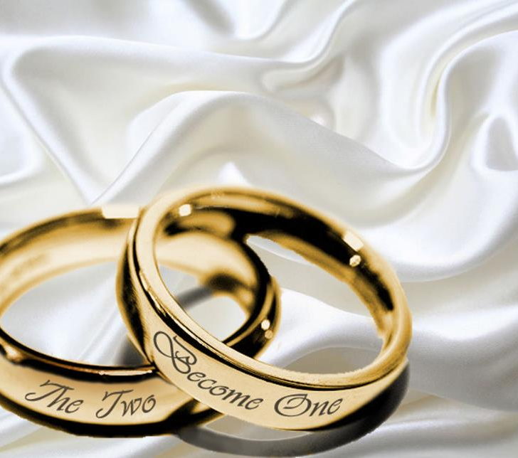
GOD-GIVEN MARRIAGE
Calculated to strengthen and shield your marriage
GENESIS 2:18-25

Slide 20
God’s Arrangement
Genesis 2:18-25
Intimate Companionship, 2:18-24a
  Loneliness is replaced with a true, faithful companionship for life
  Leave (2:24): “to loosen, i.e. relinquish, permit”
  Priority and precedence of your spouse

Slide 21
God’s Arrangement
Genesis 2:18-25
Intense Commitment, 2:23-24
  Bone of bone, flesh of flesh, Ephesians 5:28-29
  Cleave (2:24): Cling, join to, adhere (glue), Deuteronomy 10:20
  Protection, security, strength, Ecclesiastes 4:9-12

Slide 22
God’s Arrangement
Genesis 2:18-25
Intentional Communication, 2:24-25
  Communicate inside your bedroom,
  1 Corinthians 7:2-5; Proverbs 5:15-20; 1 Peter 3:7
  Communicate outside your bedroom, Genesis 2:25; James 1:19-20; 3:9-14 (Col. 4:6; Jas. 3:5)

Slide 23
Marriage Under Attack
Forces of evil are working to destroy your marriage
Forces of good are still at work to strengthen your marriage
Abhor the evil and cling to the good, Romans 12:9

