Slide 1
Up on the Housetop
Matthew 10:24-28

Slide 2
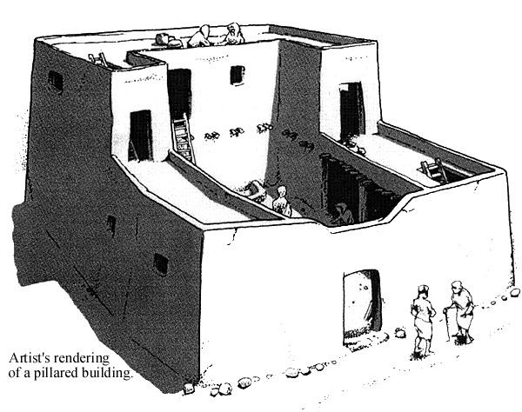
Ancient Roof Tops
On it, Matthew 24:17
Tents, 2 Samuel 16:22
Low wall, Deut. 22:8
Grass, Psalm 129:6

Slide 3
Ancient Roof Tops
Relax and sleep, 1 Samuel 9:25-26
Devotion:
To idols, Jeremiah 32:29; 19:13
To God, Acts 10:9

Slide 4
Persistent Faith
Faith at work, James 2:14-18
Patiently persist through trials, James 1:2-4
Genuine faith, 1 Peter 1:5-7
Mark 2:1-5

Slide 5
Preaching
Open, public, Acts 20:20; 26:26
Proclaim gospel, Mark 16:15; Acts 8:4
Fervor, Acts 4:20
Clarity, 2 Cor. 3:12
Urgency, 2 Cor. 5:11
Burden for the lost, 1 Cor. 9:16
Matthew 10:26-27

Slide 6
Prayer
Be alone with God, Mark 1:35; Luke 5:16; 6:12
Fervent prayer of the righteous is powerful, James 5:16
Acts 10:9-10

Slide 7
Sinful Passions
Isolated places present temptations to sin
Not secret to God, 2 Samuel 11:27; 12:7, 13 (Psalm 32:3-5); Hebrews 4:13; 1 Corinthians 4:5
Protect yourself (wall)
2 Samuel 11:2-5

Slide 8
Painful Privacy
Escape a contentious spouse
Communicate, don’t nag or be dismissive
Harmony a blessing, but discord is a curse, Colossians 3:18-19
Proverbs 21:9; 25:24

Slide 9
On Your Housetop
Prayer, proclamation, and active faith?
Sinful passions and painful privacy?

