Slide 1
Why Christians Cry

Slide 2
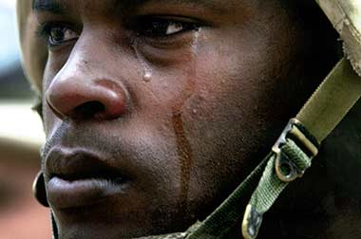
“Real men don’t cry.”
Time to cry, Eccl. 3:1, 4
God’s men wept:
David/Jonathan, 1 Sam. 20:41
Jesus, John 11:35
Paul, Acts 20:31
Peter, Matthew 26:75

Slide 3
Central Point
Sympathy / Empathy
Family affection, Romans 12:10
“Rejoice with those who rejoice, and weep with those who weep,” Romans 12:15

Slide 4
Christians Weep With Others Jesus John 11:31-36
Compassion Matt. 9:36
Tender mercies Col. 3:12-13; 2 Cor. 6:11-12
Gentle Matthew 11:29 (5:5)
Soothing disposition
Kind Matthew 7:12 Galatians 5:22
Gracious, pleasant Eph. 4:31-32; 1 Cor. 13:4
1 Thess. 2:7-8

Slide 5
Christians Weep Over Ourselves Peter Matthew 26:75
Godly sorrow over our sins, 2 Cor. 7:9-10; Acts 2:37
Repentance, Acts 20:21
Contrite heart, Psalm 34:18
If refuse to now, will later, Mark 9:43-44; Matthew 13:50
Don’t store up wrath, Rom. 2:5

Slide 6
Christians Weep Over Ourselves Peter Matthew 26:75
God sees our tears and hears our prayers when persecuted, Psalm 6:6-10 (Matthew 5:10-12)
Tears in God’s bottle, Psalm 56:8
Timothy for Paul, 2 Timothy 1:4
Rest in faith, Revelation 6:10-11

Slide 7
Christians Weep For Others Paul Acts 20:31
For lost souls and for the spiritual welfare of Christians
Teaching the lost, 1 Cor. 2:2-3
Warning of dangers, Acts 20:31
When people do not keep God’s law, Psalm 119:136

Slide 8
Christians Weep For Others Paul Acts 20:31
See a person’s sins bringing them pain and punishment
Jeremiah, Jer. 9:1, 10; Lam. 3:48
Jesus, Luke 19:41-44
Daughters of Jerusalem, Luke 23:26-31

Slide 9
When Christians Stop Crying
When tears keep us from doing God’s will
Doubt and fear, 2 Tim. 1:7 (4)
When tears hinder someone else from doing God’s will, Acts 21:10-14
When we reach heaven, Revelation 21:4

