Slide 1
Defending Dads
The War on Manhood

Slide 2
The War on Men
Anti-male bias
Women’s Liberation Movement
Organized opposition to male roles
Warped and false views of manhood

Slide 3
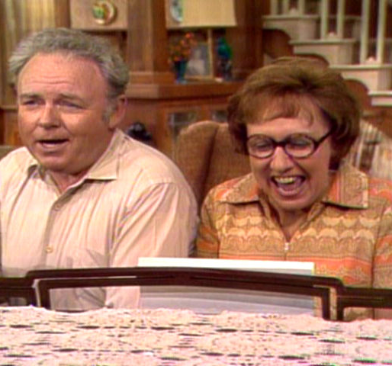
War on Men
Men are made to look foolish
Proverbs 8:1-4

Slide 4
“As I write, there is not a single example of a healthy family depicted in a sitcom that focuses on a masculine, heterosexual guy who loves his kids and is respected by his wife. Not one!” (James Dobson, Dr. Dobson’s June Newsletter)
Male-bashing in USA

Slide 5
War on Men
-Male-bashing reconditions boys and men
-Devalues God-given roles of men and women, 1 Cor. 11:3 (15:33-34)

Slide 6
Why Does This Matter?
Effectively weakens the family and damages marriages
Divide the sexes…divide marriages Matthew 19:5-6; Ephesians 5:28-29; 1 Corinthians 7:3-4

Slide 7
Why Does This Matter?
Warps the minds of children
Learn to disrespect men (fathers)
By watching strong, faithful, loving dads
Boys learn to become men
Girls learn how men treat women
2014: 23.6% kids in fatherless homes
Instability, insecurity, Prov. 23:22; Eph. 6:2

Slide 8
A Father Must…
Be compassionate, Psalm 103:13 (Proverbs 19:22)
Mercy, tenderness, concern and protection
Be a father who encourages, not stifles, Colossians 3:21

Slide 9
A Father Must…
Be a consistent teacher, Proverb 1:8 (Ephesians 6:4)
Instruction and commands, Proverbs 6:20
Correction, Proverbs 3:12; Heb. 12:9-11
Teaching child to respond wisely, Ephesians 6:1; Proverbs 13:1; 15:5, 20

Slide 10
A Father Must…
Be a caring, loving husband, 1 Peter 3:7
Teaching children by how you treat your wife
Be an example of Christ’s love for His church, Ephesians 5:25

Slide 11
A Father Must…
Be the spiritual leader of his home, Joshua 24:14-15
Serve God in sincerity and truth, 24:14
Make choices that lead your family to serve God, 24:15
Be a faithful example

Slide 12
Defending Dad
Wife plays an important part, 1 Peter 3:1-2, 5-6
Be God’s man of faith
Guided by truth, integrity and devotion
“Act like men” (ESV), 1 Corinthians 16:13

