Slide 1


They Think You Are Strange

Slide 2
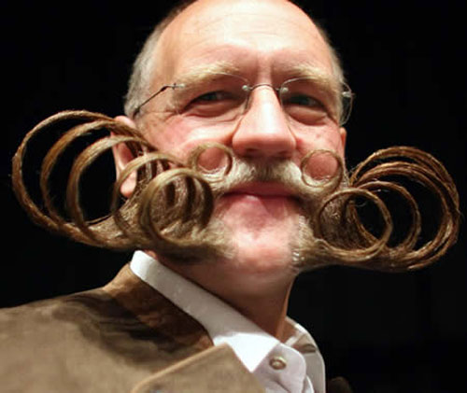
A Peculiar People
1 Peter 2:9
Special or
“purchased” possession
Blood of Christ, Acts 20:28
Purchased possession to be redeemed, Ephesians 1:14
His own special people, Titus 2:14

Slide 3

Christians Stand Out in this World
Criticism, John 15:18-19
No marvel, 1 John 3:13
1 Peter 2:10-11

Slide 4
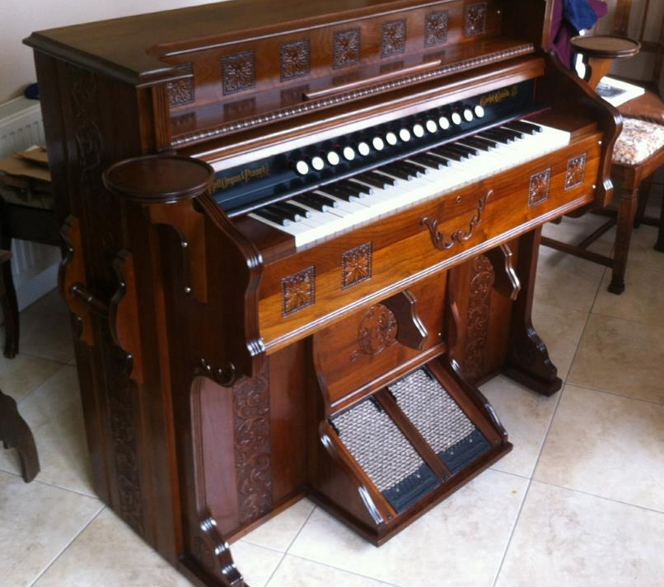
Instrumental Music in Worship
Ephesians 5:19
Colossians 3:16
Worship is revealed by
God, not devised by
men, John 4:23-24
NT pattern: Sing
Hold fast pattern, 2 Tim. 1:13
Instrument is an addition, Galatians 1:8-9; 2 John 9
“STRANGE!”

Slide 5

Creation in Six Days
Genesis 1
Psalm 33:6-9
Believe the Bible,
Exodus 20:11 (Gen. 2:1-2)
Adam and Eve created with appearance of age
Universe follows that pattern
“STRANGE!”

Slide 6
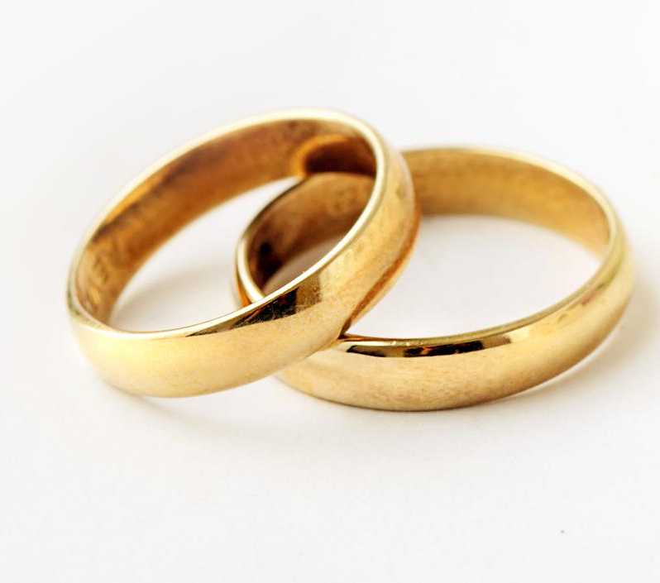
Sexual Activity before Marriage
Galatians 5:19
Not named among us, Ephesians 5:3
Morally acceptable: 69%
Between teenagers: 42%
“STRANGE!”

Slide 7
Sexual Activity before Marriage
Galatians 5:19
Ephesians 5:3
Premarital/Extramarital
Sinful and dangerous
Selfish and lustful, Matt. 5:28
Dishonors God, Heb. 13:4
Dishonors body, 1 Cor. 6:18
Foolish exploit, Prov. 6:25-29
“STRANGE!”

Slide 8
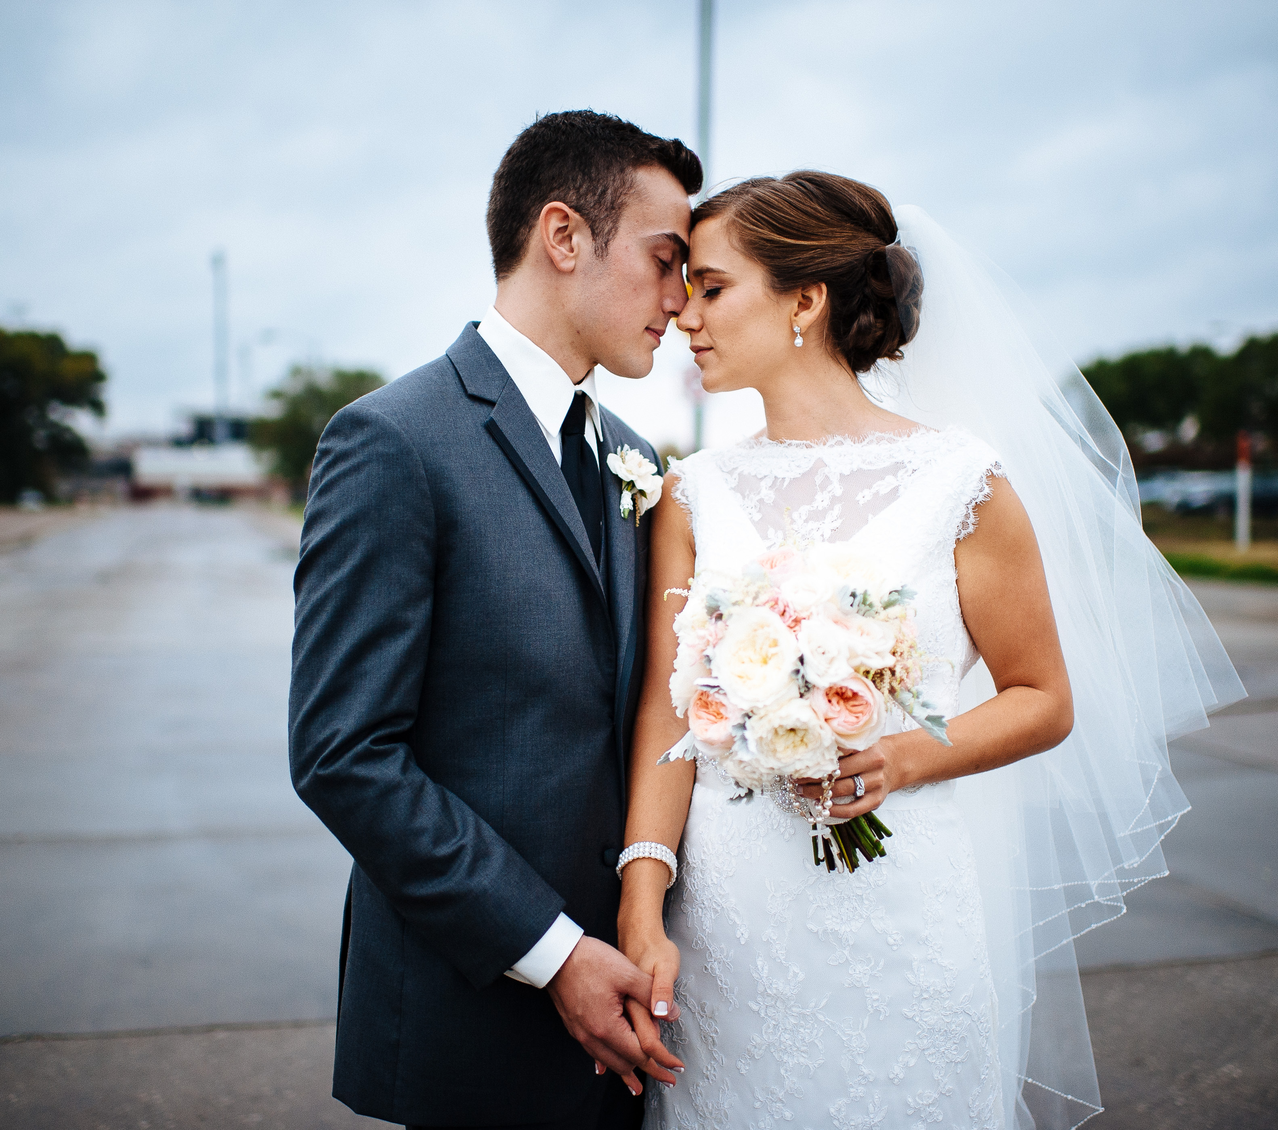
Marriage is Only for One Man and One Woman
Genesis 2:24
1 Cor. 7:1-2; Rom. 7:2
67% same-sex marriage is morally acceptable
Permanency of marriage is discounted by cohabitation and other temporary approaches to marriage
“STRANGE!”

Slide 9

Reject Divorce for Any Reason
Matthew 19:3-9
1 Cor. 7:10-11
76% say divorce is morally acceptable
Jesus and His apostles did not agree
“STRANGE!”

Slide 10

Say “No” to the
“Fun Things”
Galatians 5:19
Col. 3:5; 1 Pet. 4:3
Going to the dance
Drinking and drugs
Profanity
Pornography
“STRANGE!”

Slide 11

What Can You Do?
Listen to and obey your parents, Proverbs 1:8-15
You are not defined by what others say about you, Genesis 39:14-20

Slide 12
What Can You Do?
Do not love the world, 1 John 2:15-17
Follow the truth of Jesus Christ, John 8:31-32

