Slide 1
Battling Secret Sins
Psalm 19:12-14

Slide 2
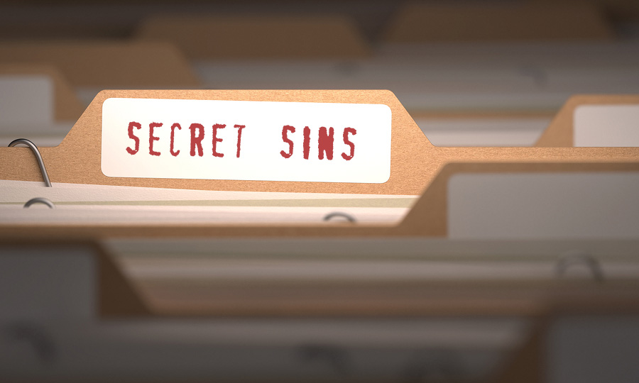
Secret, but not private, Psalm 90:7-8

Slide 3
Deception of Secret Sins
“Nobody knows…nobody is harmed”
“God doesn’t see,” Psalm 94:4-7 (10:11; Zephaniah 1:12)
Sinner is harmed, Romans 6:23
Others are impacted, 1 Corinthians 5:6
Sin is influential, Proverbs 23:7; 4:23

Slide 4
Impact of Secret Sins on Others
Achan, Joshua 6:18; 7:1
Defeat at Ai – 36 men died, Joshua 7:5
Israel and Joshua, Joshua 7:5-6
Achan and his family, Joshua 7:24-25

Slide 5
Impact of Secret Sins on Others
David and Bathsheba, 2 Samuel 12:9-12
Bathsheba brought into sin, 2 Samuel 11:4
Uriah sinned against, 2 Samuel 11:13-17
Child died, 2 Samuel 12:14, 18
God’s name suffered, 2 Samuel 12:14
The kingdom suffered, 2 Samuel 12:10
David suffered, 2 Samuel 12:10

Slide 6
Impact of Secret Sins on Others
Jonah, Jonah 1:2-3
Asleep in bottom of ship, Jonah 1:4-5
Mariners, Jonah 1:5, 10-14, 16
Jonah (fish), Jonah 1:15, 17

Slide 7
Impact of Secret Sins on Others
Ananias and Sapphira, Acts 5:2-4, 9
Church and others had great fear, Acts 5:11 (growth, 5:14)
Others like Ananias and Sapphira stayed away, Acts 5:13

Slide 8
Secret Sins We Fight Against
Hate
Sins of the heart, 1 John 3:11-15
Cain’s hate, Genesis 4:5-8
To overcome sinful attitudes we must arrest them early
Assure holy conduct, Ephesians 4:23-24, 31

Slide 9
Secret Sins We Fight Against
Fornication
Private indulgence must be publicly resisted, Prov. 7:18-20; 6:25-29; 7:21, 24-27
Reject its path immediately
Joseph’s private resistance resulted in public injustice, Genesis 39:7-14, 20

Slide 10
Secret Sins We Fight Against
Pornography
Covenant with your eyes, Job 31:1-4
May 2018: 43% -- Porn morally acceptable
Lust of the eyes, Matthew 5:28; 1 John 2:16
Moral defilement, unlawful passion, self-indulgent craving, Colossians 3:5

Slide 11
Secret Sins We Fight Against
Alcohol / Drugs
Path of foolishness, Prov. 20:1; 23:29-32
Marijuana, opioids (heroin, morphine, Vicodin, hydrocodone, oxycodone, and fentanyl)
2017: 11.8 mil. Americans abused opioids
2016: 63,632 opioid overdose deaths

Slide 12
What Must We Do To Resist Secret Sins?
Psalm 19:12-14

Slide 13
What To Do? Psalm 19:12-14
Be accountable, Psalm 51:3 (2 Sam. 12:12-13)
Seek forgiveness (repent and confess), Psalm 19:12; 32:3-5 (51:1-2); 1 John 1:8-9; Acts 8:22

Slide 14
What To Do? Psalm 19:12-14
Ask God’s help, Psalm 19:13; Matthew 6:13
Guard thoughts and words, Psalm 19:14
Respect judgment to come, Eccl. 12:13-14

Slide 15
Not forgotten by God, Psalm 10:11-14
He sees all our sins and still wants to save us in His Son, Jesus!

