Slide 1
Be Prepared
Matthew 25:1-13

Slide 2
Preparation
For success
Joshua, Joshua 1:10-11
John, Isaiah 40:3
Unprepared: Shame, hurt, harm, danger 2 Corinthians 9:3-4

Slide 3
Unprepared Spiritually
Parable of virgins, Matthew 25:1-13
Preparation alone is not enough
Must do what we prepare to do

Slide 4
When We Are Not Prepared For The Lord’s Return We Are Being…
Foolish, Matthew 25:2; Ephesians 5:15-16
Idle (lazy), Proverbs 6:6-11
Spiritual laziness, Hebrews 6:9-12

Slide 5
When We Are Not Prepared For The Lord’s Return We Are Being…
Wasteful, Ephesians 5:16 (Matt. 25:8-12)
Self-centered and self-indulgent, Luke 12:15-21
Unfaithful, Matthew 24:42-51

Slide 6
Must Prepare For…
Death, Hebrews 9:27 (2 Kings 20:1)
Obey gospel, Romans 6:16-18, 23
Repent, 2 Peter 3:9-10
What hinders you? Acts 8:36

Slide 7
Must Prepare For…
Judgment, Hebrews 9:27; Amos 4:12
Avoid sin: Watch and pray, Luke 21:33-36
Faithful living, Romans 2:3-11 (7, 10)
Be Saved–Be Faithful –Be Growing

Slide 8
Must Prepare For…
Life, James 4:13-17
In youth, Eccl. 11:9-12:1
In old age, Eccl. 12:1ff
Whole of our existence, Ecclesiastes 12:13-14

Slide 9
Preparation is Essential
Husband / Wife, Ephesians 5:22-33
Parent, Judges 13:8; Ephesians 6:4
Sacrifice time, money, energy…
Wisdom and self-discipline to train, Proverbs 4:1-4, 10-13, 20-23 (Heb. 12:6)

Slide 10
Preparation is Essential
Bible student and teacher, 2 Tim. 2:2, 15
Accept the responsibility, Jas. 3:1; Heb. 5:12
Equip yourself with the word, 1 Timothy 4:13, 15-16
Live the word, 1 Timothy 4:12

Slide 11
Preparation is Essential
Serve in the kingdom of God (Matt. 10:42)
Teach sinners and saints, Matthew 28:18-20
Both need teaching, Romans 10:13-15; 1:15
Lost brethren, James 5:19-20 (Gal. 6:1)

Slide 12
Preparation is Essential
Serve in the kingdom of God (Matt. 10:42)
Gospel preachers, 2 Timothy 4:2-5
Elders and deacons, 1 Timothy 3:1, 10, 13
Strive: “To stretch oneself, reach out after”
Faithful steward (3:13); 1 Peter 4:10-11

Slide 13
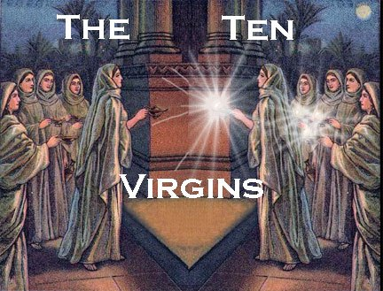
How tragic to miss heaven for being unprepared!
Matthew 25:11-12

