Slide 1
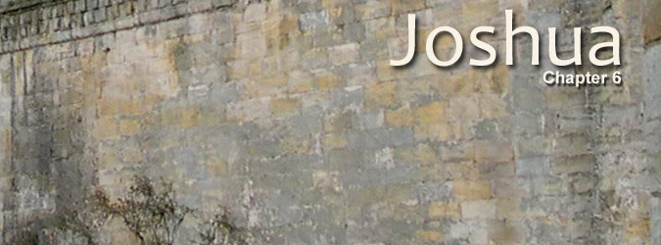
Have I not commanded you? Be strong and of good courage; do not be afraid, nor be dismayed, for the Lord your God is with you wherever you go. (Joshua 1:9)

Slide 2
Lessons at Jericho
Joshua 6

Slide 3
Jericho
City of palm trees (2 Chron. 28:15)
10 miles NW of Dead Sea
1000’ below sea level and 3500’ lower than Jerusalem

Slide 4
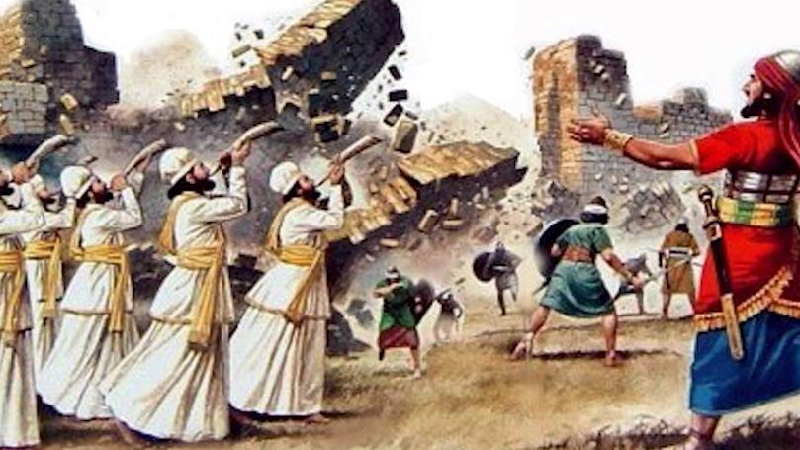
#1 – Being afraid of God is not enough belief to save you, Joshua 2:8-11
Fear without faith, Heb. 11:31 (Jas. 2:19; Ac 24:25)
Rahab acted on her fearful faith, Heb. 11:31; James 2:25
Photo credit: Ytimg.com

Slide 5
#1 – Being afraid of God is not enough belief to save you
Applications
Reverence, Matthew 10:28
Fear God and work righteousness, Ac 10:34-35
Do not bury your abilities and opportunities in fear, Matthew 25:24-26
Photo credit: Ytimg.com

Slide 6
#2 – Salvation is by grace through faith, Joshua 6:2-5 (Ephesians 2:8-9)
Success when obey, Hebrews 11:30
God’s grace (6:2, 16): “I have given”
Man’s faith (6:3-5) Obey (Romans 5:1-2)
Photo credit: Ytimg.com

Slide 7
#2 – Salvation is by grace through faith, Joshua 6:2-5
Applications
Grace and obedient faith are companions
Obedient faith works, 6:6-11; James 2:14-22
Obedient faith endures, 6:12-14 (Heb. 4:11; 12:1)
Photo credit: Ytimg.com

Slide 8
#3 – Careful obedience is possible and essential to faith, Joshua 6:3-5 (6-11)
God teaches us faith by commanding faith, 6:3-5 “You shall” – 7 times
The victory of faith, 1 John 5:3-4
Photo credit: Ytimg.com

Slide 9
#3 – Careful obedience is possible and essential to faith
Applications
Understand/Obey, 6:3-5
Carefully and fully, 1 Tim. 4:6; 2 Tim. 3:10
Not Pharisaical, Matthew 23:3, 23; 7:21
Not earning (grace)
Photo credit: Ytimg.com

Slide 10
#4 – Do not touch what God has cursed, Joshua 6:17-19 (Leviticus 27:28-29)
Dedicated for destruction
Spoils to His treasury
All Israel was affected when Achan sinned (7:1)
Photo credit: Ytimg.com

Slide 11
#4 – Do not touch what God has cursed, Joshua 6:17-19
Applications
Do not return to sin, 2 Peter 2:20-22
Flee sin, 1 Corinthians 6: 18; 2 Tim. 2:22; 1 Ths. 5:22
Sin in the camp, 1 Cor. 5:7
Photo credit: Ytimg.com

Slide 12
#5 – Spiritual victories require you to fight, Joshua 6:20-21
God gave the city, but Israel also had to fight, Ephesians 6:10-13
Photo credit: Ytimg.com

Slide 13
#5 – Spiritual victories require you to fight
Applications
Good fight of faith to lay hold of eternal life, 1 Timothy 6:12
Militancy against sin and error, 2 Cor. 10:3-5
Photo credit: Ytimg.com

Slide 14
#6 – Your spiritual battle is straight in front of you, Joshua 6:20-21 (5)
Applications
Each one, 1 Timothy 6:12
Side by side, Heb. 12:12f
Without distraction
Can’t fight someone else’s battle…can exhort
Photo credit: Ytimg.com

Slide 15
#7 – God’s judgments are sure, Joshua 6:24, 26
500 years later, Hiel rebuilt Jericho at the cost of two sons, 1 Kings 16:34
Photo credit: Ytimg.com

Slide 16
#7 – God’s judgments are sure
Applications
Time does not change God’s judgments, 2 Peter 3:8-9
God is not overthrown
Judgment coming, Hebrews 9:27
Photo credit: Ytimg.com

Slide 17
JERICHO
God’s judgment of sin
God’s grace to Israel
Blessings of faith
Fear God…Obey God… Be Saved
Photo credit: Ytimg.com

