Slide 1
Things I Must Have to Follow Truth
Notes:
NOTE:
To change the image on this slide, select the picture and delete it. Then click the Pictures icon in the placeholder to insert your own image.

Slide 2
God’s Truth
Practical and life-changing, Hebrews 4:12
Forms Christ within, Galatians 4:19 (3:27)
Gives life when we live by it, Matthew 4:4; John 14:21-23

Slide 3
God’s Truth
Challenge: How do I turn what Scripture says into the way I live?
How do I make my heart His type of heart? (Colossians 3:12-15)
How do I become the person God wants? (Colossians 3:18-4:1)
How do I go on to maturity? (Hebrews 6:1)

Slide 4
A Good Heart (Luke 8:15)
Open to hearing Scriptures and holding them fast, Acts 17:11
First cleanse heart, Matt. 23:25-26
Accept its correction and guidance, 2 Timothy 3:16-17
Cling to truth, Luke 8:15
Patiently bears fruit, Luke 8:15

Slide 5
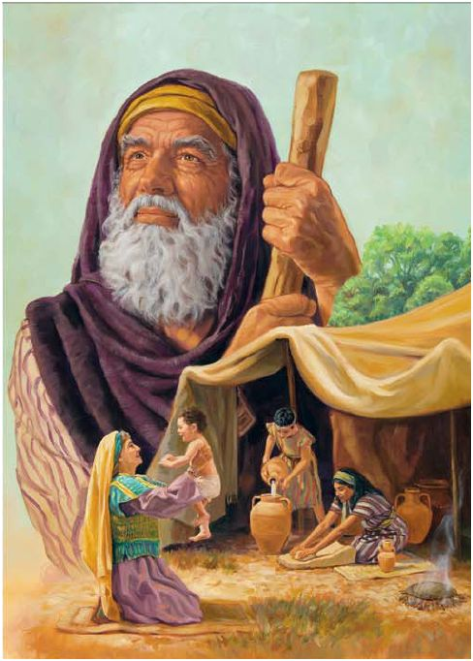
Obedient Faith (Hebrews 11:6)
Trust God’s way to work, 11:7, 11-12, 17-19, 29
Show compassion to improve relations, Colossians 3:12-15
Wife and husband, Col. 3:18-19
Labor for Christ, 1 Cor. 15:58
Faith is victorious, 1 John 5:4

Slide 6
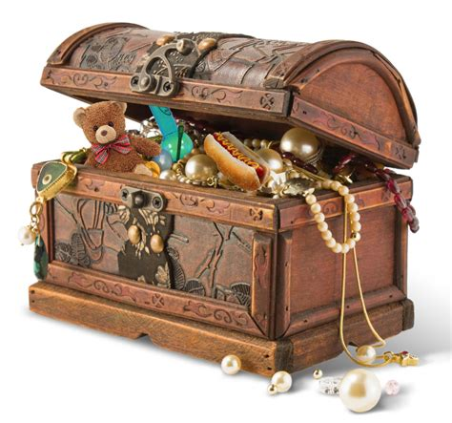
Full Commitment (Matthew 6:19-24)
We pursue what is valuable to us, Matthew 6:19-21
Problem of double vision, Matthew 6:22-24
Passionate use of God’s word, Hebrews 5:13-14
Use…practice…discernment
Press on for maturity, Hebrews 6:1-3

Slide 7
Serious Bible Study (2 Timothy 2:15)
Bible is our final authority, John 6:63, 68
Lay it up in our heart to avoid sin, Psalm 119:11
To know and obey God, John 7:17
Form Christ in us, Galatians 4:19 (5:16, 25)

Slide 8
Self-exam / Self-correction (James 1:22-25)
Don’t compare yourself to wrong things:
Others, 2 Corinthians 10:12
Worldly wisdom, Colossians 2:8
Opinions of men, Proverbs 14:12
Your feelings, Jeremiah 10:23
Implement…Improve…Christ in you

Slide 9
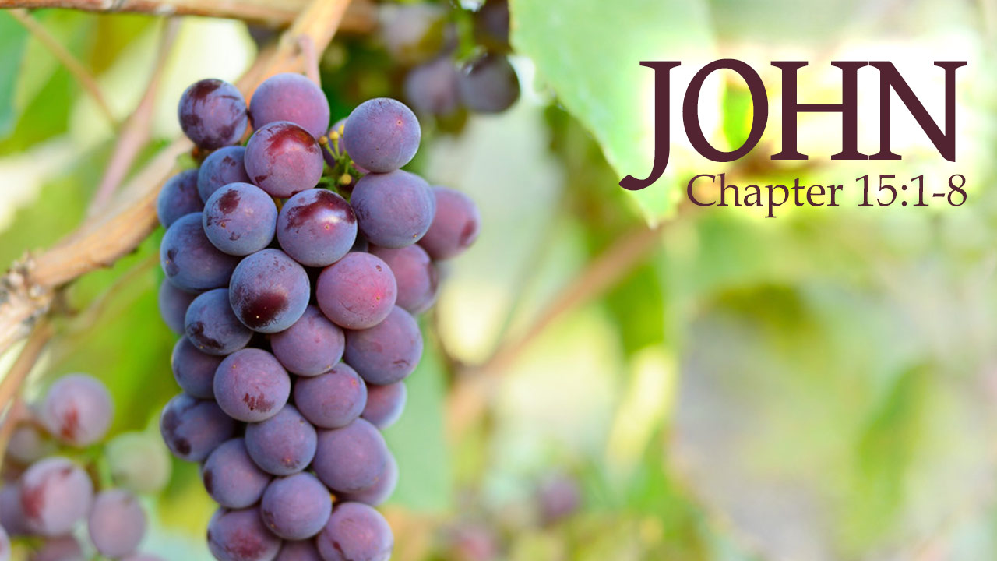
Christ in Us and We in Him
Fruitful when we abide in Christ and He abides in us
Christ is formed in us by using these necessary tools, Ephesians 3:20-21 (17)

